Slide 1
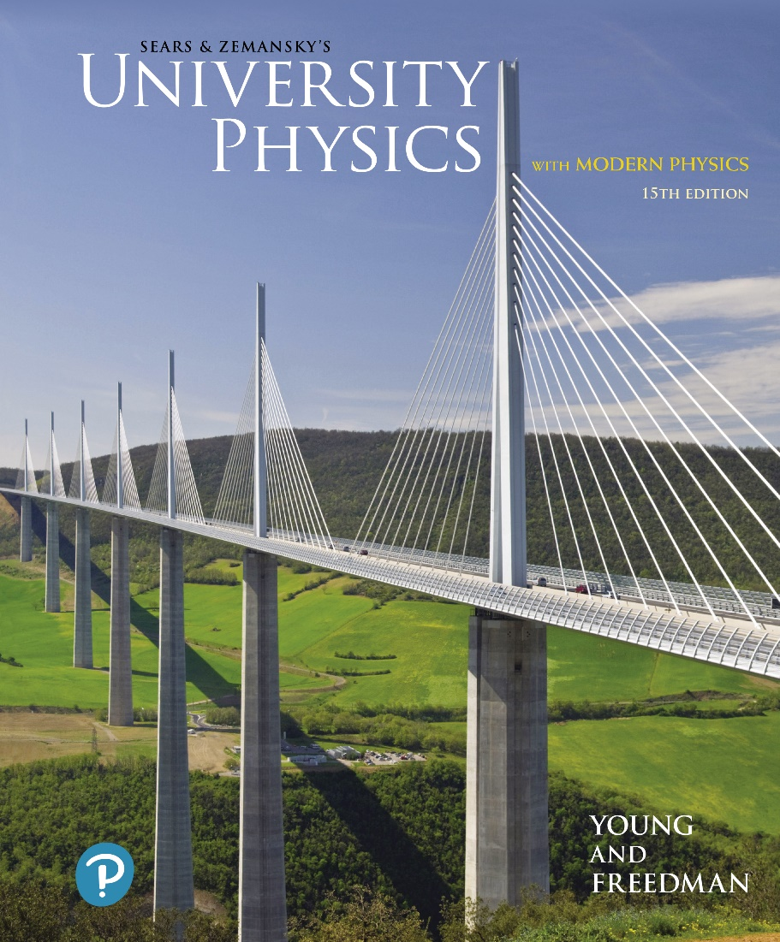
University Physics with Modern Physics
Fifteenth Edition
Chapter 9
Rotation of Rigid Bodies
Copyright © 2020 Pearson Education, Inc. All Rights Reserved

Slide 2
Learning Outcomes
In this chapter, you’ll learn…
how to describe the rotation of a rigid body in terms of angular coordinate, angular velocity, and angular acceleration.
how to analyze rigid-body rotation when the angular acceleration is constant.
the meaning of an object’s moment of inertia about a rotation axis, and how it relates to rotational kinetic energy.
how to calculate the moment of inertia of objects with various shapes, and different rotation axes.

Slide 3
Introduction
An airplane propeller, a revolving door, a ceiling fan, and a Ferris wheel all involve rotating rigid objects.
Real-world rotations can be very complicated because of stretching and twisting of the rotating object. But for now we’ll assume that the rotating object is perfectly rigid.

Slide 4
Angular Coordinate
A car’s speedometer needle rotates about a fixed axis.

Slide 5
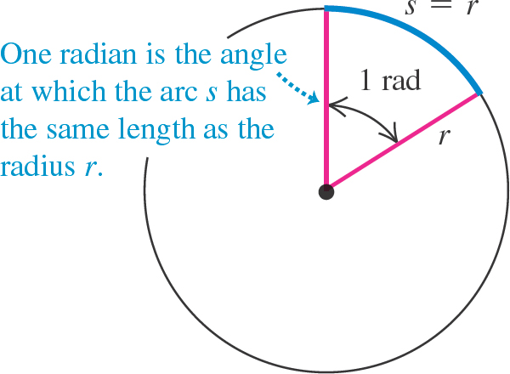
Units of Angles (1 of 2)
One complete revolution is

Slide 6
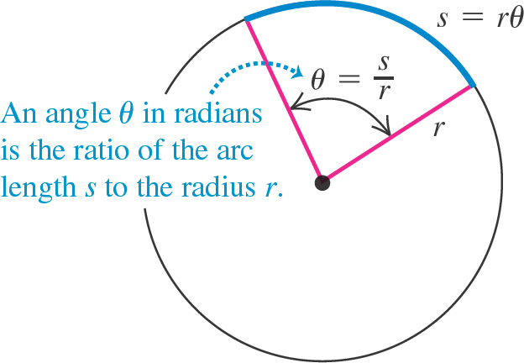
Units of Angles (2 of 2)
An angle in radians is
as shown in the figure.

Slide 7
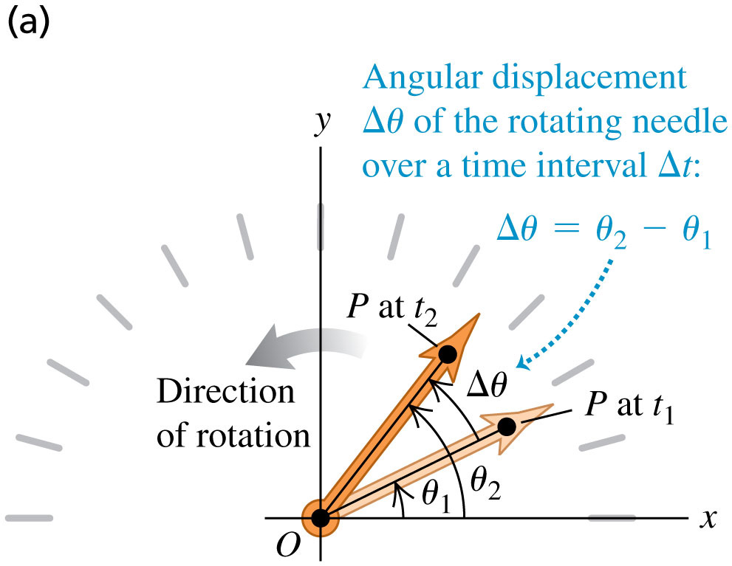
Angular Velocity (1 of 2)
The average angular velocity of an object is
The subscript z means that the rotation is about the z-axis.

Slide 8
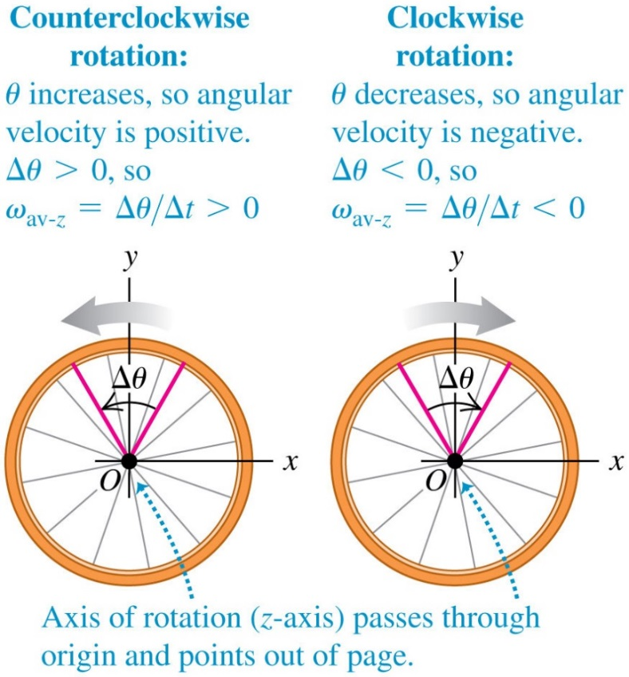
Angular Velocity (2 of 2)
We choose the angle θ to increase in the counterclockwise rotation.

Slide 9
Instantaneous Angular Velocity
The instantaneous angular velocity is the limit of average angular velocity as Δθ approaches zero:
When we refer simply to “angular velocity,” we mean the instantaneous angular velocity, not the average angular velocity.
The z-subscript means the object is rotating around the z-axis.
The angular velocity can be positive or negative, depending on the direction in which the rigid body is rotating.
Video Tutor Solution: Example 9.1

Slide 10
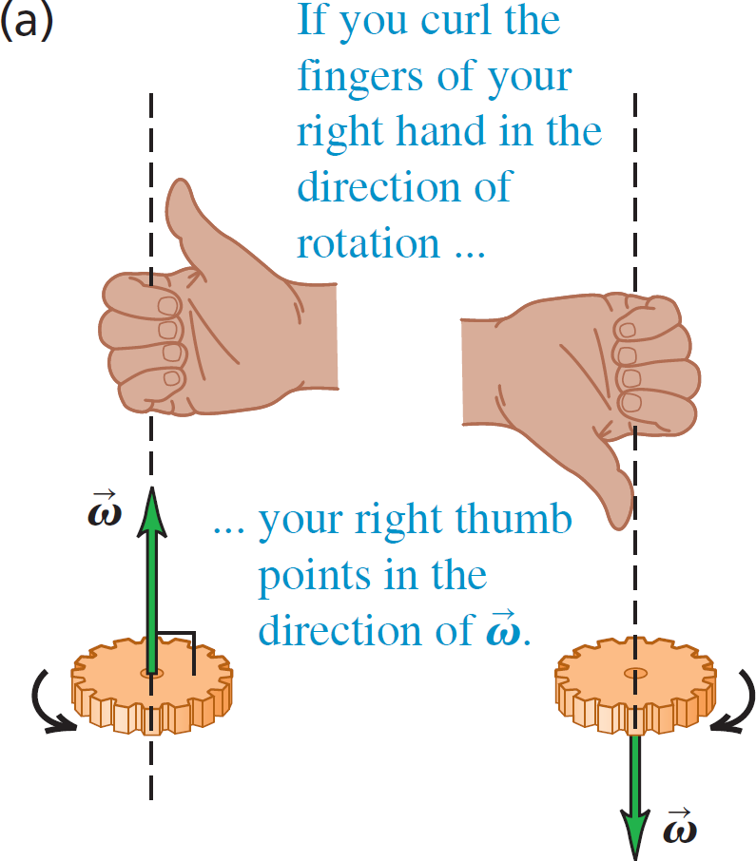
Angular Velocity Is a Vector (1 of 2)
Angular velocity is defined as a vector whose direction is given by the right-hand rule.

Slide 11
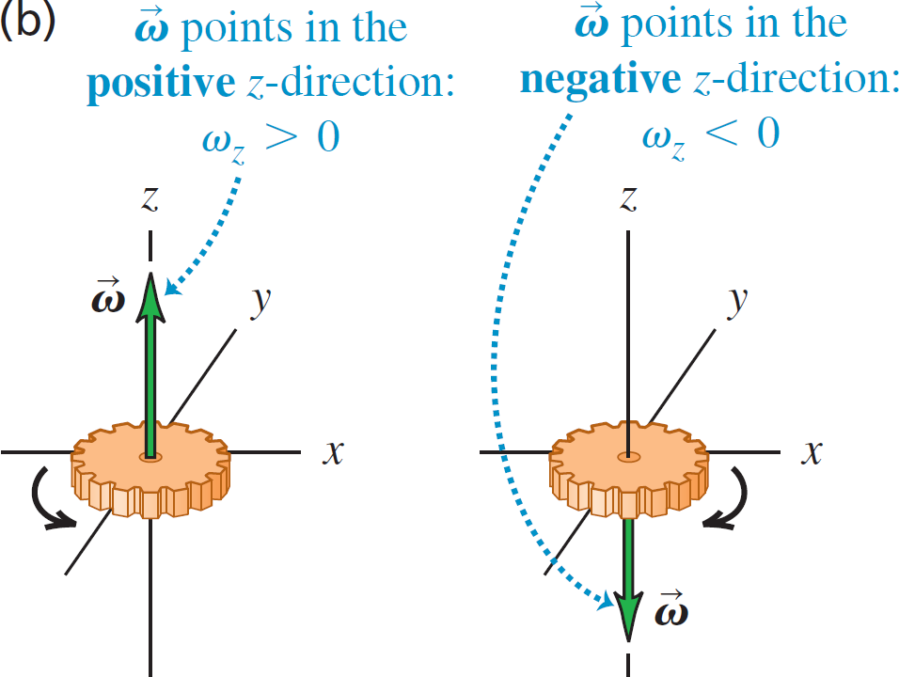
Angular Velocity Is a Vector (2 of 2)
The sign of ω_{z} for rotation along the z-axis

Slide 12
Rotational Motion in Bacteria
Escherichia coli bacteria are found in the lower intestines of humans and other warm-blooded animals.
The bacteria swim by rotating their long, corkscrew-shaped flagella, which act like the blades of a propeller.
Each flagellum is rotated at angular speeds from 200 to 1000 rev/min (about 20 to 100 rad/s) and can vary its speed to give the flagellum an angular acceleration.

Slide 13
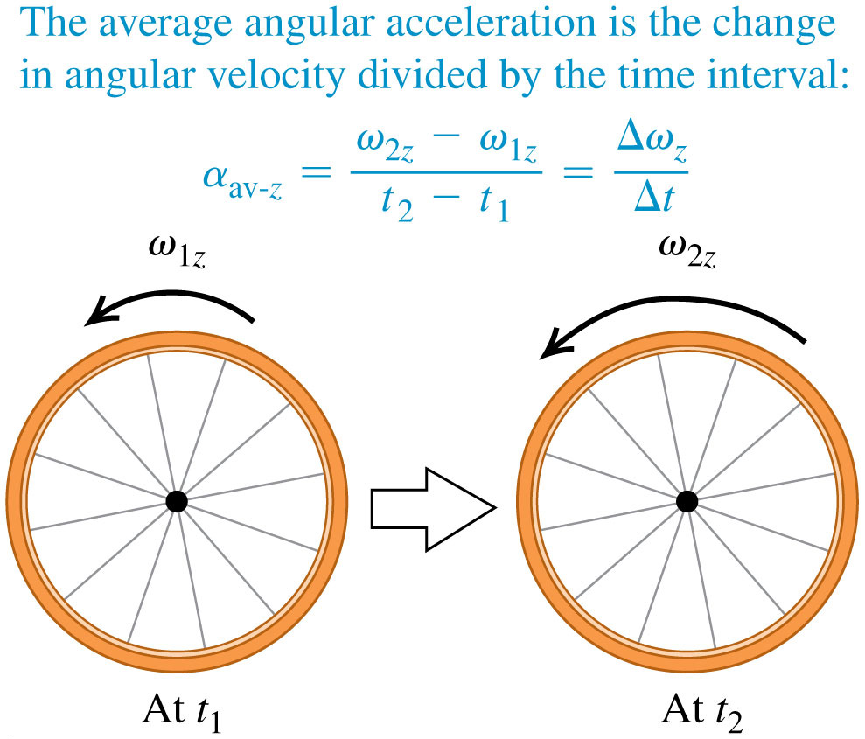
Angular Acceleration
The instantaneous angular acceleration is

Slide 14
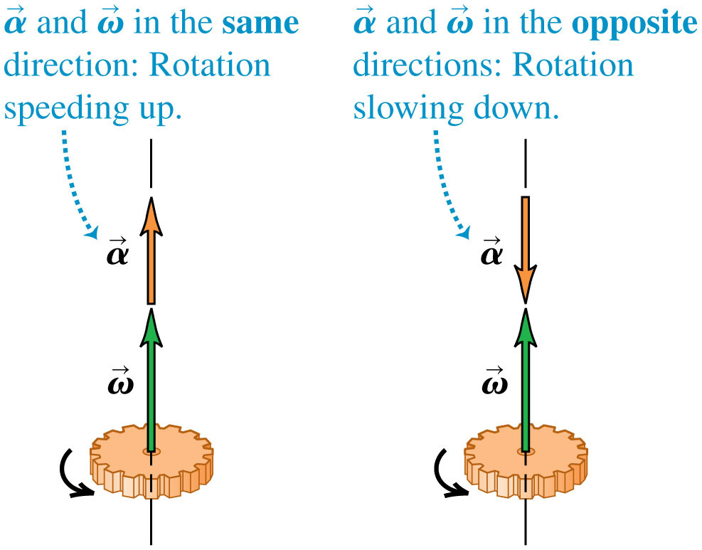
Angular Acceleration as a Vector

Slide 15
Rotation with Constant Angular Acceleration
The rotational formulas have the same form as the straight-line formulas, as shown in Table 9.1 below.
Straight-Line Motion with Constant Linear Acceleration | Fixed-Axis Rotation with Constant Angular Acceleration
ay sub x = constant | alpha sub z = constant
v sub x = v sub 0 x + ay sub x t | omega sub z = omega sub 0 z + alpha sub z t
x = x sub 0 + v sub 0 x t + one-half ay sub x t squared | theta = theta sub 0 + theta sub 0 z t + one-half alpha sub z t squared
 | omega sub z squared = omega sub 0 z squared + 2 alpha sub z times, theta minus theta sub 0
x minus x sub 0 = one-half times, v sub 0 x + v sub x, times t | theta minus theta sub 0 = one-half times, omega sub 0 z + omega sub z, times t
Video Tutor Solution: Example 9.3

Slide 16
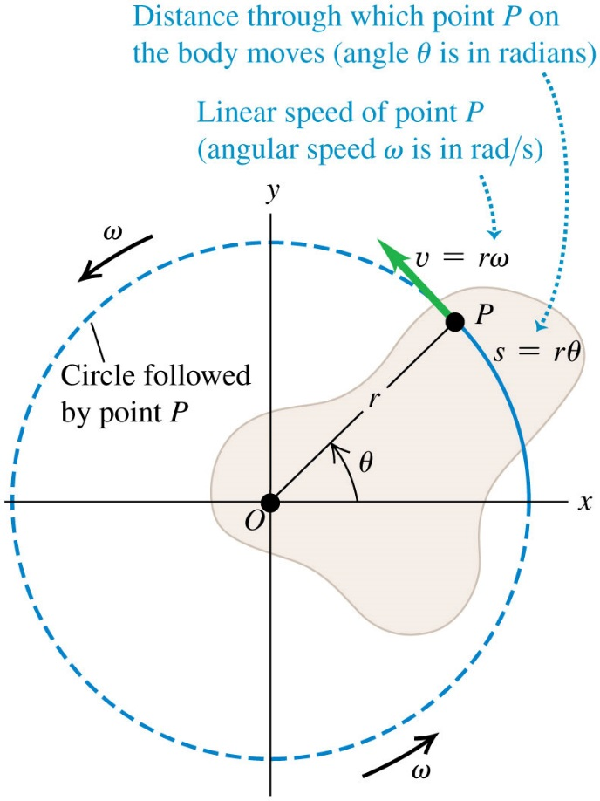
Relating Linear and Angular Kinematics (1 of 2)
A point at a distance r from the axis of rotation has a linear speed of

Slide 17
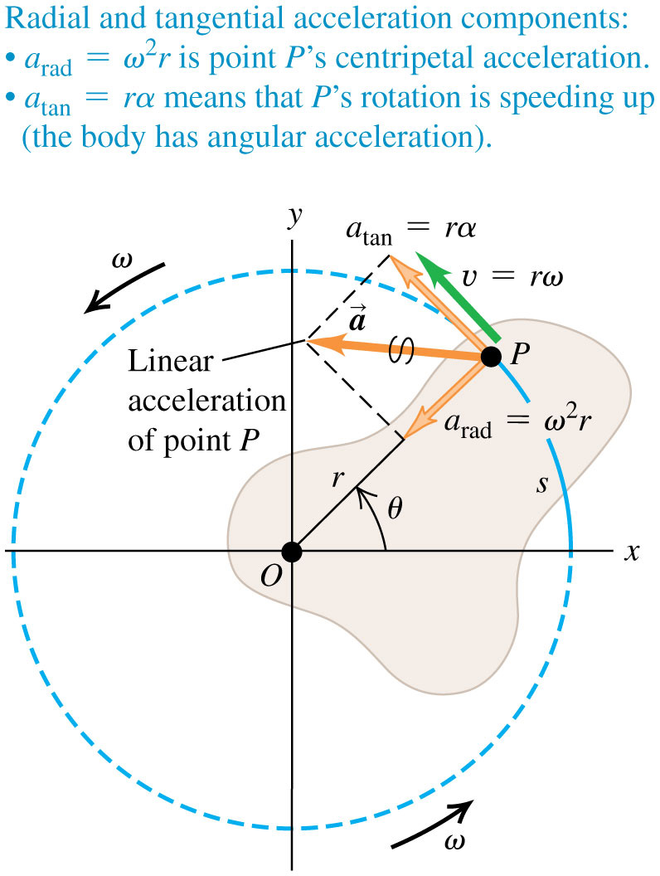
Relating Linear and Angular Kinematics (2 of 2)
For a point at a distance r from the axis of rotation:
its tangential acceleration is
its centripetal (radial) acceleration is

Slide 18
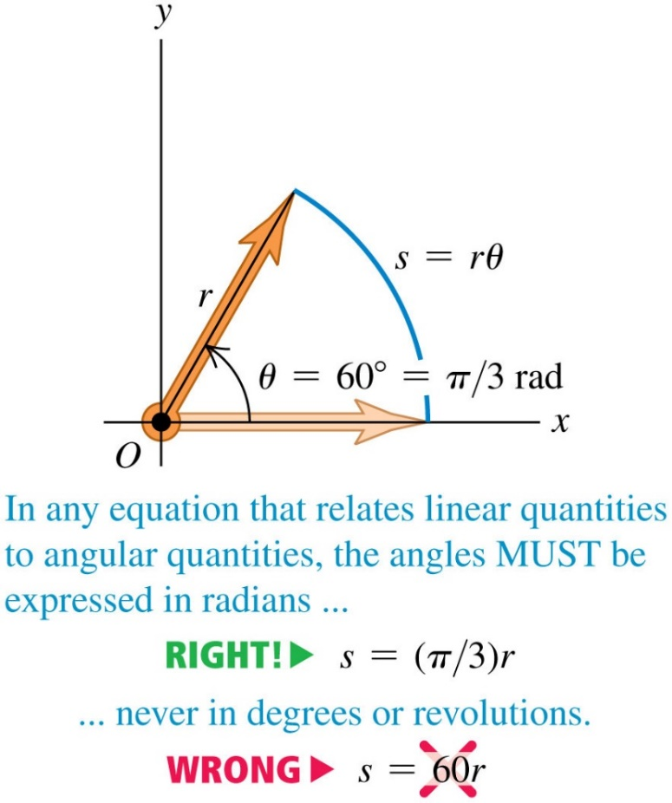
The Importance of Using Radians, Not Degrees!
Always use radians when relating linear and angular quantities.

Slide 19
Rotational Kinetic Energy
The rotational kinetic energy of a rigid body is:
The moment of inertia, I, is obtained by multiplying the mass of each particle by the square of its distance from the axis of rotation and adding these products:
The SI unit of I is the

Slide 20
Moment of Inertia (1 of 2)
Here is an apparatus free to rotate around a vertical axis.
To reduce the moment of inertia, lock the two equal-mass cylinders close to the center of the horizontal shaft.

Slide 21
Moment of Inertia (2 of 2)
Here is an apparatus free to rotate around a vertical axis.
To increase the moment of inertia, lock the two equal-mass cylinders far from the center of the horizontal shaft.

Slide 22
Moment of Inertia of a Bird's Wing
When a bird flaps its wings, it rotates the wings up and down around the shoulder.
A hummingbird has small wings with a small moment of inertia, so the bird can move its wings rapidly (up to 70 beats per second).
By contrast, the Andean condor has immense wings with a large moment of inertia, and flaps its wings at about one beat per second.

Slide 23
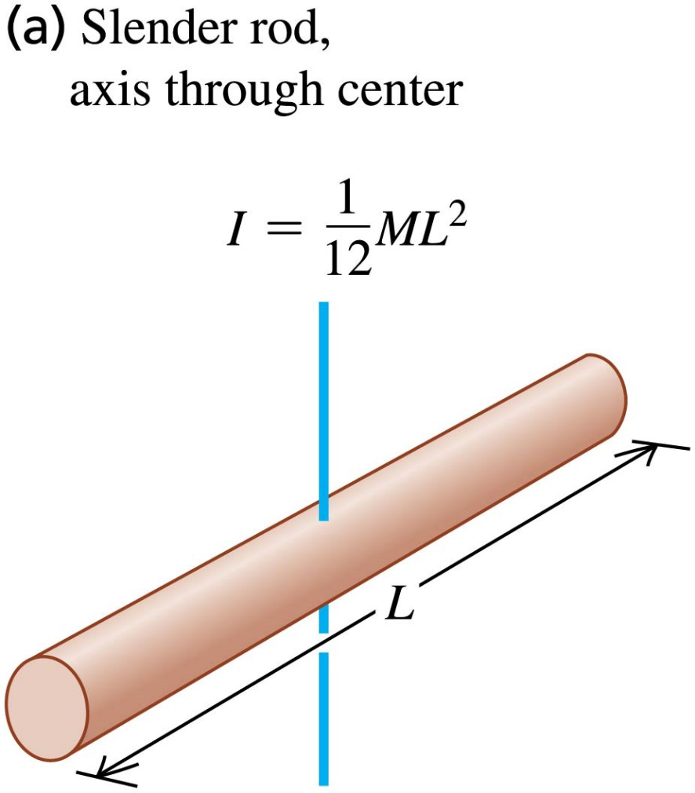
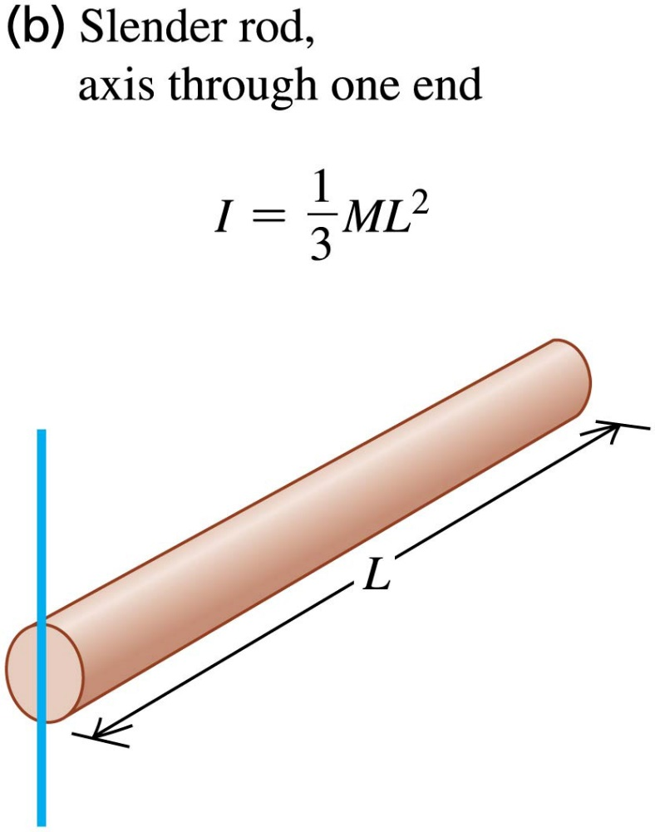
Moments of Inertia of Some Common Objects (1 of 4)
Table 9.2

Slide 24
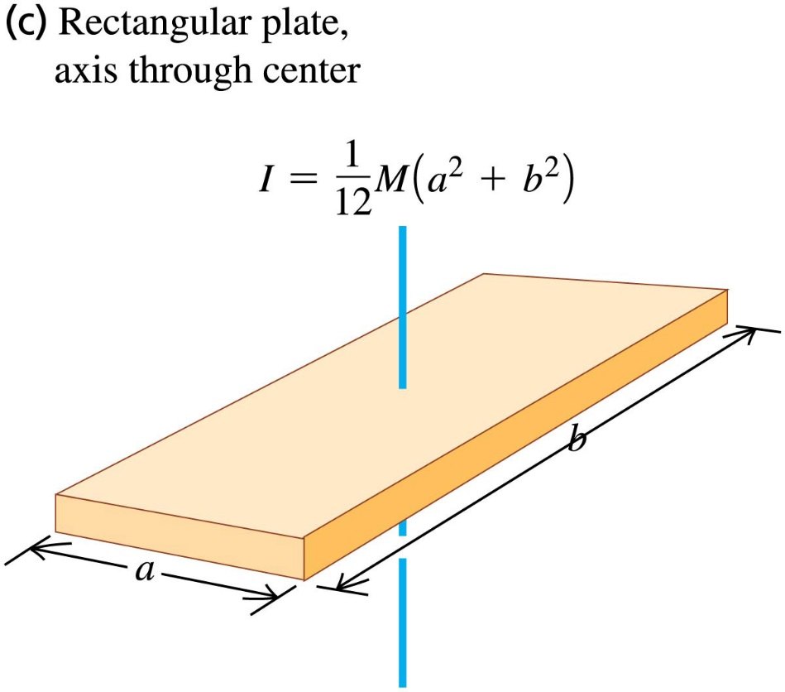
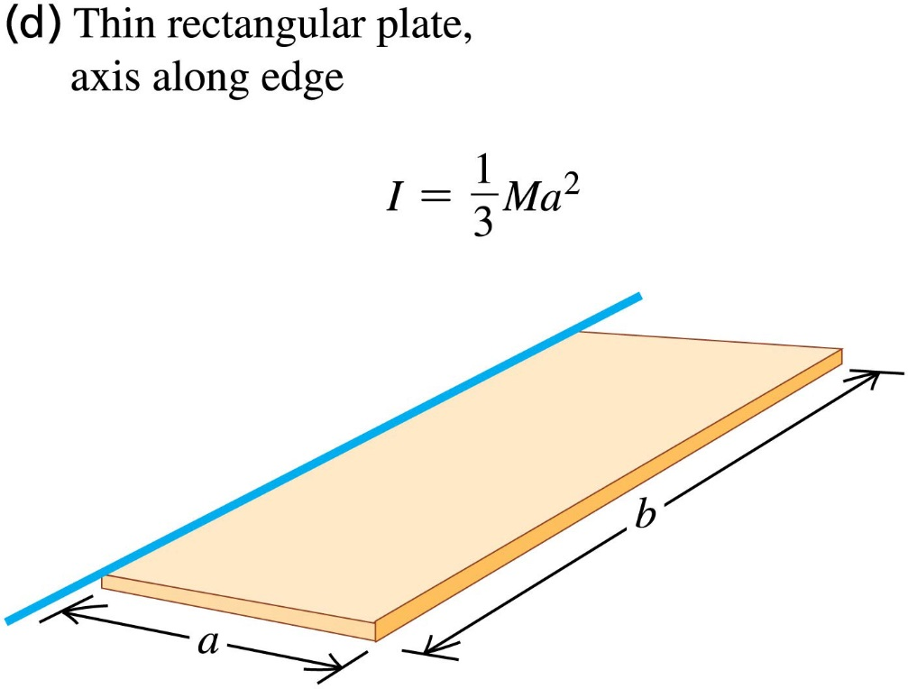
Moments of Inertia of Some Common Objects (2 of 4)
Table 9.2

Slide 25
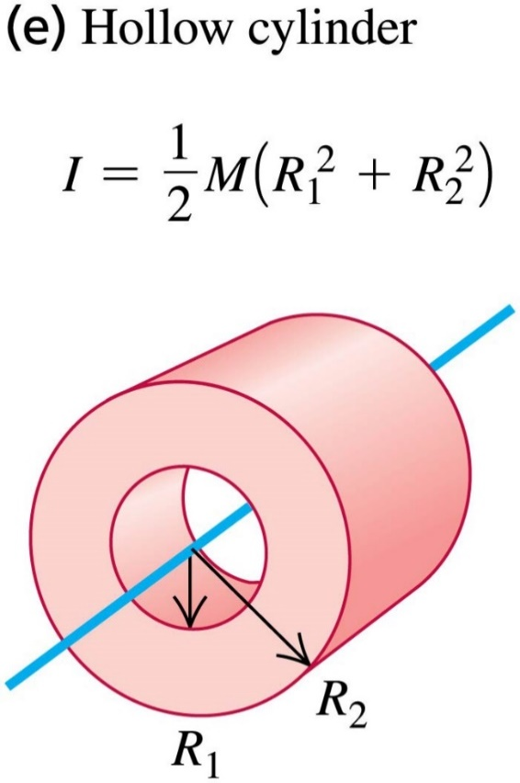
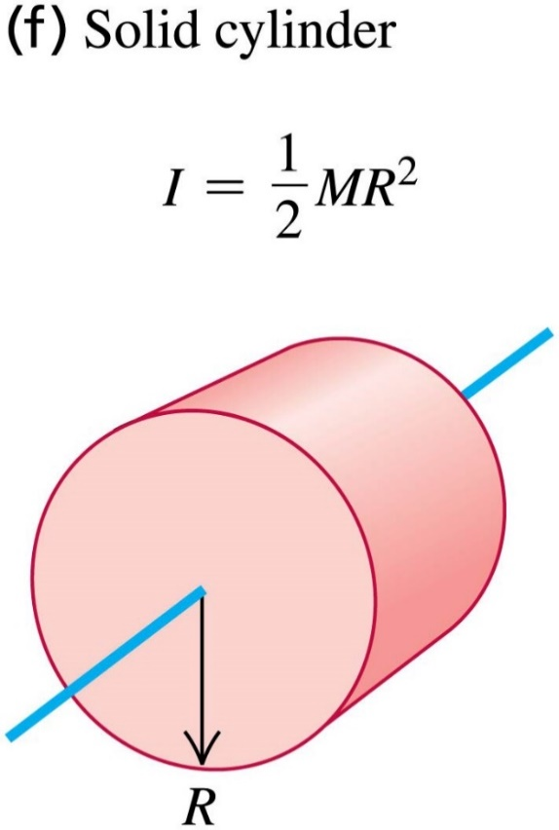
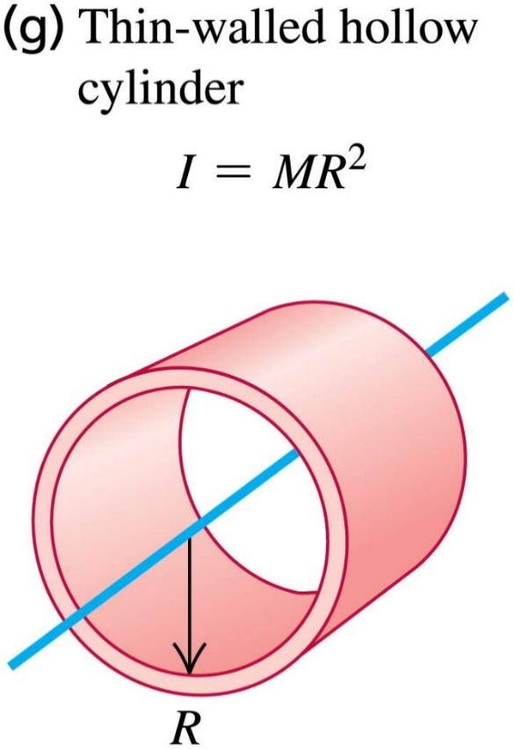
Moments of Inertia of Some Common Objects (3 of 4)
Table 9.2
Video Tutor Demonstration: Canned Food Race

Slide 26
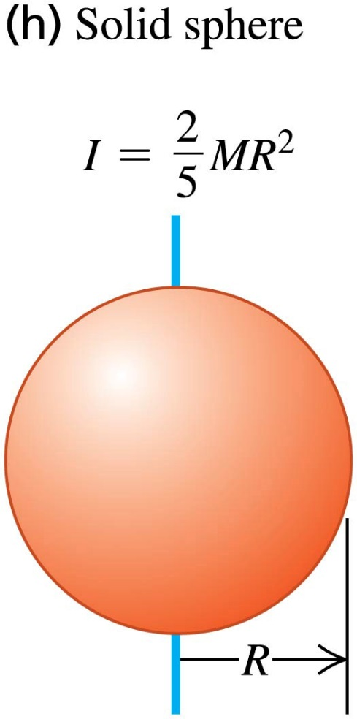
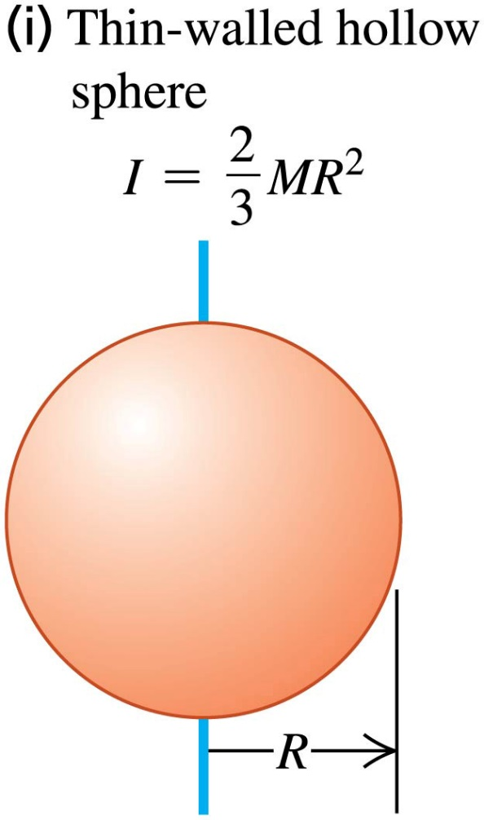
Moments of Inertia of Some Common Objects (4 of 4)
Table 9.2

Slide 27
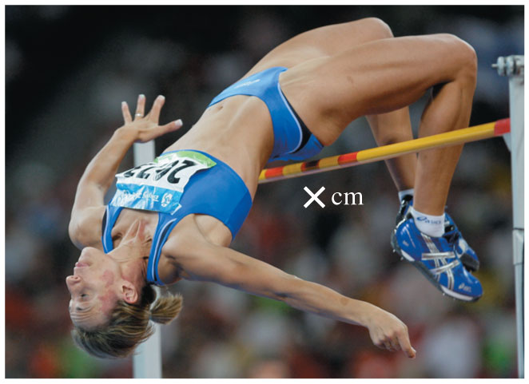
Gravitational Potential Energy of an Extended Object
The gravitational potential energy of an extended object is the same as if all the mass were concentrated at its center of mass: U_{grav} = Mgy_{cm}.
This athlete arches her body so that her center of mass actually passes under the bar.
This technique requires a smaller increase in gravitational potential energy than straddling the bar.

Slide 28
The Parallel-Axis Theorem
There is a simple relationship, called the parallel-axis theorem, between the moment of inertia of an object about an axis through its center of mass and the moment of inertia about any other axis parallel to the original axis.

Slide 29
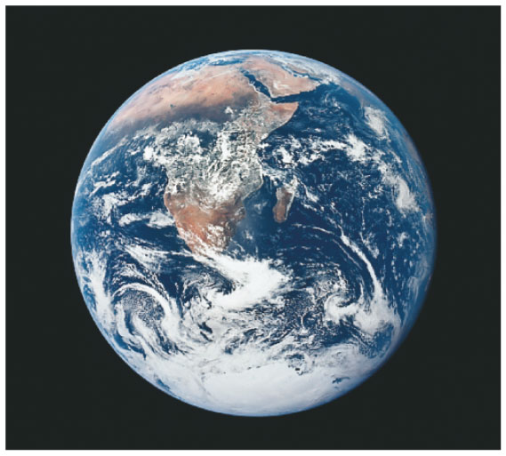
Moment of Inertia Calculations
The moment of inertia of any distribution of mass can be found by integrating over its volume:
By measuring small variations in the orbits of satellites, geophysicists can measure the earth’s moment of inertia.
This tells us how our planet’s mass is distributed within its interior.
The data show that the earth is far denser at the core than in its outer layers.

