Slide 1
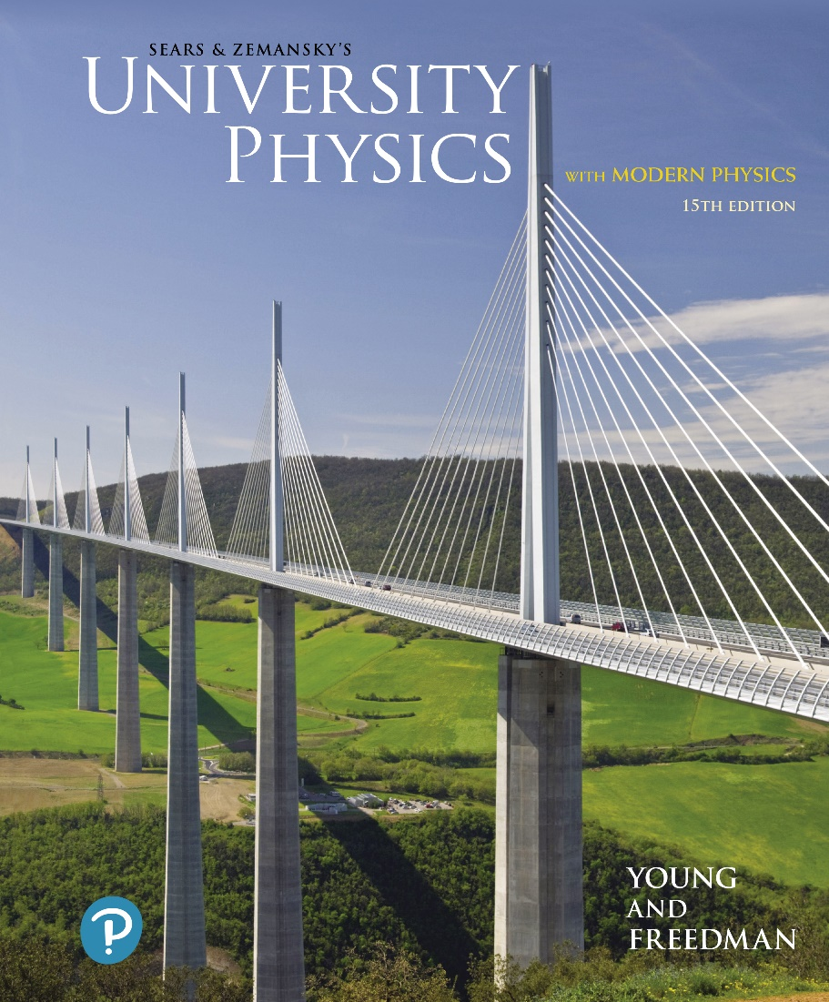
University Physics with Modern Physics
Fifteenth Edition
Chapter 7
Potential Energy and Energy Conservation
Copyright © 2020 Pearson Education, Inc. All Rights Reserved

Slide 2
Learning Outcomes
In this chapter, you’ll learn…
how to use gravitational potential energy in problems that involve vertical motion.
how to use elastic potential energy in problems that involve a moving object attached to a stretched or compressed spring.
the distinction between conservative and nonconservative forces. (Conservative forces always have a corresponding potential-energy function.)
how to use energy diagrams to understand how an object moves under the influence of a conservative force.

Slide 3
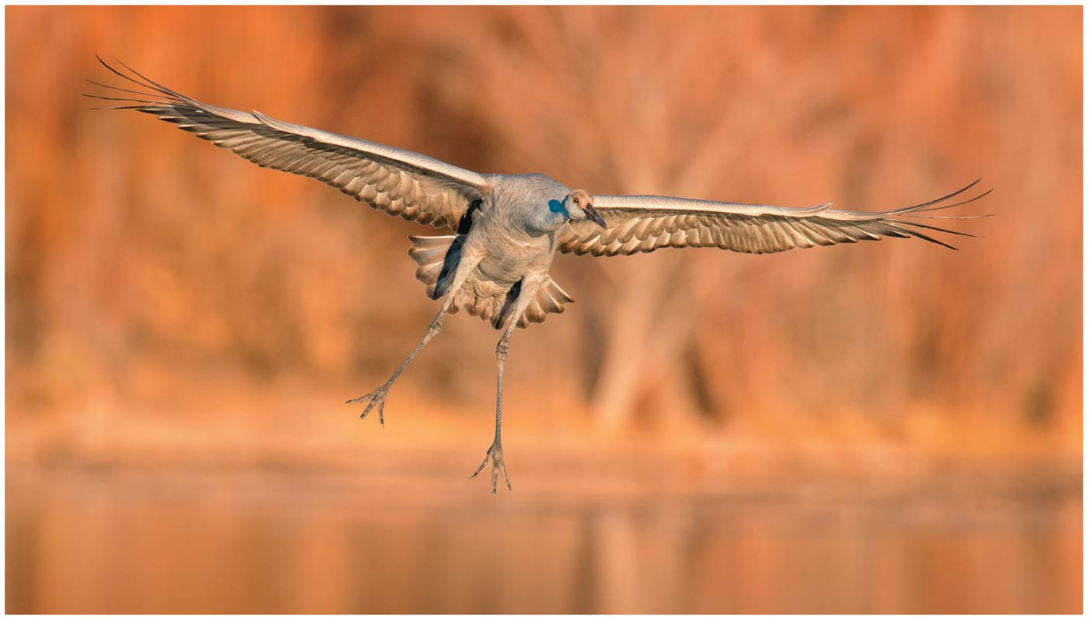
Introduction
How do energy concepts apply to the descending sandhill crane?
We will see that we can think of energy as being stored and transformed from one form to another.

Slide 4
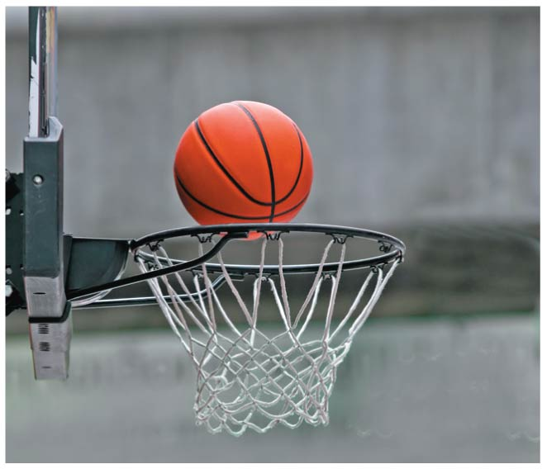
Gravitational Potential Energy (1 of 3)
When a particle is in the gravitational field of the earth, there is a gravitational potential energy associated with the particle:
As the basketball descends, gravitational potential energy is converted to kinetic energy and the basketball’s speed increases.

Slide 5
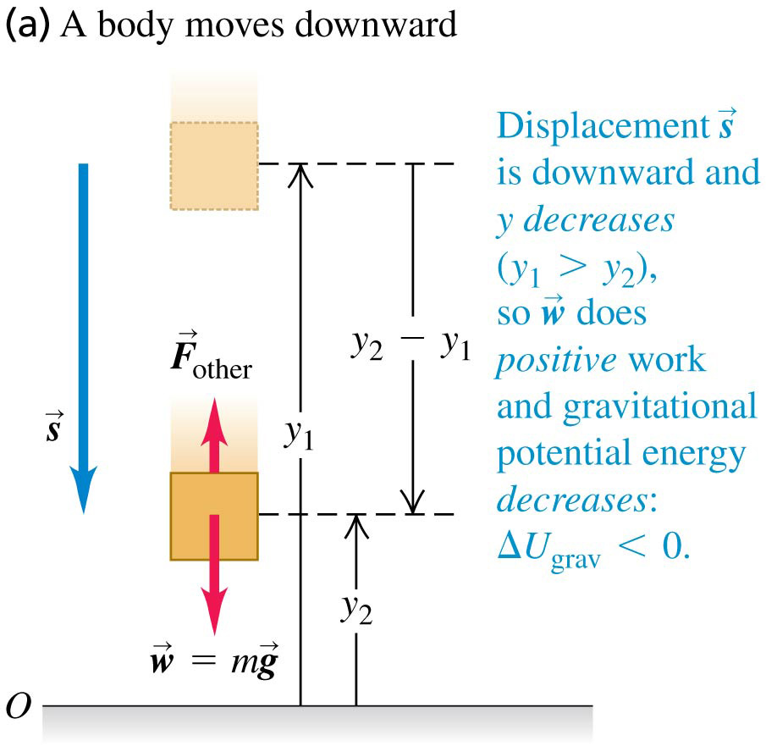
Gravitational Potential Energy (2 of 3)
The change in gravitational potential energy is related to the work done by gravity.

Slide 6
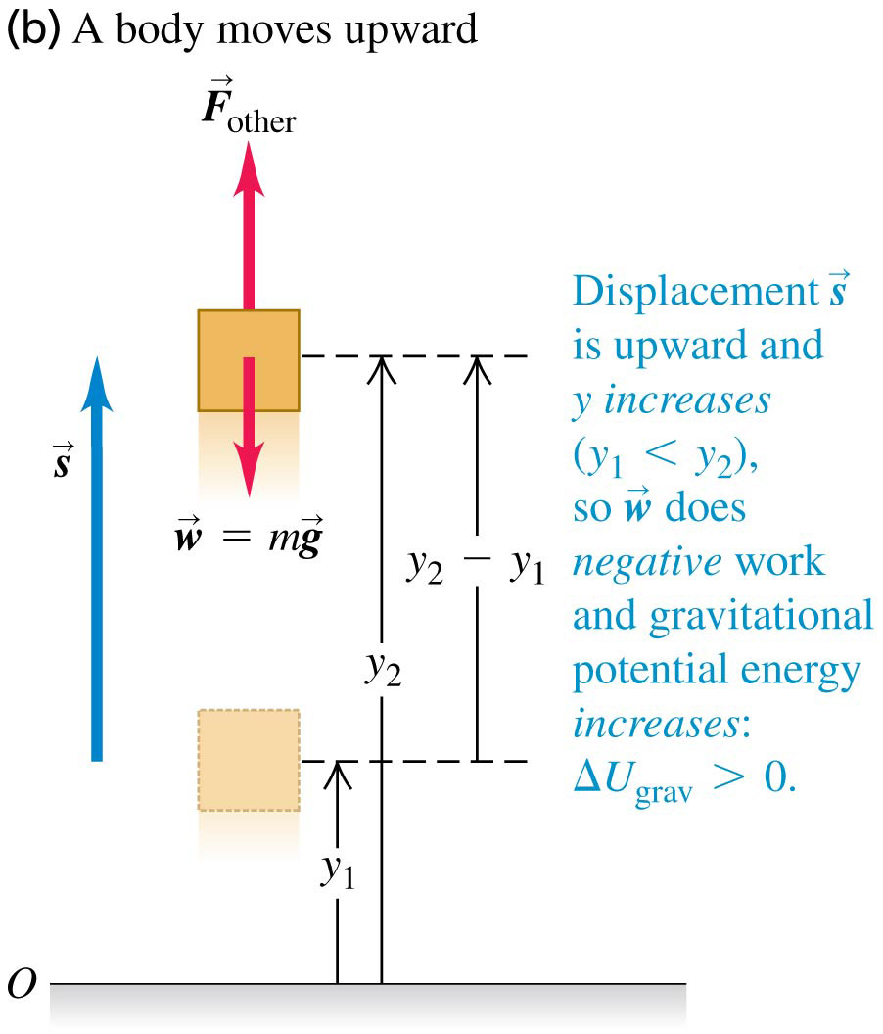
Gravitational Potential Energy (3 of 3)
When the object moves up, y increases, the work done by the gravitational force is negative, and the gravitational potential energy increases.

Slide 7
The Conservation of Mechanical Energy (1 of 2)
The total mechanical energy of a system is the sum of its kinetic energy and potential energy.
A quantity that always has the same value is called a conserved quantity.
When only the force of gravity does work on a system, the total mechanical energy of that system is conserved.
This is an example of the conservation of mechanical energy.
Video Tutor Demonstration: Chin Basher?

Slide 8
The Conservation of Mechanical Energy (2 of 2)
When only the force of gravity does work on a system, the total mechanical energy of that system is conserved.
Video Tutor Solution: Example 7.1

Slide 9
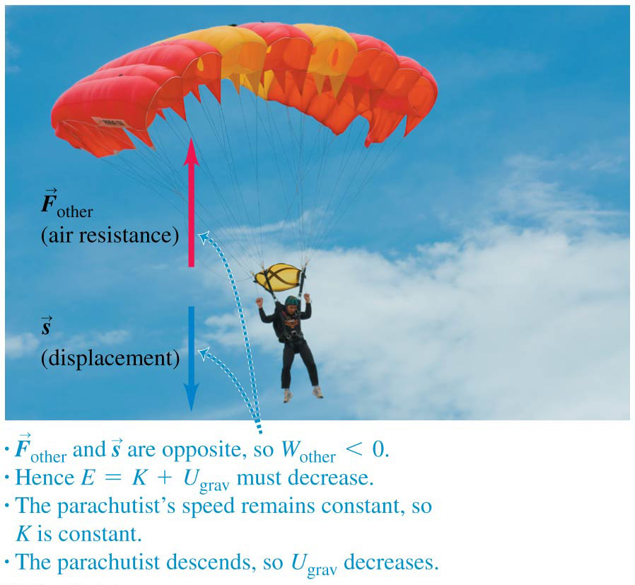
When Forces Other Than Gravity Do Work

Slide 10
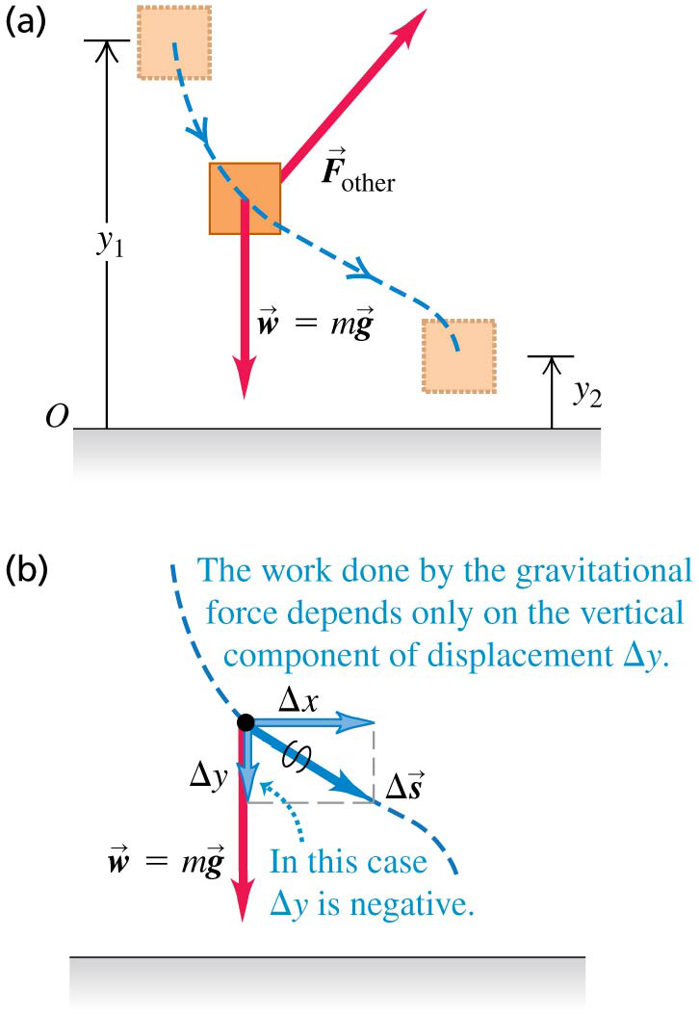
Work and Energy Along a Curved Path
We can use the same expression for gravitational potential energy whether the object’s path is curved or straight.
W_{grav} = mgy₁ − mgy₂

Slide 11
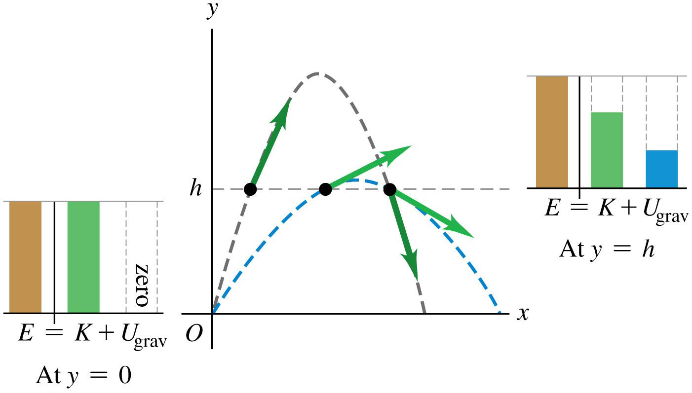
Conceptual Example 7.3
Two identical balls leave from the same height with the same speed but at different angles.

Slide 12
Elastic Potential Energy (1 of 2)
A object is elastic if it returns to its original shape after being deformed.
Elastic potential energy is the energy stored in an elastic object, such as a spring:

Slide 13
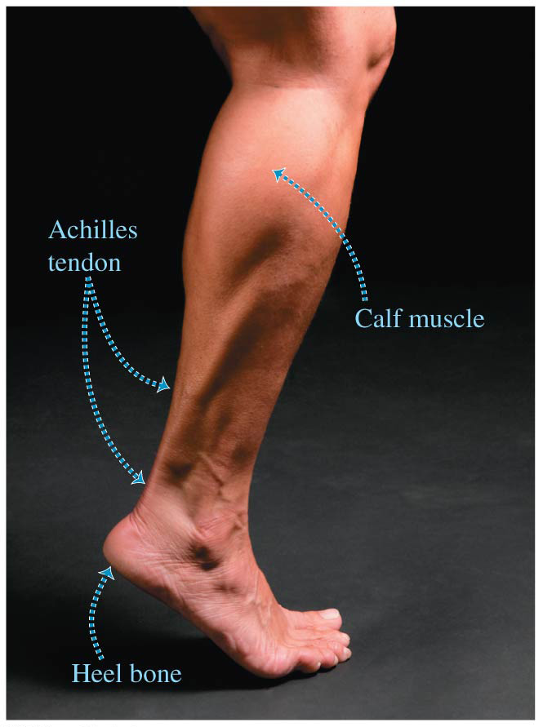
Elastic Potential Energy (2 of 2)
The Achilles tendon acts like a natural spring.
When it stretches and then relaxes, this tendon stores and then releases elastic potential energy.
This spring action reduces the amount of work your leg muscles must do as you run.

Slide 14
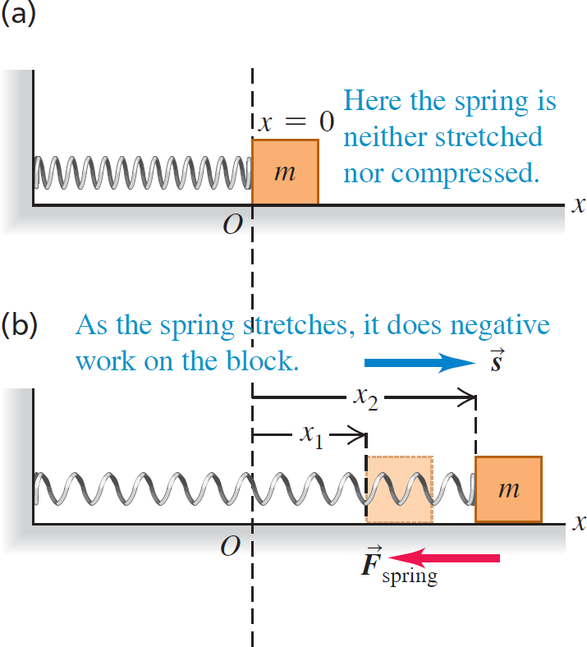
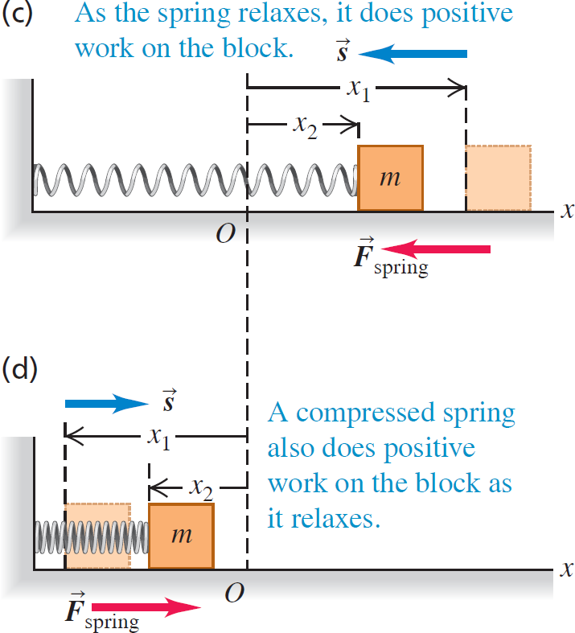
Work Done by a Spring
Figure 7.13 below shows how a spring does work on a block as it is stretched and compressed.

Slide 15
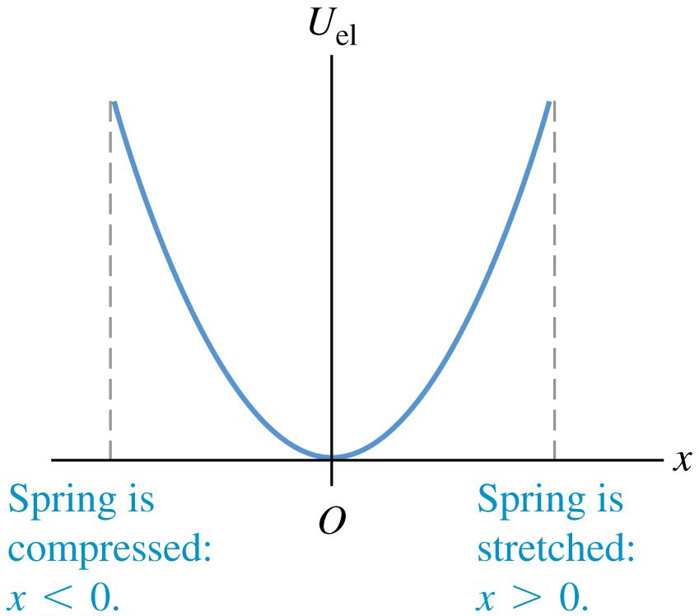
Elastic Potential Energy
The graph of elastic potential energy for an ideal spring is a parabola.
x is the extension or compression of the spring.
Elastic potential energy is never negative.

Slide 16
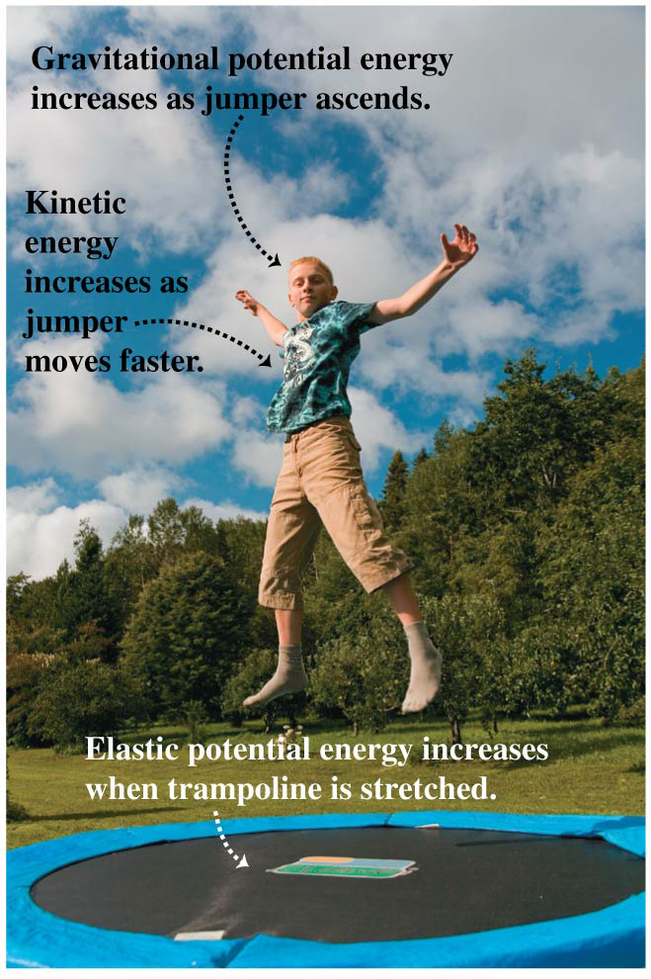
Situations with Both Gravitational and Elastic Forces
When a situation involves both gravitational and elastic forces, the total potential energy is the sum of the gravitational potential energy and the elastic potential energy:
U = U_{grav} + U_{el}

Slide 17
Conservative and Nonconservative Forces
A conservative force allows conversion between kinetic and potential energy. Gravity and the spring force are conservative.
The work done between two points by any conservative force
can be expressed in terms of a potential energy function.
is reversible.
is independent of the path between the two points.
is zero if the starting and ending points are the same.
A force (such as friction) that is not conservative is called a nonconservative force, or a dissipative force.

Slide 18
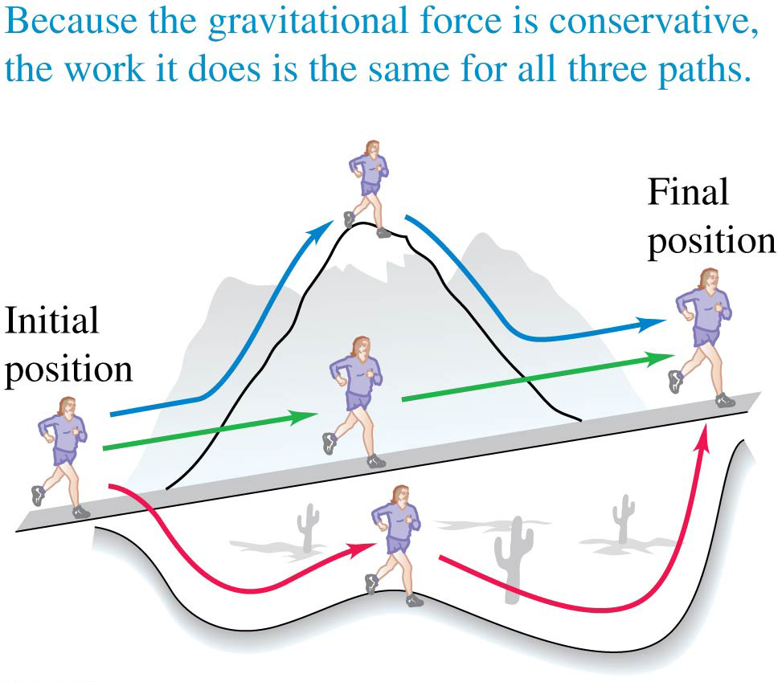
Conservative Forces
The work done by a conservative force such as gravity depends on only the endpoints of a path, not the specific path taken between those points.

Slide 19
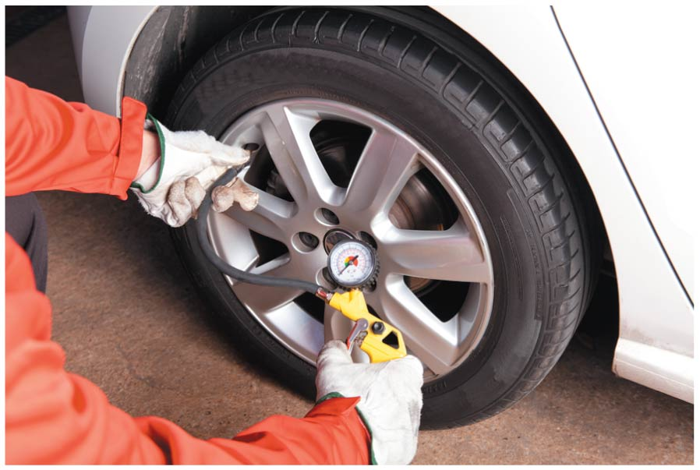
Nonconservative Forces
As an automobile tire flexes as it rolls, nonconservative internal friction forces act within the rubber.
Mechanical energy is lost and converted to internal energy of the tire.
This causes the temperature and pressure of a tire to increase as it rolls.
That’s why tire pressure is best checked before the car is driven, when the tire is cold.
Video Tutor Solution: Example 7.11

Slide 20
Conservation of Energy
Nonconservative forces do not store potential energy, but they do change the internal energy of a system.
The law of conservation of energy means that energy is never created or destroyed; it only changes form.
This law can be expressed as

Slide 21
Force and Potential Energy in One Dimension (1 of 3)
In one dimension, a conservative force can be obtained from its potential energy function using:
In regions where U(x) changes most rapidly with x, this corresponds to a large force magnitude.
Also, when F_{x}(x) is in the positive x-direction, U(x) decreases with increasing x.
A conservative force always acts to push the system toward lower potential energy.

Slide 22
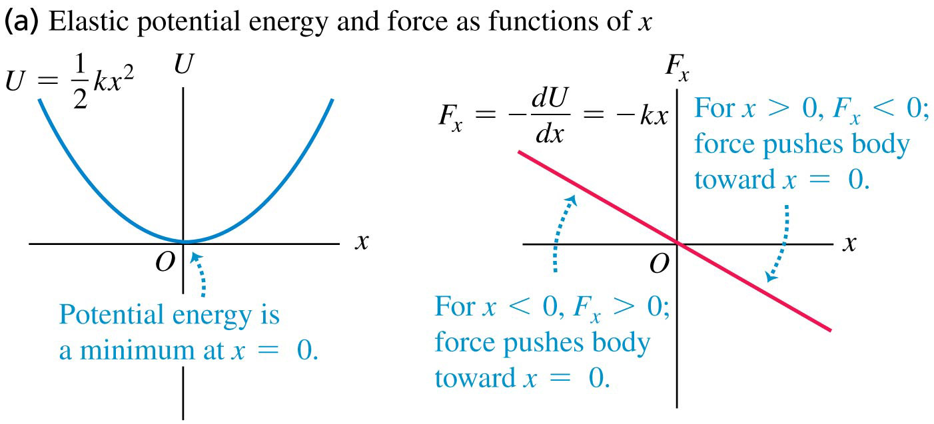
Force and Potential Energy in One Dimension (2 of 3)
Elastic potential energy and force as functions of x for an ideal spring.

Slide 23
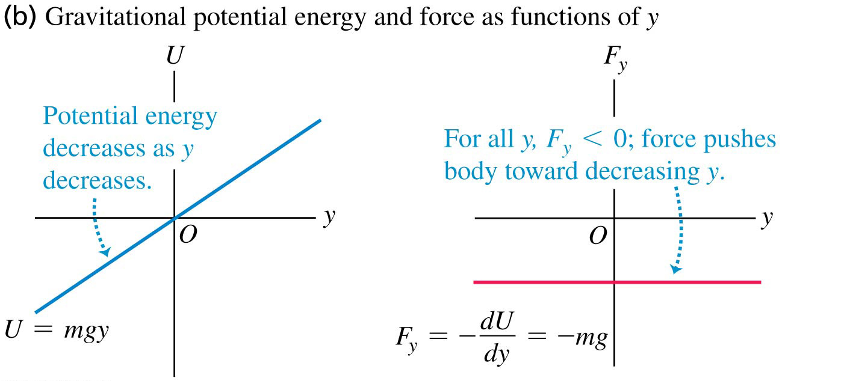
Force and Potential Energy in One Dimension (3 of 3)
Gravitational potential energy and the gravitational force as functions of y.

Slide 24
Force and Potential Energy in Three Dimensions (1 of 2)
In three dimensions, the components of a conservative force can be obtained from its potential energy function using partial derivatives:

Slide 25
Force and Potential Energy in Three Dimensions (2 of 2)
When we take the partial derivative of U with respect to each coordinate, multiply by the corresponding unit vector, and then take the vector sum, this is called the gradient of U:
Video Tutor Solution: Example 7.14

Slide 26
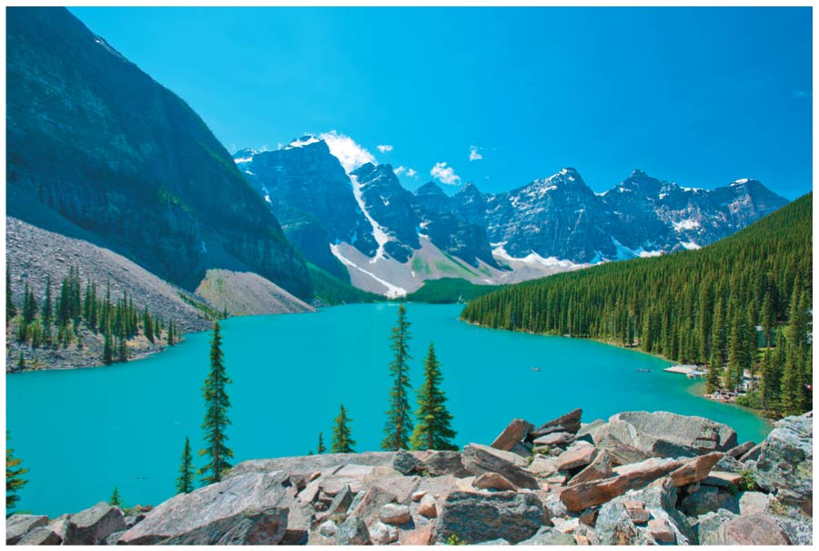
Force and Potential Energy
The greater the elevation of a hiker in Canada’s Banff National Park, the greater the gravitational potential energy U_{grav}.
Where the mountains have steep slopes, U_{grav} has a large gradient and there’s a strong force pushing you along the mountain’s surface toward a region of lower elevation (and hence lower U_{grav}).
There’s zero force along the surface of the lake, which is all at the same elevation.

Slide 27
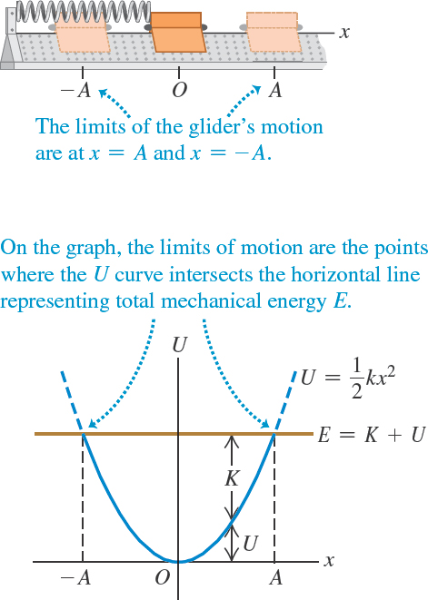
Energy Diagrams
An energy diagram is a graph that shows both the potential-energy function U(x) and the total mechanical energy E.
The figure illustrates the energy diagram for a glider attached to a spring on an air track.

Slide 28
Force and a Graph of Its Potential-Energy Function
For any graph of potential energy versus x, the corresponding force is
Whenever the slope of U is zero, the force there is zero, and this is a point of equilibrium.
When U is at a minimum, the force near the minimum draws the object closer to the minimum, so it is a restoring force. This is called stable equilibrium.
When U is at a maximum, the force near the maximum draws the object away from the maximum. This is called unstable equilibrium.

Slide 29
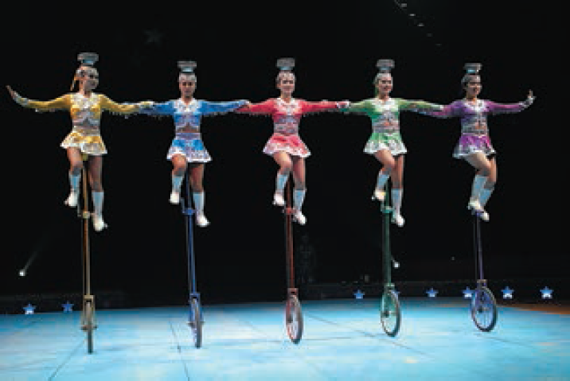
Unstable Equilibrium
Each of these acrobats is in unstable equilibrium.
The gravitational potential energy is lower no matter which way an acrobat tips, so if she begins to fall she will keep on falling.
Staying balanced requires the acrobats’ constant attention.

