Slide 1
University Physics with Modern Physics
Fifteenth Edition
Chapter 6
Work and Kinetic Energy
Copyright © 2020 Pearson Education, Inc. All Rights Reserved

Slide 2
Learning Outcomes
In this chapter, you’ll learn…
what it means for a force to do work on an object, and how to calculate the amount of work done.
The definition of the kinetic energy (energy of motion) of an object, and how the total work done on an object changes the object’s kinetic energy.
How to use the relationship between total work and change in kinetic energy when the forces are not constant, the object follows a curved path, or both.
how to solve problems involving power (the rate of doing work).

Slide 3
Introduction
A baseball pitcher does work with his throwing arm to give the ball a property called kinetic energy.
In this chapter, the introduction of the new concepts of work, energy, and the conservation of energy will allow us to deal with problems in which Newton’s laws alone aren’t enough.

Slide 4
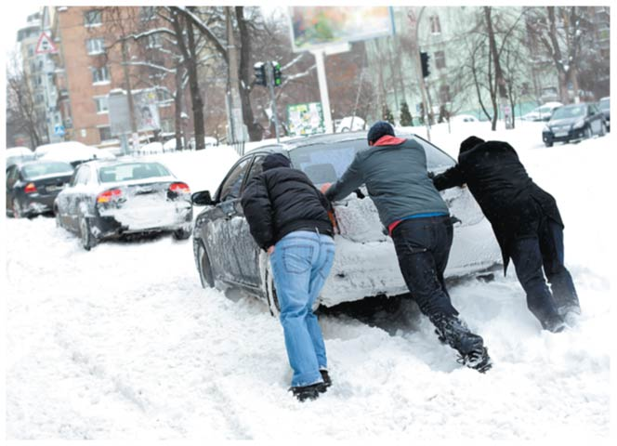
Work
A force on an object does work if the object undergoes a displacement.
These people are doing work as they push on the car because they exert a force on the car as it moves.

Slide 5
Units of Work
The SI unit of work is the joule (named in honor of the 19th-century English physicist James Prescott Joule).
Since W = Fs, the unit of work is the unit of force multiplied by the unit of distance.
In SI units:
1 joule = (1 newton) (1 meter) or 1 J = 1 N ∙ m
If you lift an object with a weight of 1 N a distance of 1 m at a constant speed, you do 1 J of work on it.

Slide 6
Work Done by a Constant Force (1 of 2)
The work done by a constant force acting at an angle to the displacement is:
This can be written more compactly as:

Slide 7
Positive Work
When the force has a component in the direction of the displacement, work is positive.

Slide 8
Negative Work
When the force has a component opposite to the direction of the displacement, work is negative.

Slide 9
Zero Work (1 of 2)
When the force is perpendicular to the direction of the displacement, the force does no work on the object.

Slide 10
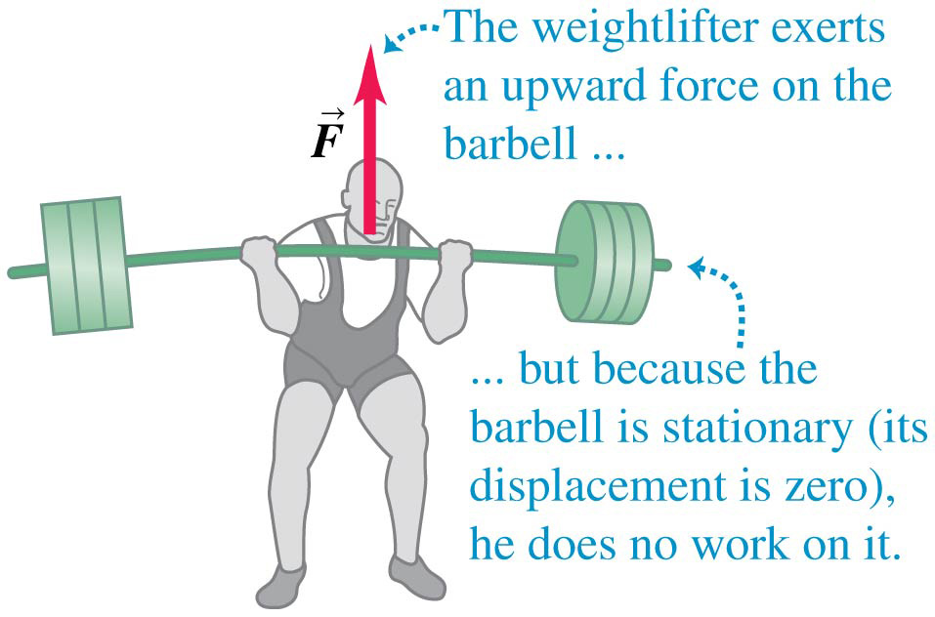
Zero Work (2 of 2)
A weightlifter does no work on a barbell as long as he holds it stationary.

Slide 11
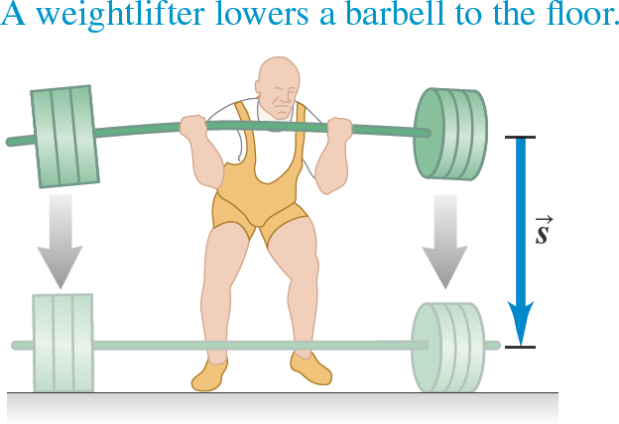
Lowering the Barbell to the Floor: Slide 1

Slide 12
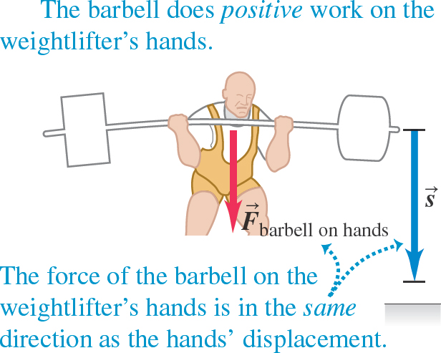
Lowering the Barbell to the Floor: Slide 2

Slide 13
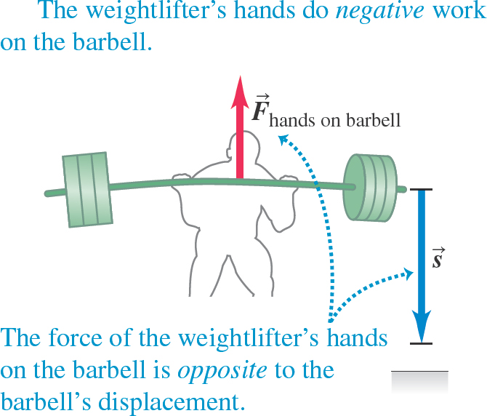
Lowering the Barbell to the Floor: Slide 3

Slide 14
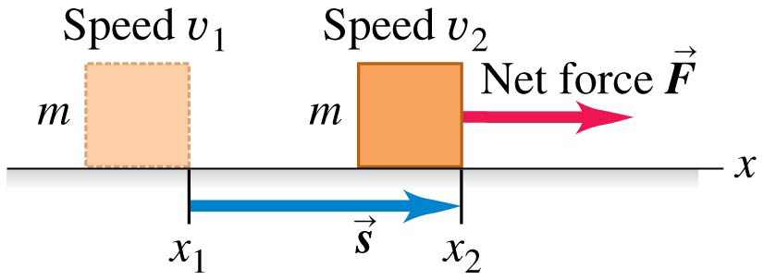
Total Work
The work done by the net force on a particle as it moves is called the total work W_{tot}.
The particle speeds up if W_{tot} > 0, slows down if W_{tot} < 0, and maintains the same speed if W_{tot} = 0.
Video Tutor Solution: Example 6.2

Slide 15
Kinetic Energy (1 of 4)
The energy of motion of a particle is called kinetic energy:
Like work, the kinetic energy of a particle is a scalar quantity; it depends on only the particle’s mass and speed, not its direction of motion.
Kinetic energy can never be negative, and it is zero only when the particle is at rest.
The SI unit of kinetic energy is the joule.

Slide 16
Kinetic Energy (2 of 4)
Kinetic energy does not depend on the direction of motion.

Slide 17
Kinetic Energy (3 of 4)
Kinetic energy increases linearly with the mass of the object.

Slide 18
Kinetic Energy (4 of 4)
Kinetic energy increases with the square of the speed of the object.

Slide 19
The Work-Energy Theorem
The work-energy theorem: The work done by the net force on a particle equals the change in the particle’s kinetic energy.

Slide 20
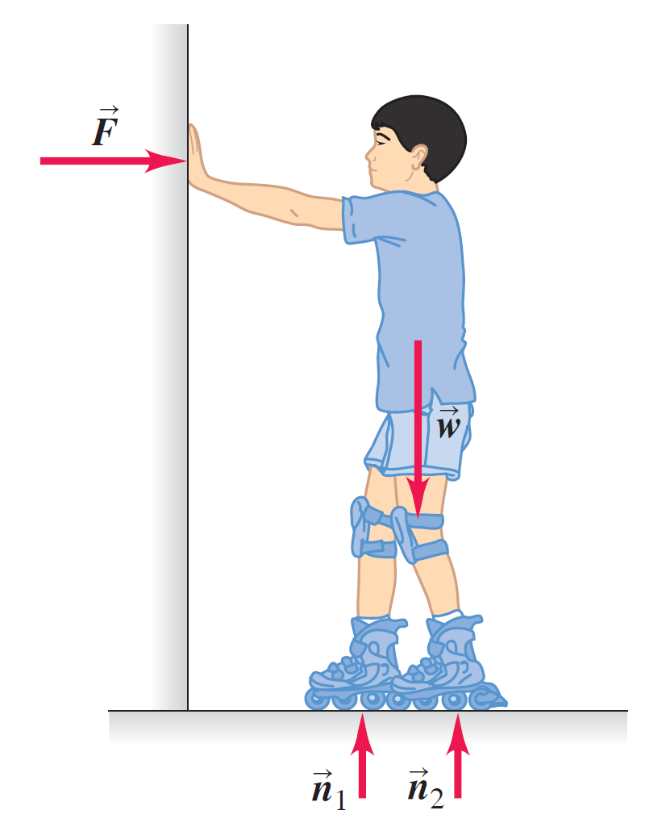
Work and Kinetic Energy in Composite Systems
The work done by the external forces acting on the skater is zero.
But the skater’s kinetic energy changes nonetheless!
The explanation is that it’s not adequate to represent the boy as a single point mass.
Video Tutor Solution: Example 6.5

Slide 21
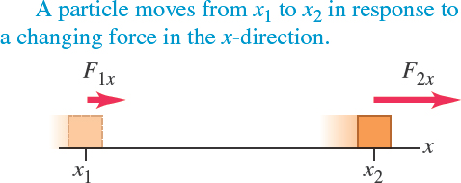
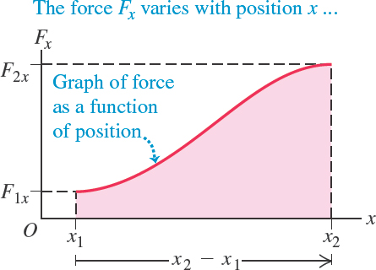
Work and Energy with Varying Forces (1 of 3)
Many forces are not constant.
Suppose a particle moves along the x-axis from x₁ to x₂.

Slide 22
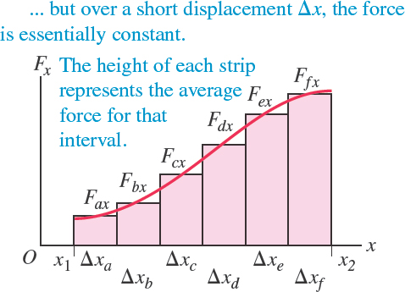
Work and Energy with Varying Forces (2 of 3)
We calculate the approximate work done by the force over many segments of the path.
We do this for each segment and then add the results for all the segments.

Slide 23
Work and Energy with Varying Forces (3 of 3)
The work done by the force in the total displacement from x₁ to x₂ is the integral of F_{x} from x₁ to x₂:
On a graph of force as a function of position, the total work done by the force is represented by the area under the curve between the initial and final positions.

Slide 24
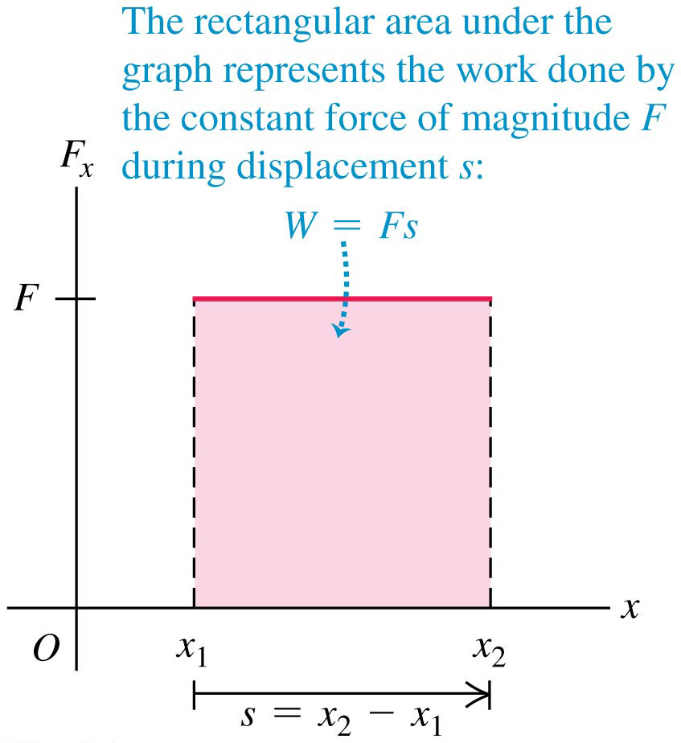
Work Done by a Constant Force (2 of 2)

Slide 25
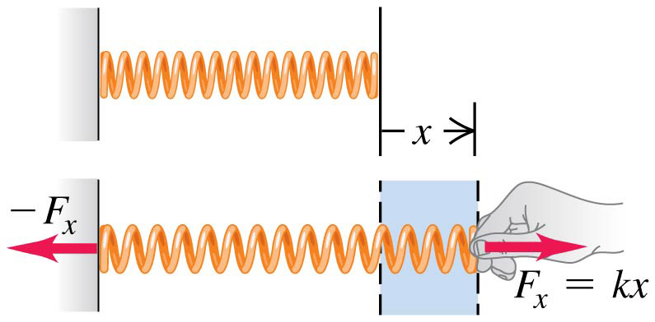
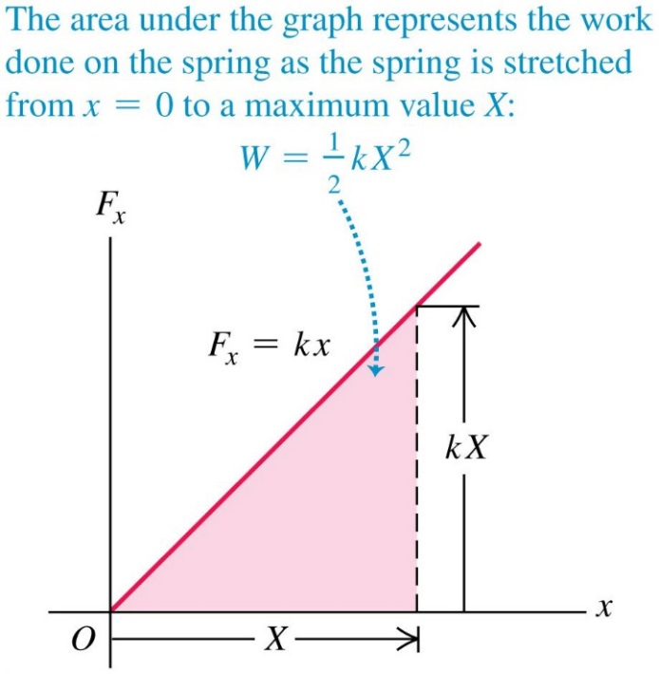
Stretching a Spring
The force required to stretch a spring a distance x is proportional to x: F_{x} = kx.
The area under the graph represents the work done on the spring to stretch it a distance

Slide 26
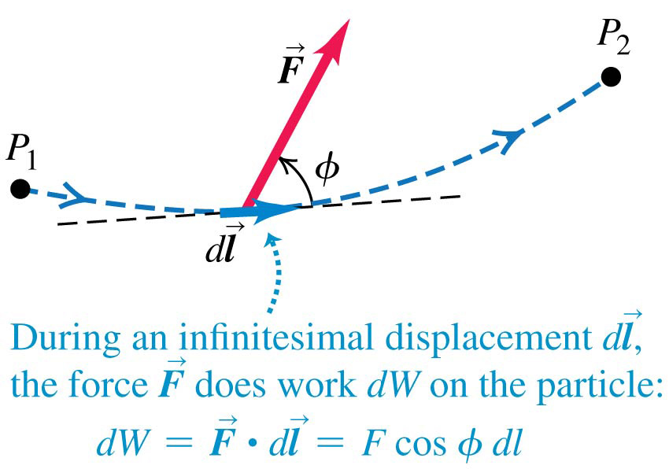
Work–Energy Theorem for Motion Along a Curve
A particle moves along a curved path from point P₁ to P₂, acted on by a force that varies in magnitude and direction.
The work can be found using a line integral:
Video Tutor Solution: Example 6.8

Slide 27
Power (1 of 2)
Power is the rate at which work is done.
Average power is:
Instantaneous power is:
The SI unit of power is the watt (1 W = 1 J/s), but another familiar unit is the horsepower (1 hp = 746 W).

Slide 28
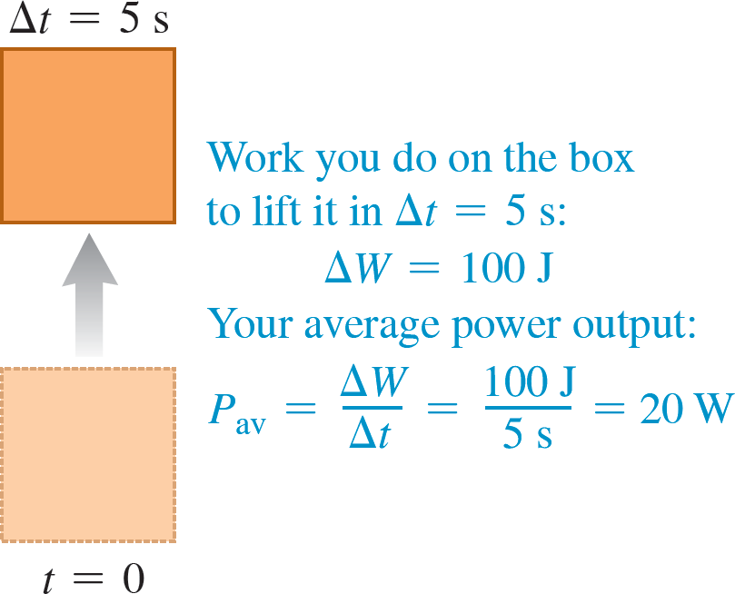
Power: Lifting a Box Slowly

Slide 29
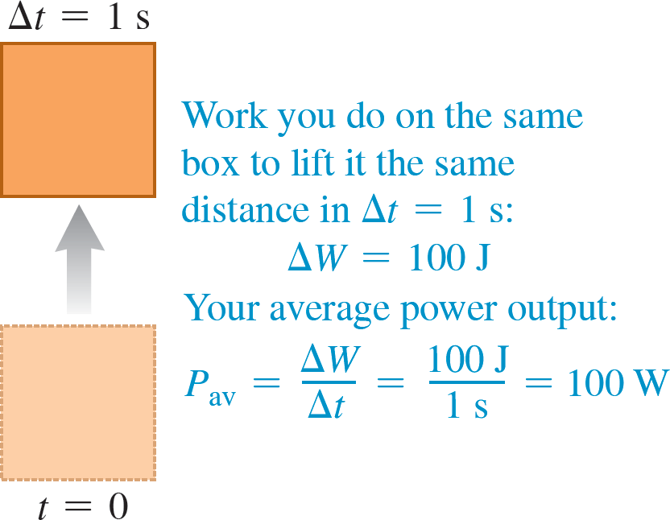
Power: Lifting a Box Quickly

Slide 30
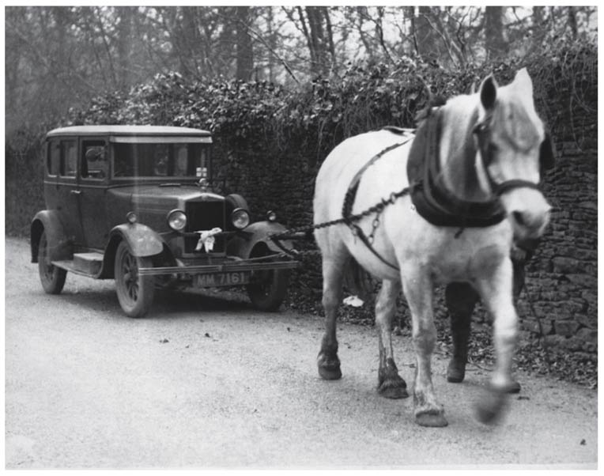
Power (2 of 2)
In mechanics we can also express power in terms of force and velocity:
Here is a one-horsepower (746-W) propulsion system.

