Slide 1
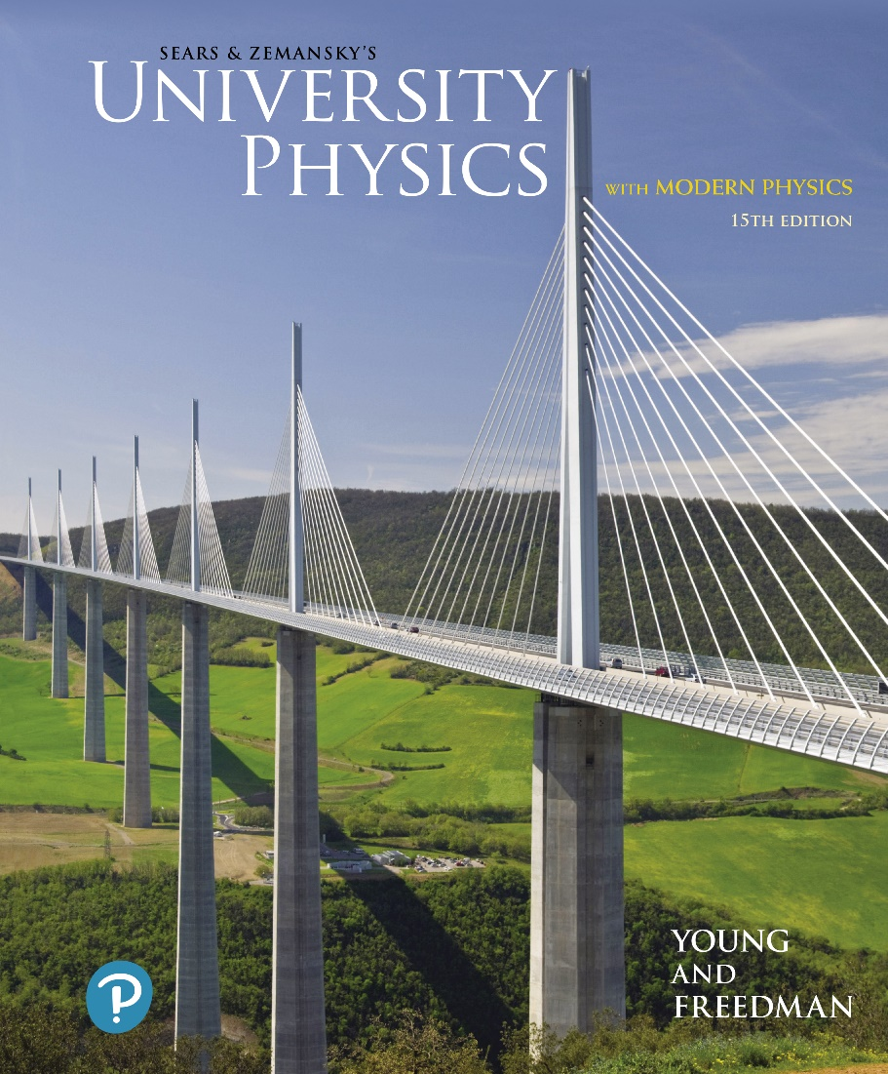
University Physics with Modern Physics
Fifteenth Edition
Chapter 4
Newton’s Laws of Motion
Copyright © 2020 Pearson Education, Inc. All Rights Reserved

Slide 2
Learning Outcomes
In this chapter, you’ll learn…
what the concept of force means in physics, why forces are vectors, and the significance of the net force on an object.
what happens when the net force on an object is zero, and the significance of inertial frames of reference.
how the acceleration of an object is determined by the net force on the object and the object’s mass.
the difference between the mass of an object and its weight.
how the forces that two objects exert on each other are related.

Slide 3
Introduction
We’ve seen how to use kinematics to describe motion in one, two, or three dimensions.
But what causes objects to move the way that they do?
The answer takes us into the subject of dynamics, the relationship of motion to the forces that cause it.
The principles of dynamics were clearly stated for the first time by Sir Isaac Newton; today we call them Newton’s laws of motion.
Newton did not derive these laws, but rather deduced them from a multitude of experiments performed by other scientists.

Slide 4
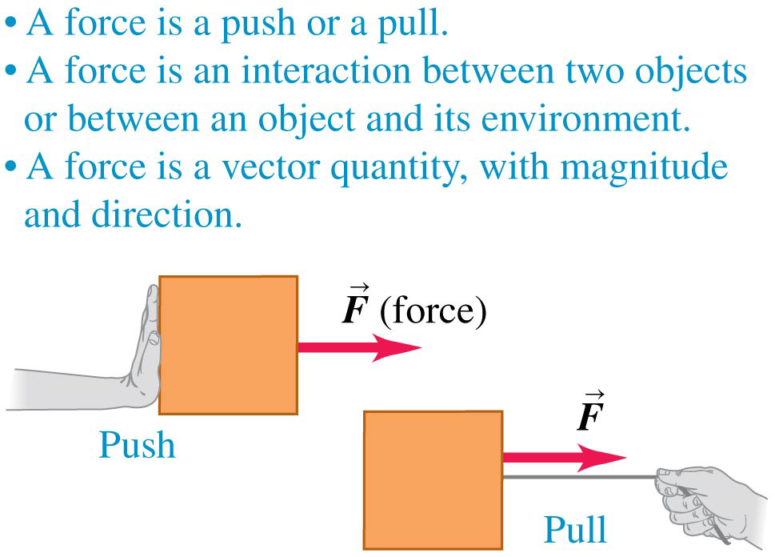
What Are Some Properties of a Force?

Slide 5
There Are Four Common Types of Forces: Normal
The normal force is a contact force.

Slide 6
There Are Four Common Types of Forces: Friction
Friction is a contact force.

Slide 7
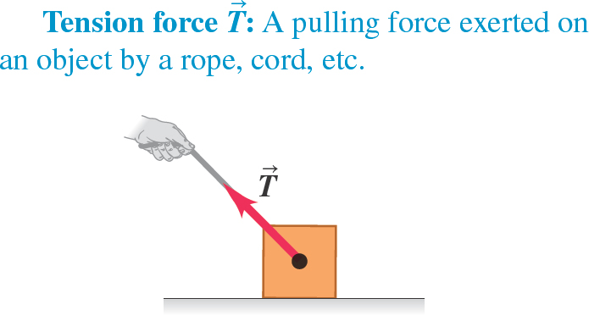
There Are Four Common Types of Forces: Tension
Tension is a contact force.

Slide 8
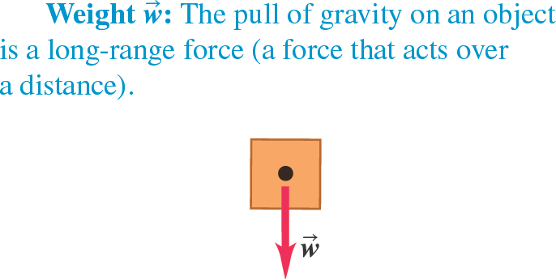
There Are Four Common Types of Forces: Weight
Weight is a long-range force.

Slide 9
What Are the Magnitudes of Common Forces?
The SI unit of the magnitude of force is the newton, abbreviated N. Some typical force magnitudes are:
Sun’s gravitational force on the earth | 3.5 times 10 to the 20 second newtons
Weight of a large blue whale | 1.9 times 10 to the sixth newtons
Maximum pulling force of a locomotive | 8.9 times 10 to the fifth newtons
Weight of a 250-lb linebacker | 1.1 times 10 cubed newtons
Weight of a medium apple
Weight of the smallest insect eggs | 2 times 10 to the negative sixth newtons
Electric attraction between the proton and the electron in a hydrogen atom | 8.2 times 10 to the negative eighth newtons
Weight of a very small bacterium | 1 times 10 to the eighteenth newtons
Weight of a hydrogen atom | 1.6 times 10 to the negative 20 sixth newtons
Weight of an electron | 8.9 times 10 to the negative thirtieth newtons
Gravitational attraction between the proton and the electron in a hydrogen atom | 3.6 times 10 to the negative 40 seventh newtons
1 ✕ 10⁰ N

Slide 10
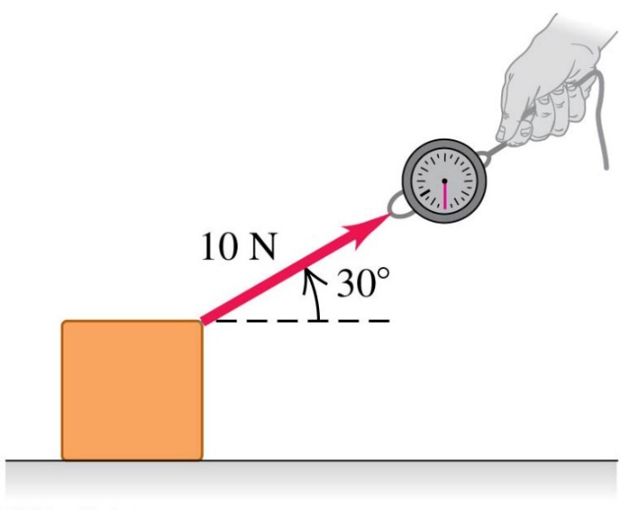
Drawing Force Vectors
The figure shows a spring balance being used to measure a pull that we apply to a box.
We draw a vector to represent the applied force.
The length of the vector shows the magnitude; the longer the vector, the greater the force magnitude.

Slide 11
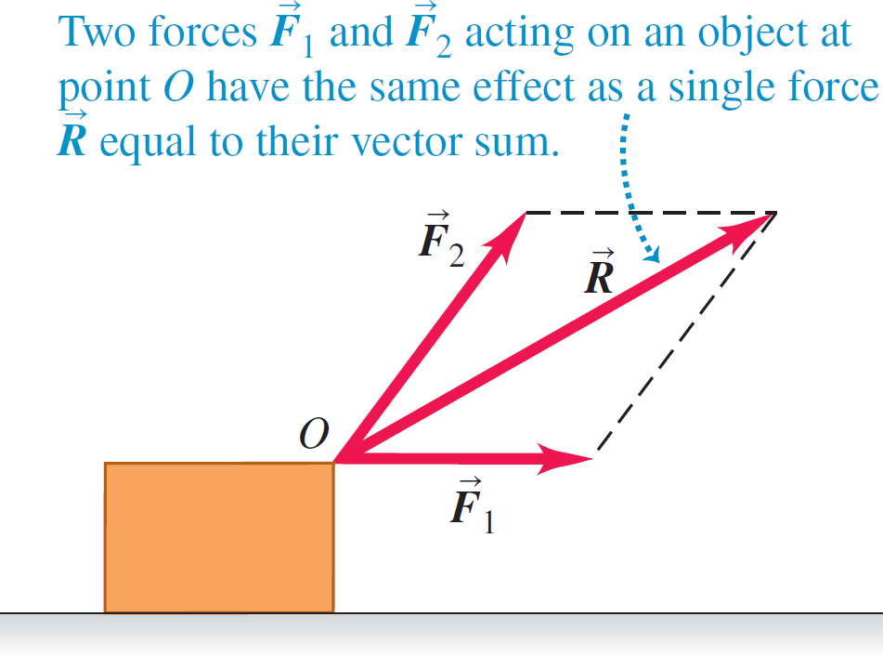
Superposition of Forces
Several forces acting at a point on an object have the same effect as their vector sum acting at the same point.

Slide 12
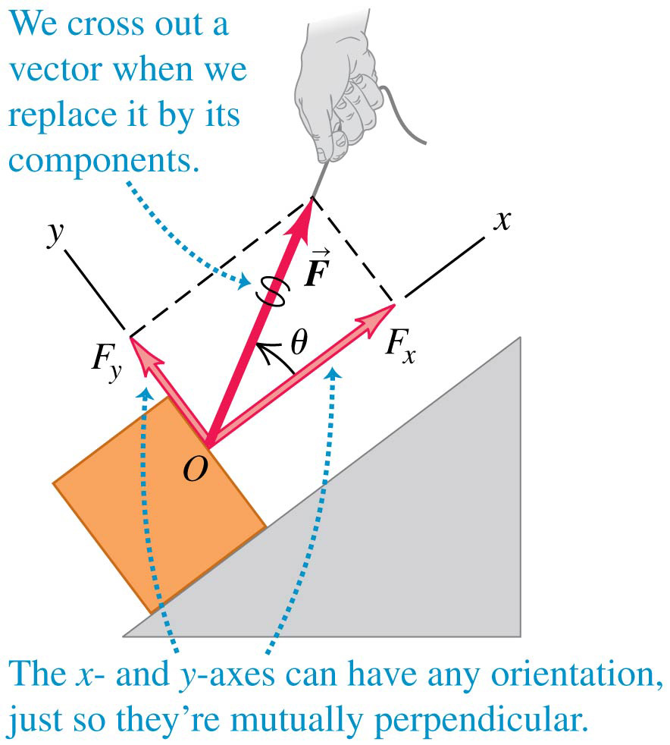
Decomposing a Force into Its Component Vectors
Choose perpendicular x- and y-axes.
F_{x} and F_{y} are the components of a force along these axes.
Use trigonometry to find these force components.
Video Tutor Solution: Example 4.1

Slide 13
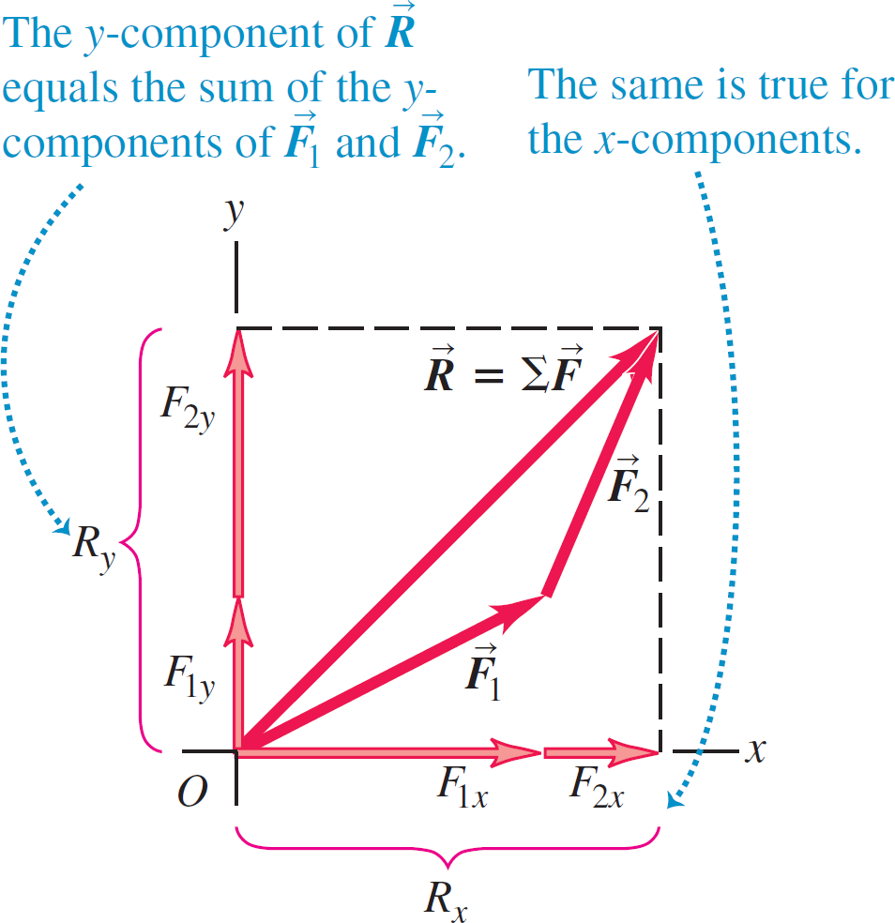
Notation for the Vector Sum
The vector sum of all the forces on an object is called the resultant of the forces or the net force:

Slide 14
Newton's First Law (1 of 2)
When an object is either at rest or moving with constant velocity (in a straight line with constant speed), we say that the object is in equilibrium.
For an object to be in equilibrium, it must be acted on by no forces, or by several forces such that their vector sum—that is, the net force—is zero:

Slide 15
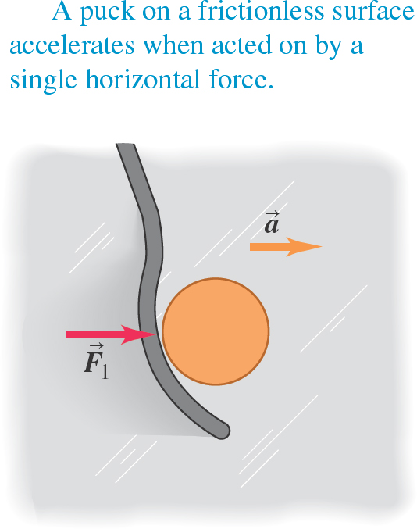
Net Force Causes Acceleration
A hockey puck accelerates in the direction of a net applied force.

Slide 16
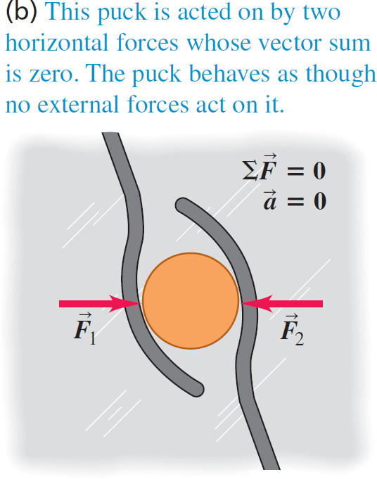
Newton's First Law (2 of 2)
When the net force is zero, the acceleration is zero, and the puck is in equilibrium.

Slide 17
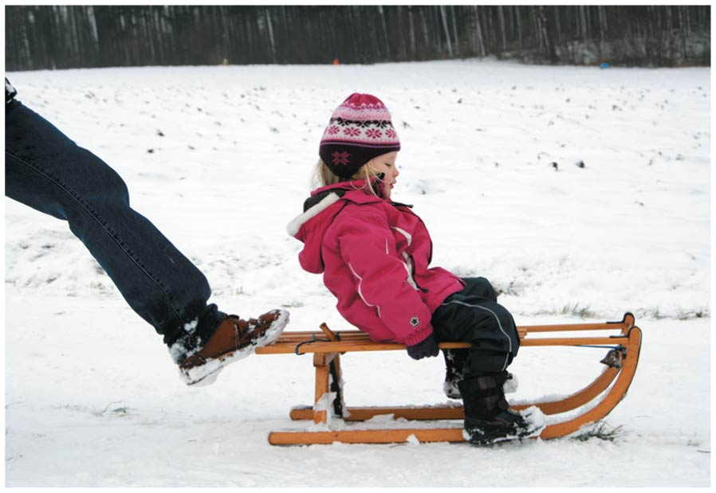
Sledding with Newton's First Law
The downward force of gravity acting on the child and sled is balanced by an upward normal force exerted by the ground.
The adult’s foot exerts a forward force that balances the backward force of friction on the sled.
Hence there is no net external force on the child and sled, and they slide with a constant velocity.

Slide 18
When Is Newton's First Law Valid?
Suppose you are in a bus that is traveling on a straight road and speeding up.
If you could stand in the aisle on roller skates, you would start moving backward relative to the bus as the bus gains speed.
It looks as though Newton’s first law is not obeyed; there is no net force acting on you, yet your velocity changes.
The bus is accelerating with respect to the earth and is not a suitable frame of reference for Newton’s first law.
A frame of reference in which Newton’s first law is valid is called an inertial frame of reference.

Slide 19
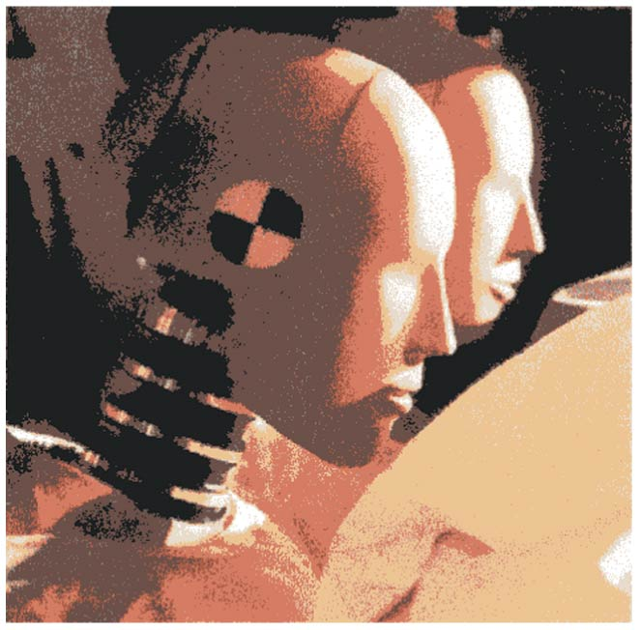
Crash Test Dummies
From the frame of reference of the car, it seems as though a force is pushing the crash test dummies forward as the car comes to a sudden stop.
But there is really no such force: As the car stops, the dummies keep moving forward as a consequence of Newton’s first law.

Slide 20
An Object Undergoing Uniform Circular Motion
As we have already seen, an object in uniform circular motion is accelerated toward the center of the circle. So the net external force on the object must point toward the center of the circle.

Slide 21
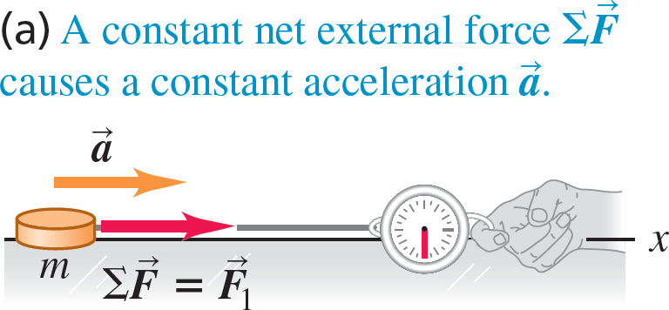
Force and Acceleration (1 of 2)
of an object is directly proportional to the net external force
The acceleration
on the object.

Slide 22
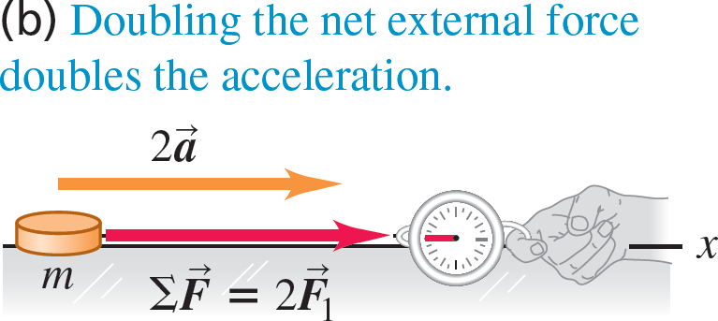
Force and Acceleration (2 of 3)
of an object is directly proportional to the net external force
The acceleration
on the object.

Slide 23
Force and Acceleration (3 of 3)
of an object is directly proportional to the net external force
The acceleration
on the object.

Slide 24
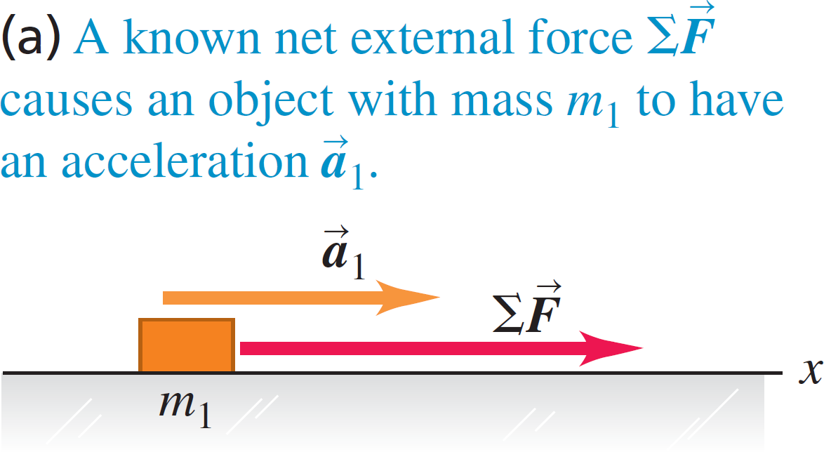
Mass and Acceleration (1 of 3)
The acceleration of an object is inversely proportional to the object’s mass if the net external force remains fixed.

Slide 25
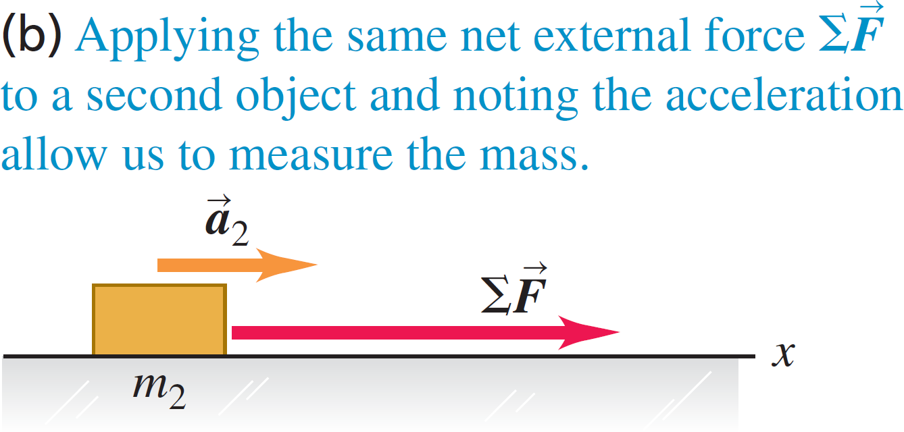
Mass and Acceleration (2 of 3)
The acceleration of an object is inversely proportional to the object’s mass if the net external force remains fixed.

Slide 26
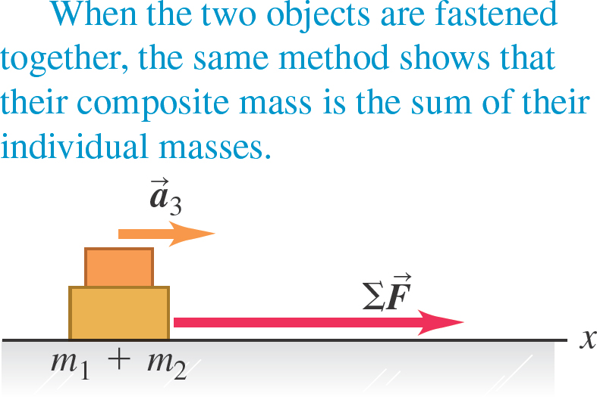
Mass and Acceleration (3 of 3)
The acceleration of an object is inversely proportional to the object’s mass if the net external force remains fixed.

Slide 27
Newton's Second Law of Motion
The acceleration of an object is directly proportional to the net external force acting on it, and inversely proportional to the mass of the object.
The S I unit for force is the newton (N).
Video Tutor Solution: Example 4.4

Slide 28
Systems of Units: Table 4.2
We will use the SI system.
In the British system, force is measured in pounds, distance in feet, and mass in slugs.
In the cgs system, mass is in grams, distance in centimeters, and force in dynes.
System of Units | Force | Mass | Acceleration
SI | newton (N) | kilogram (kg) | meters per second squared
cgs | dyne (dyn) | gram (g) | centimeters per second squared
British | pound (lb) | slug | feet per second squared

Slide 29
Mass and Weight
The weight of an object (on the earth) is the gravitational force that the earth exerts on it.
The weight w of an object of mass m is:
The value of g depends on altitude.
On other planets, g will have an entirely different value than on the earth.
Video Tutor Demonstration: Tension in String Between Hanging Weights

Slide 30
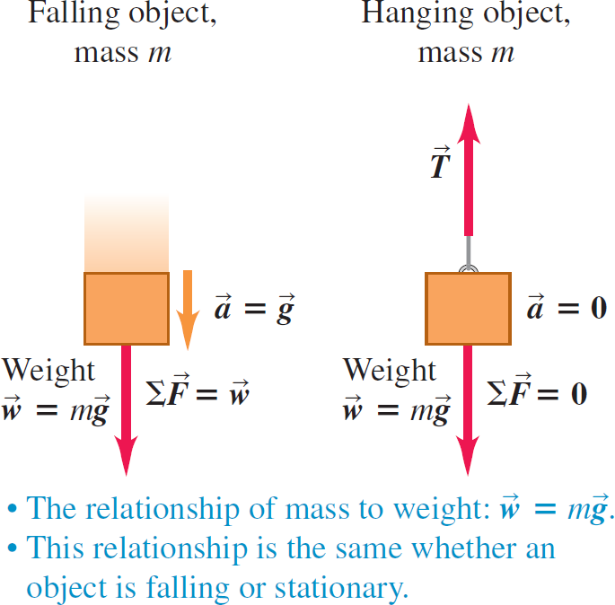
Relating the Mass and Weight of a Object

Slide 31
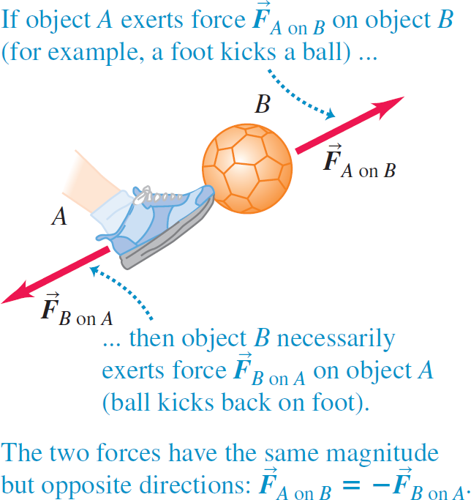
Newton's Third Law (1 of 2)
Video Tutor Demonstration: Cart with Fan and Sail

Slide 32
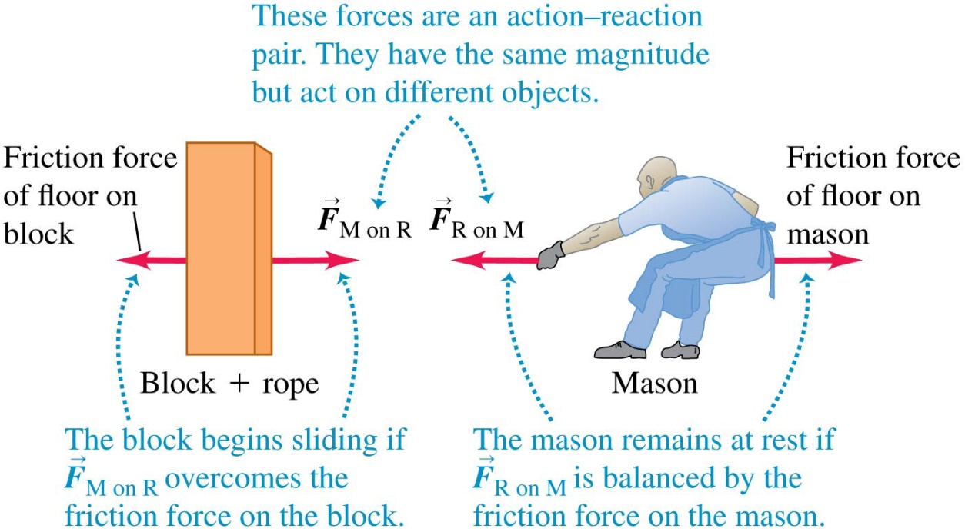
A Paradox?
If an object pulls back on you just as hard as you pull on it, how can it ever accelerate?
Video Tutor Demonstration: Weighing a Hovering Magnet

Slide 33
Newton's Third Law (2 of 2)
The simple act of walking depends crucially on Newton’s third law.
To start moving forward, you push backward on the ground with your foot.
As a reaction, the ground pushes forward on your foot (and hence on your body as a whole) with a force of the same magnitude.
This external force provided by the ground is what accelerates your body forward.

Slide 34
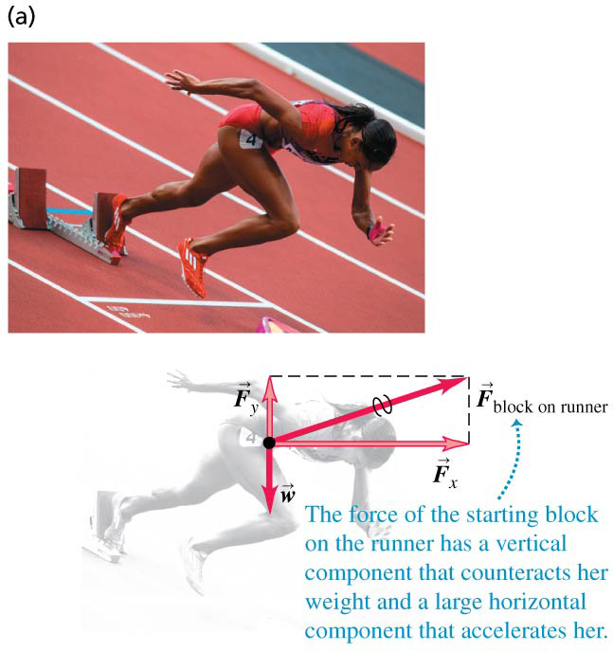
Free-Body Diagrams (1 of 2)

Slide 35
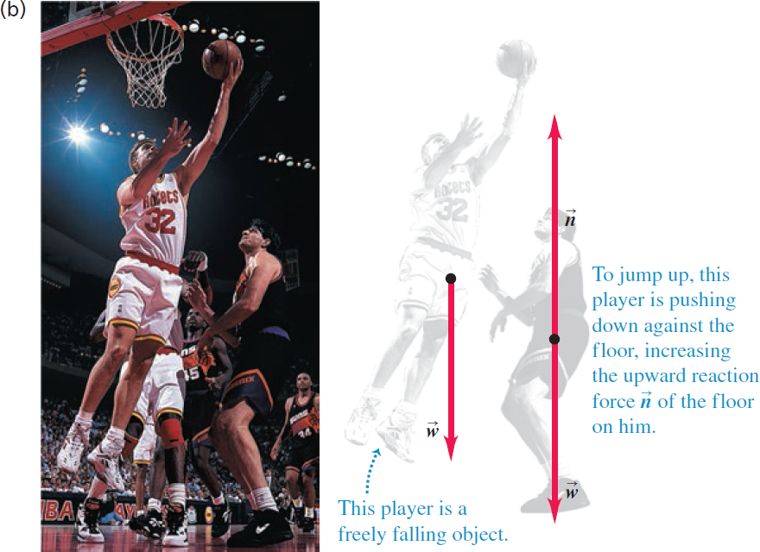
Free-Body Diagrams (2 of 2)

