Slide 1
University Physics with Modern Physics
Fifteenth Edition
Chapter 12
Fluid Mechanics
Copyright © 2020 Pearson Education, Inc. All Rights Reserved

Slide 2
Learning Outcomes
In this chapter, you’ll learn…
the meaning of the density and pressure of a fluid, and how they are measured.
how to calculate the buoyant force that a fluid exerts on an object immersed in it.
how to use Bernoulli’s equation to relate pressure and flow speed at different points in certain types of flow.
the significance of laminar versus turbulent fluid flow, and how the speed of flow in a tube depends on the tube’s size.
how viscous flow and turbulent flow differ from ideal flow.

Slide 3
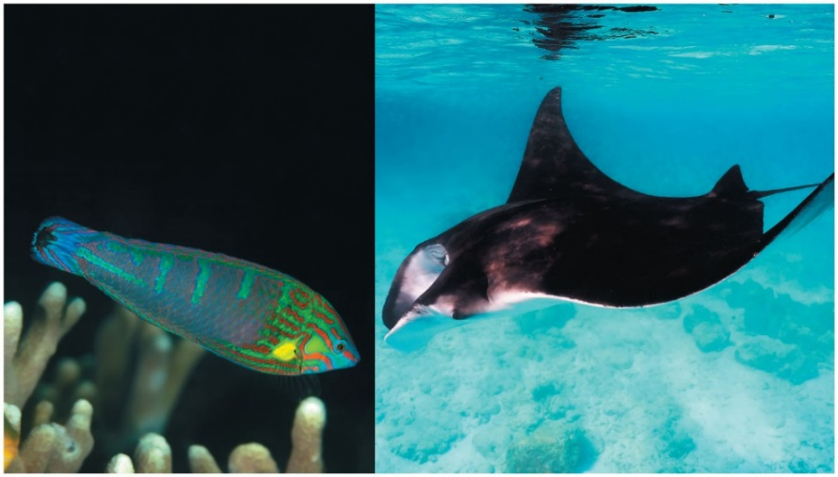
Introduction
A colorful tail-spot wrasse is about 10 cm long and can float in the ocean with little effort.
A manta ray is more than 5 m across and must “flap” its fins continuously to keep from sinking.
The differences have to do with fluid mechanics.
We begin with fluids at rest and then move on to the more complex field of fluid dynamics.

Slide 4
Density (1 of 2)
An important property of any material, fluid or solid, is its density, defined as its mass per unit volume.
A homogeneous material such as ice or iron has the same density throughout.
For a homogeneous material,
The SI unit of density is the kilogram per cubic meter

Slide 5
Density (2 of 2)
Here are two objects with different masses and different volumes, but the same density.

Slide 6
Densities of Some Common Substances
Material | Densitykilograms per cubic meter
Air (1 atm, 20 degrees Celsius) | 1.20 ✕ 10⁰
Ice | ^{0.92 times 10 cubed}
Water | ^{1.00 times 10 cubed}
Blood | ^{1.06 times 10 cubed}
Aluminum | ^{2.7 times 10 cubed}
Lead | ^{11.3 times 10 cubed}
Gold | ^{19.3 times 10 cubed}

Slide 7
Pressure in a Fluid
A fluid exerts a force perpendicular to any surface in contact with it, such as a container wall or an object immersed in the fluid.
Consider a small surface of area dA within a fluid at rest, centered on a point in the fluid.
We define the pressure p at that point as:
The SI unit of pressure is the pascal, where

Slide 8
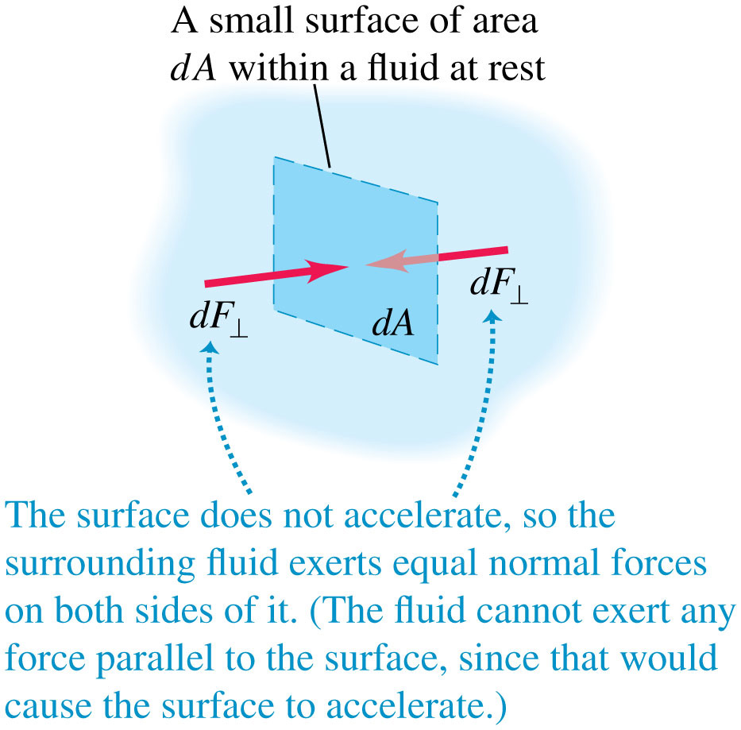
Pressure
Here are the forces acting on a small surface within a fluid at rest.

Slide 9
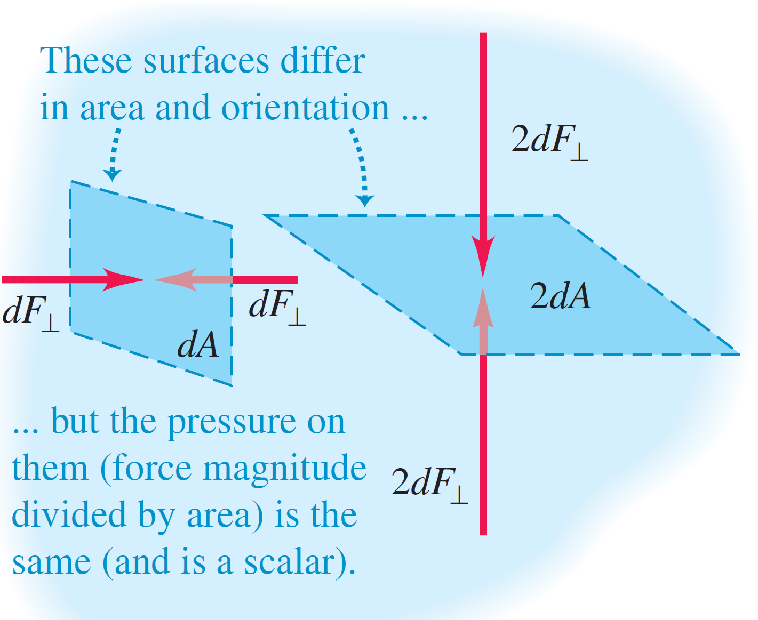
Pressure Is a Scalar Quantity

Slide 10
Pressure at Depth in a Fluid (1 of 2)
The pressure at a depth h in a fluid is greater than the pressure p₀ at the surface:
Video Tutor Solution: Example 12.4

Slide 11
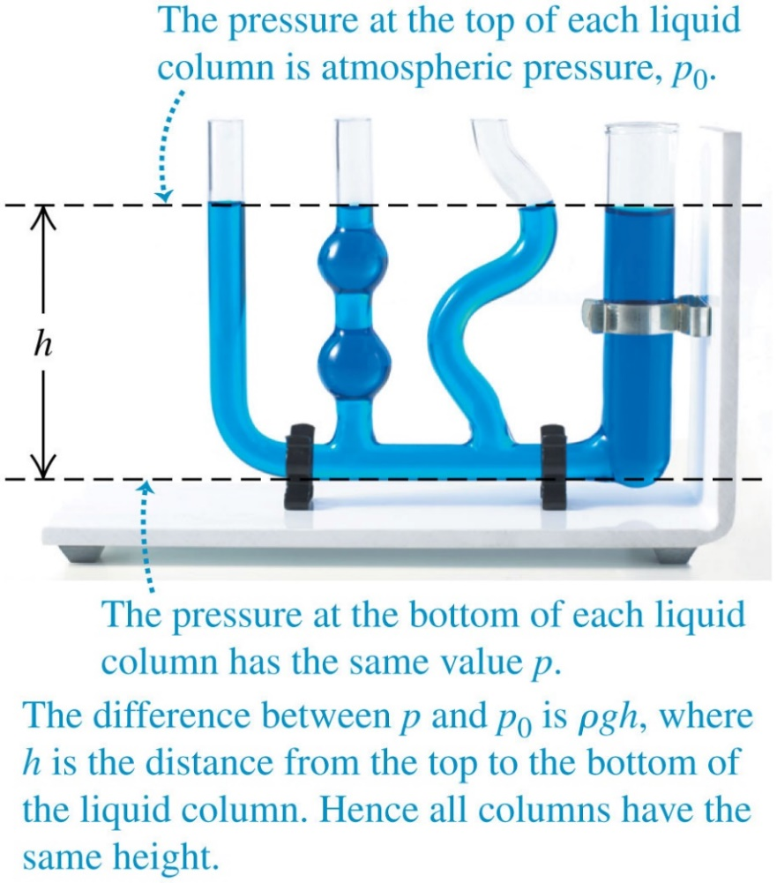
Pressure at Depth in a Fluid (2 of 2)
Each fluid column has the same height, no matter what its shape.
Video Tutor Demonstration: Water Level in Pascal’s Vases

Slide 12
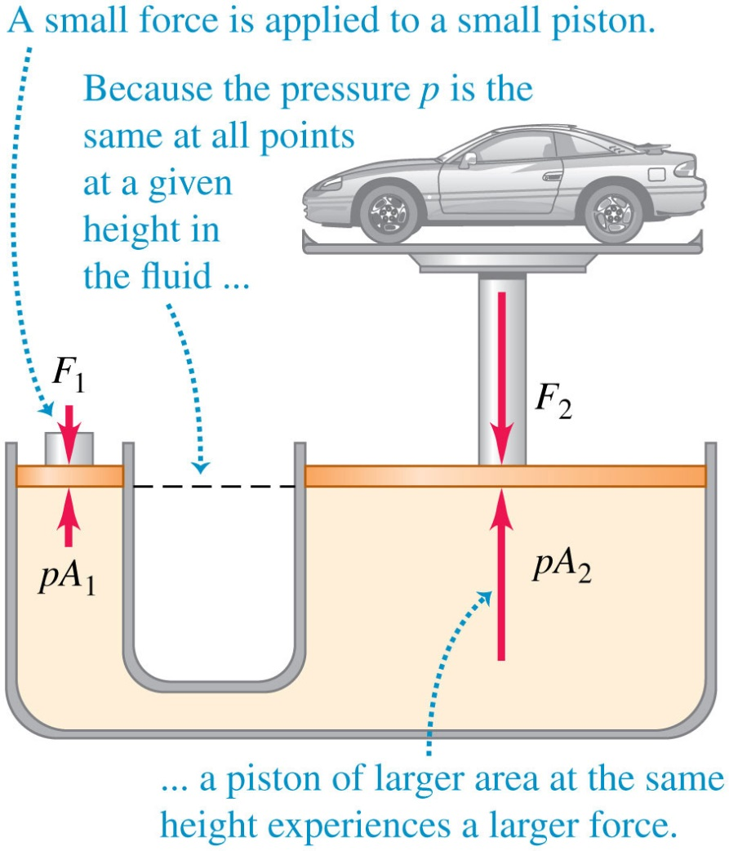
Pascal’s law
Pressure applied to an enclosed fluid is transmitted undiminished to every portion of the fluid and the walls of the containing vessel:

Slide 13
Absolute Pressure and Gauge Pressure
When we say that the pressure in a car tire is “32 psi” (2.2 × 10⁵ Pa), we mean that it is greater than atmospheric pressure by this amount.
The total pressure in the tire is greater by p_{atm}.
The excess pressure above atmospheric pressure is usually called gauge pressure.
The total pressure is called absolute pressure.
If the pressure is less than atmospheric, as in a partial vacuum, the gauge pressure is negative.

Slide 14
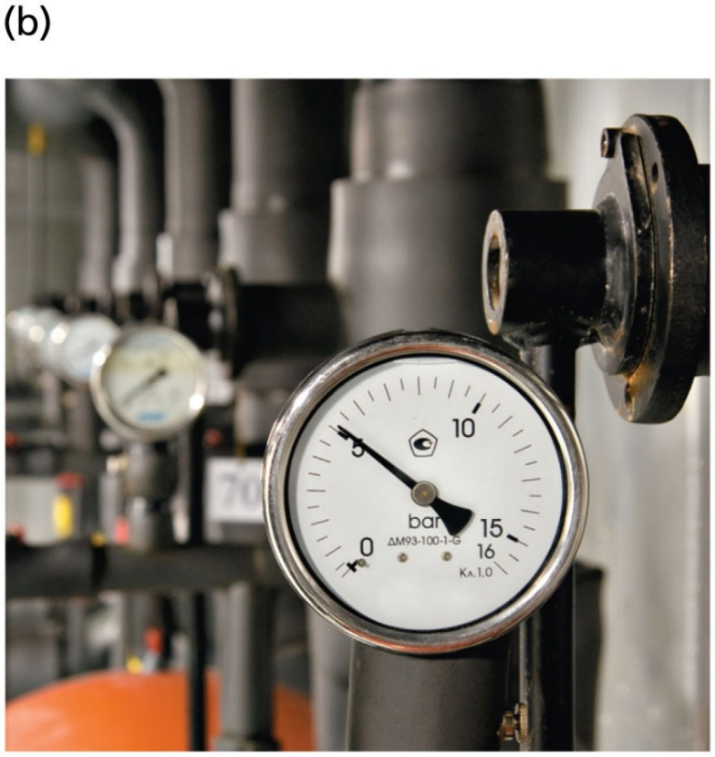
Pressure Gauges
This Bourdon-type pressure gauge is connected to a high-pressure gas line.
The gauge pressure shown is just over 5 bars

Slide 15
Blood Pressure
Blood-pressure readings, such as 130/80, give the maximum and minimum gauge pressures in the arteries, measured in “mm Hg” or “torr.”
Blood pressure varies with vertical position within the body.
The standard reference point is the upper arm, level with the heart.

Slide 16
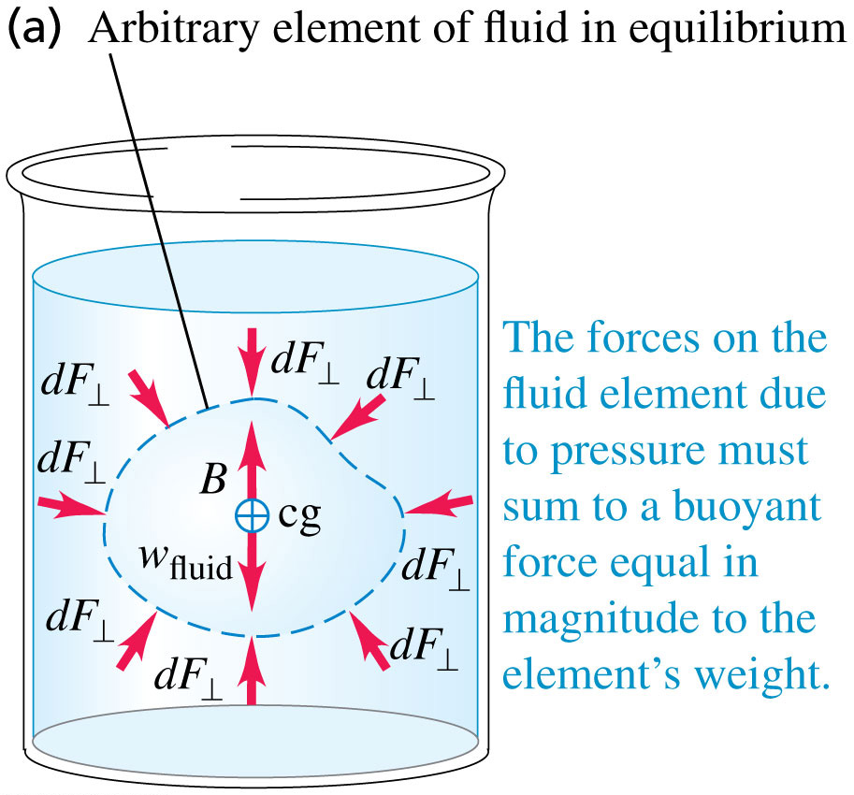
Archimedes's Principle: Proof Step 1

Slide 17
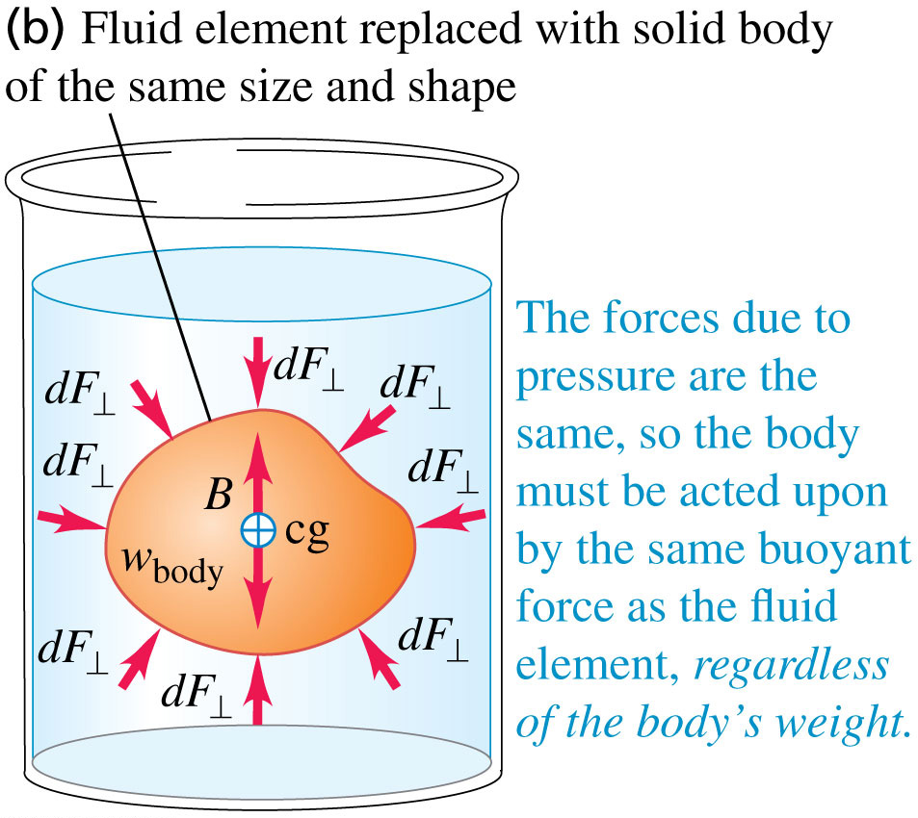
Archimedes's Principle: Proof Step 2

Slide 18
Archimedes's Principle
An object immersed in water seems to weigh less than when it is in air.
When the object is less dense than the fluid, it floats.
The human body usually floats in water, and a helium-filled balloon floats in air.
These are examples of buoyancy, a phenomenon described by Archimedes’s principle:
When an object is completely or partially immersed in a fluid, the fluid exerts an upward force on the object equal to the weight of the fluid displaced by the object.
Video Tutor Demonstration: Weighing Weights in Water

Slide 19
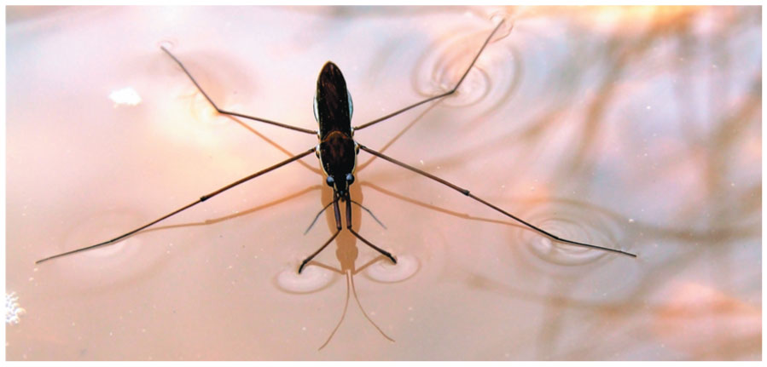
Surface Tension (1 of 2)
The surface of the water acts like a membrane under tension, allowing this water strider to “walk on water.”

Slide 20
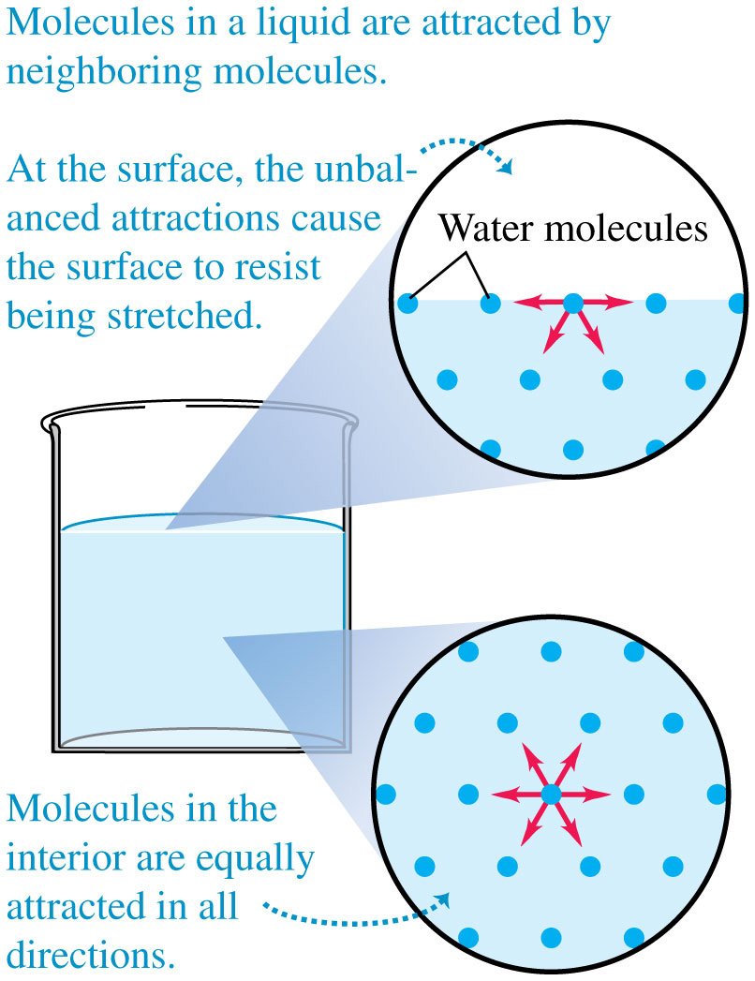
Surface Tension (2 of 2)
A molecule at the surface of a liquid is attracted into the bulk liquid, which tends to reduce the liquid’s surface area.

Slide 21
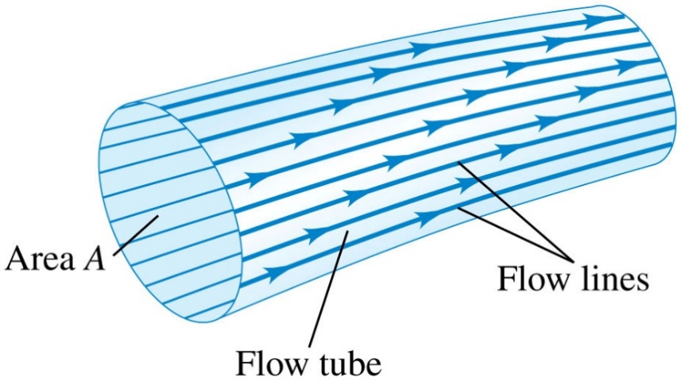
Fluid Flow (1 of 2)
The path of an individual particle in a moving fluid is called a flow line.
In steady flow, the overall flow pattern does not change with time, so every element passing through a given point follows the same flow line.
In steady flow no fluid can cross the side walls of a given flow tube.

Slide 22
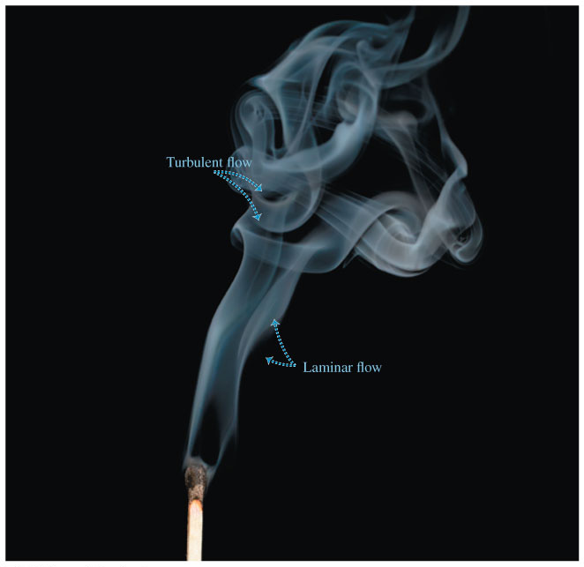
Fluid Flow (2 of 2)
In laminar flow, adjacent layers of fluid slide smoothly past each other and the flow is steady.
At sufficiently high flow rates, the flow can become turbulent.
In turbulent flow there is no steady-state pattern; the flow pattern changes continuously.

Slide 23
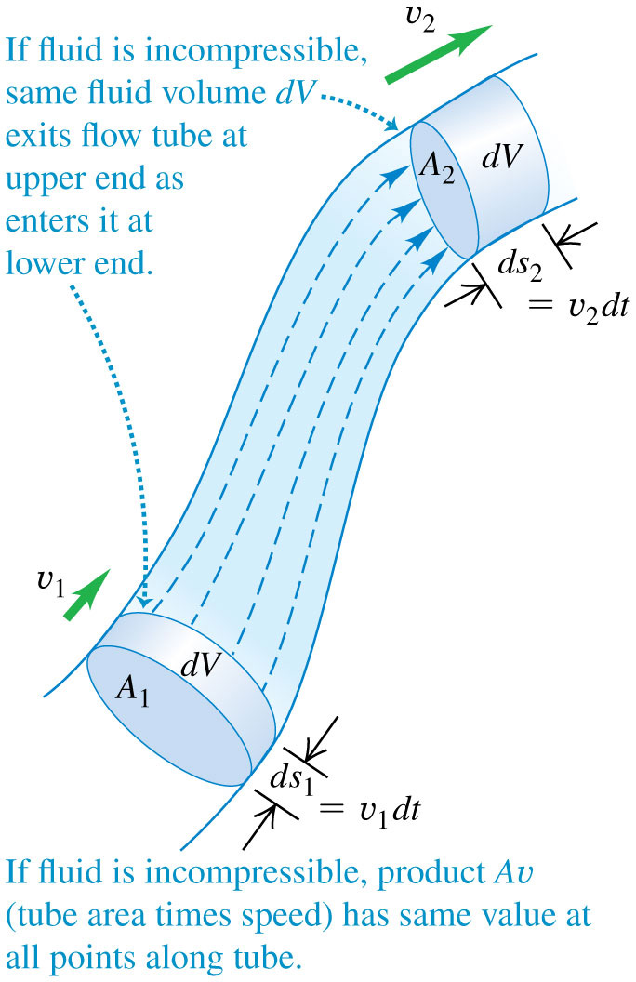
The Continuity Equation (1 of 2)
The figure at the right shows a flow tube with changing cross-sectional area.
The continuity equation for an incompressible fluid is A₁v₁ = A₂v₂.
The volume flow rate is

Slide 24
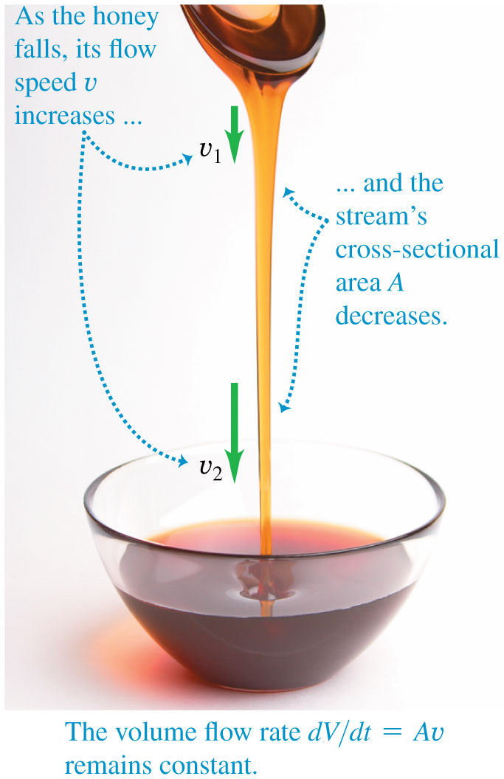
The Continuity Equation (2 of 2)
The continuity equation helps explain the shape of a stream of honey poured from a spoon.

Slide 25
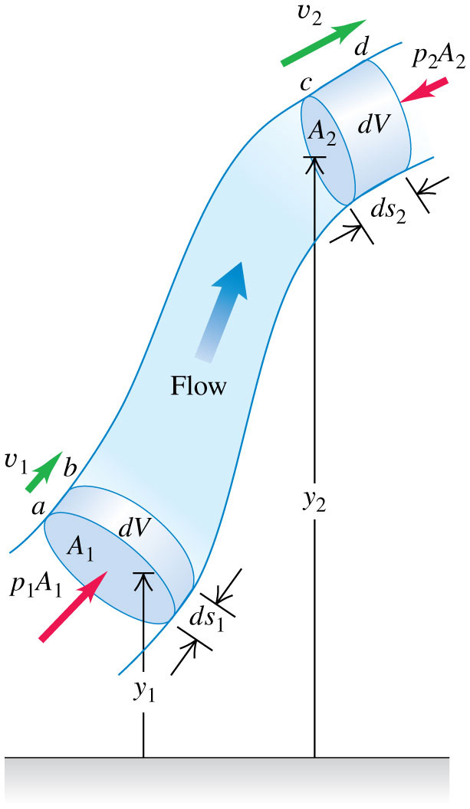
Bernoulli's Equation
Bernoulli’s equation is:
It is due to the fact that the work done on a unit volume of fluid by the surrounding fluid is equal to the sum of the changes in kinetic and potential energies per unit volume that occur during the flow.
Video Tutor Solution: Example 12.7

Slide 26
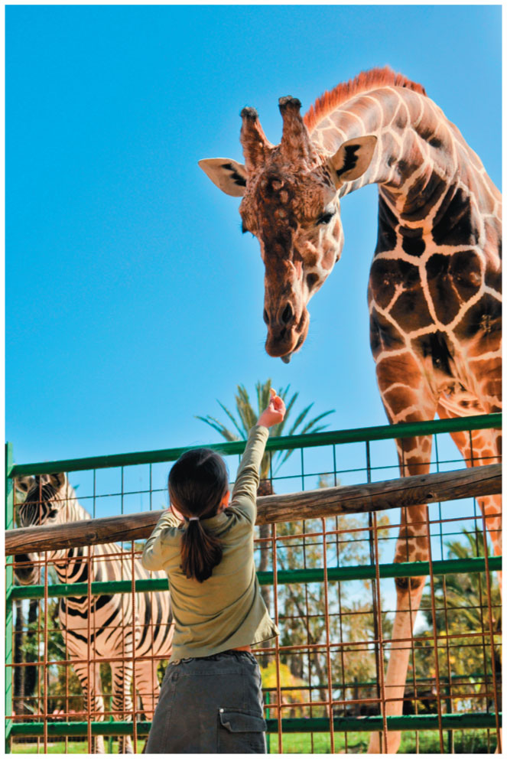
Why Healthy Giraffes Have High Blood Pressure
Bernoulli’s equation suggests that as blood flows upward at roughly constant speed v from the heart to the brain, the pressure p will drop as the blood’s height y increases.
For blood to reach the brain with the required minimal pressure, the giraffe’s maximum (systolic) blood pressure must be 280 mm Hg!

Slide 27
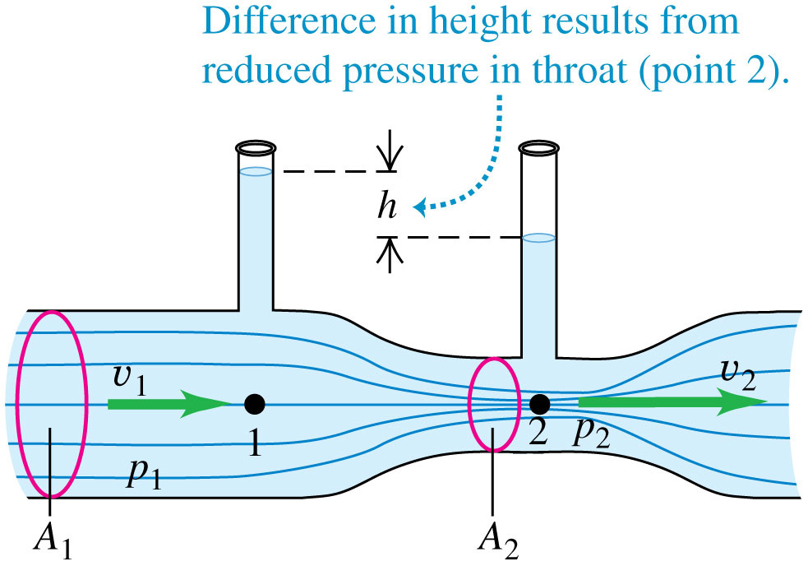
The Venturi Meter
The pressure is less at point 2 because the fluid flow speed is greater.

Slide 28
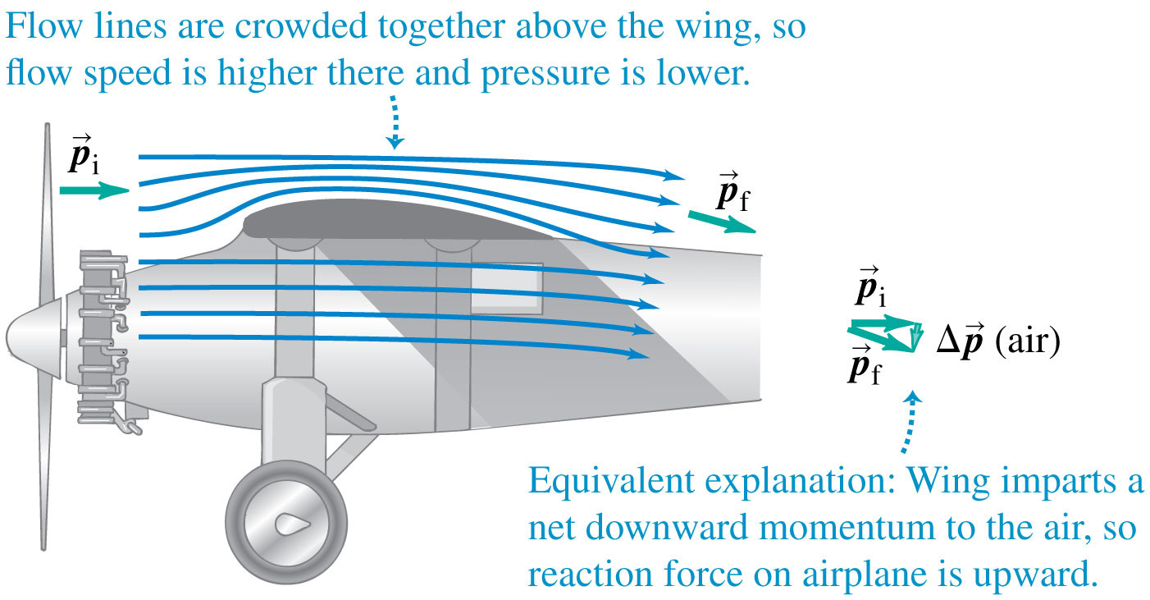
Lift on an Airplane Wing (1 of 2)
Bernoulli’s principle helps to explain how airplanes fly.

Slide 29
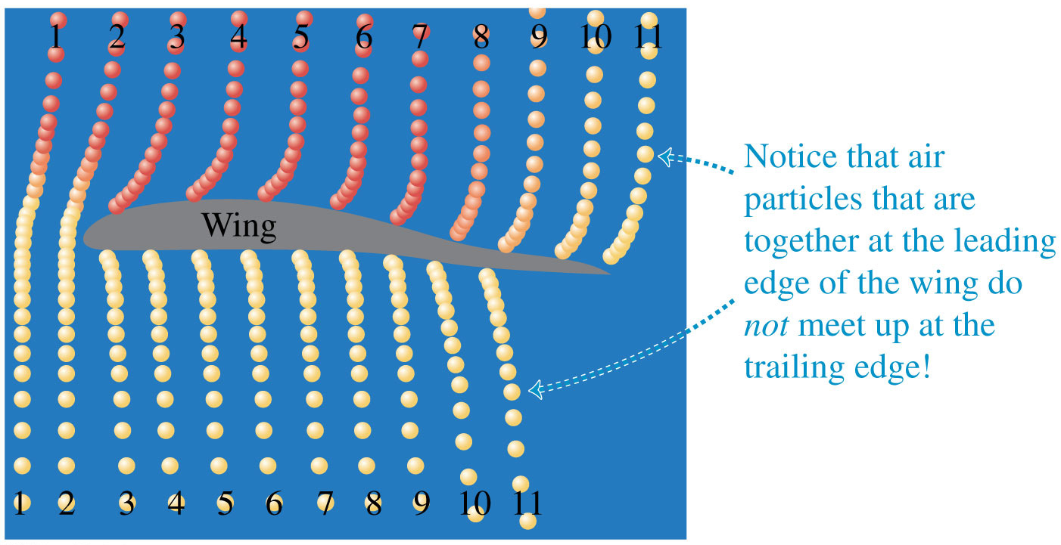
Lift on an Airplane Wing (2 of 2)
Computer simulation of air parcels flowing around a wing, showing that air moves much faster over the top than over the bottom.

Slide 30
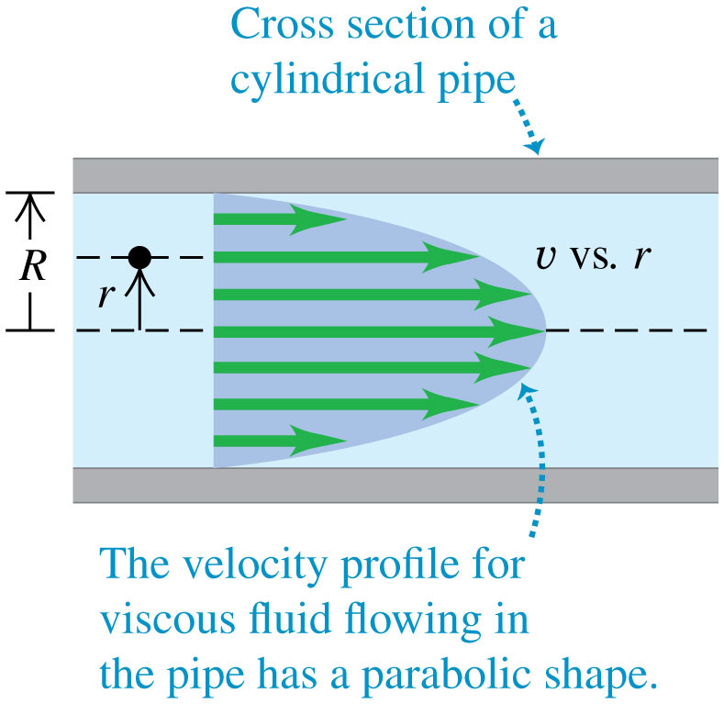
Viscosity (1 of 2)
Viscosity is internal friction in a fluid.
Due to viscosity, the speed is zero at the pipe walls (to which the fluid clings) and is greatest at the center of the pipe.

Slide 31
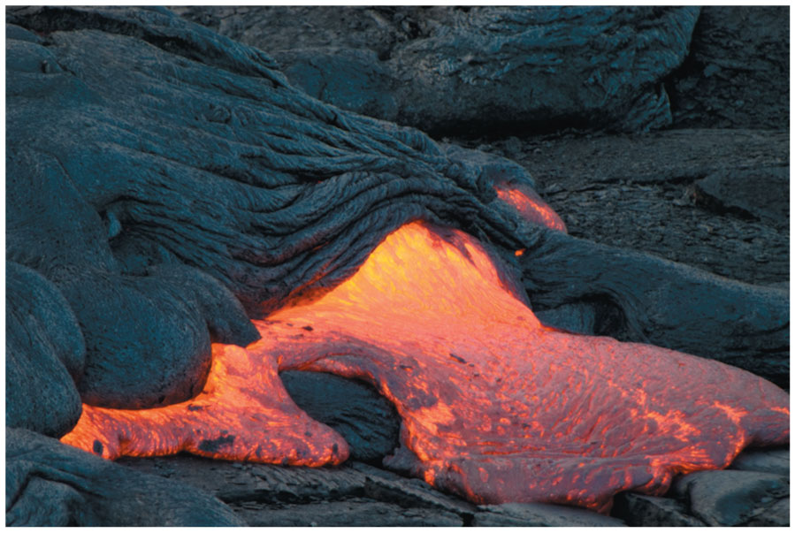
Viscosity (2 of 2)
Lava is an example of a viscous fluid.
The viscosity decreases with increasing temperature: The hotter the lava, the more easily it can flow.

Slide 32
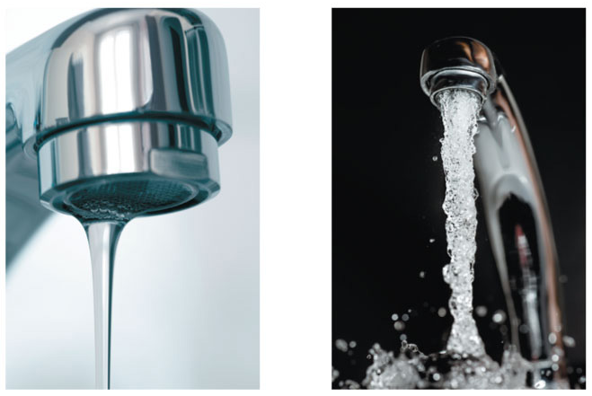
Turbulence
At low flow speeds, the flow of a fluid of a given viscosity is laminar.
When a critical speed is exceeded, however, the flow pattern becomes turbulent.
Video Tutor Solution: Example 12.11

Slide 33
Listening for Turbulent Flow
Normal blood flow in the human aorta is laminar, but a small disturbance such as a heart pathology can cause the flow to become turbulent.
Turbulence makes noise, which is why listening to blood flow with a stethoscope is a useful diagnostic technique.

