Slide 1
University Physics with Modern Physics
Fifteenth Edition
Chapter 11
Equilibrium and Elasticity
Copyright © 2020 Pearson Education, Inc. All Rights Reserved

Slide 2
Learning Outcomes
In this chapter, you’ll learn…
the conditions that must be satisfied for an object or structure to be in equilibrium.
what the center of gravity of an object is and how it relates to the object’s stability.
how to solve problems that involve rigid bodies in equilibrium.
how to analyze situations in which an object is deformed by tension, compression, pressure, or shear.
what happens when an object is stretched so much that it deforms or breaks.

Slide 3
Introduction
This Roman aqueduct uses the principle of the arch to sustain the weight of the structure and the water it carries.
In construction we’re interested in making sure that objects don’t accelerate.
Real materials are not truly rigid. They are elastic and do deform to some extent.

Slide 4
Conditions for Equilibrium
For an extended object to be in static equilibrium, two conditions must be satisfied.
The first condition is that the vector sum of all external forces acting on the object must be zero:
The second condition is that the sum of external torques must be zero about any point:

Slide 5
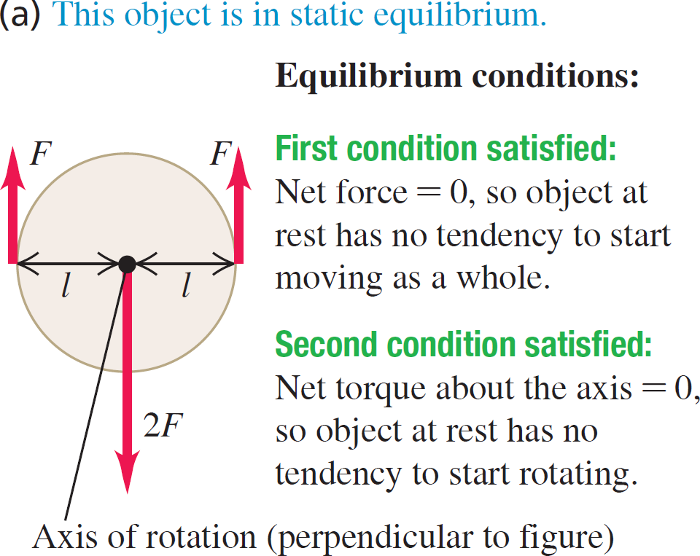
Conditions for Equilibrium: Example 1

Slide 6
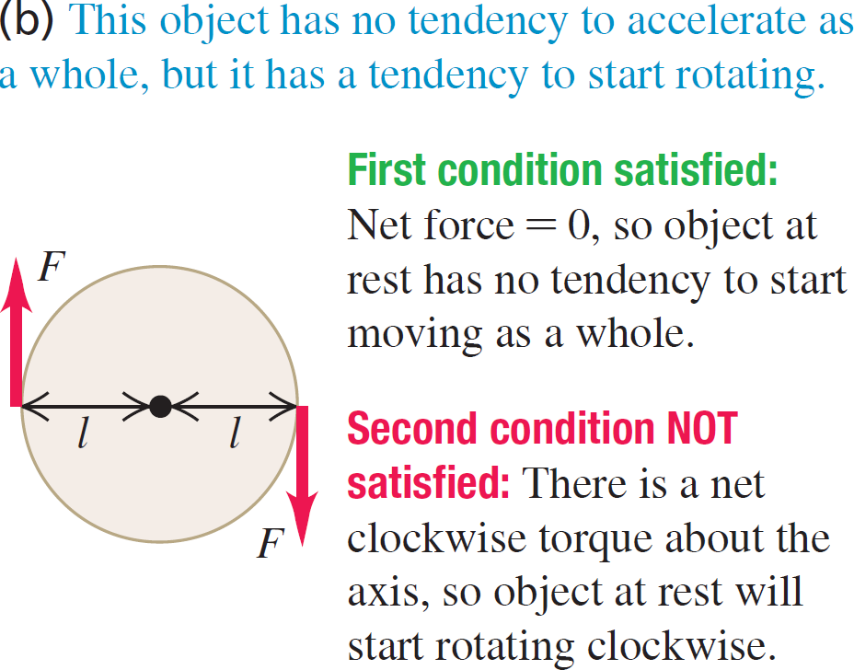
Conditions for Equilibrium: Example 2

Slide 7
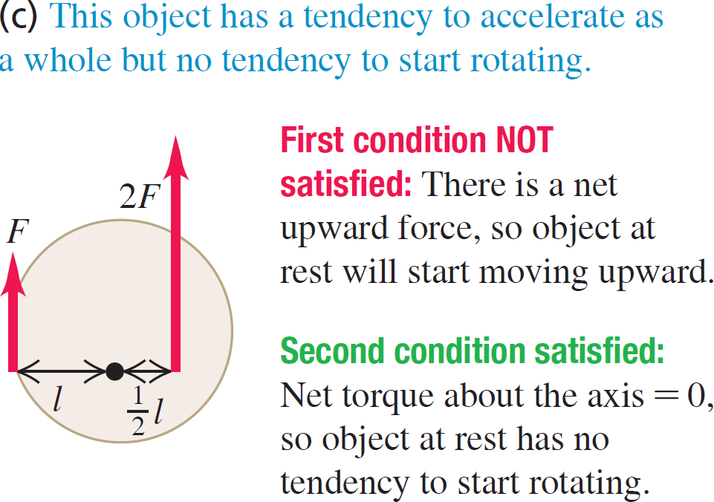
Conditions for Equilibrium: Example 3

Slide 8
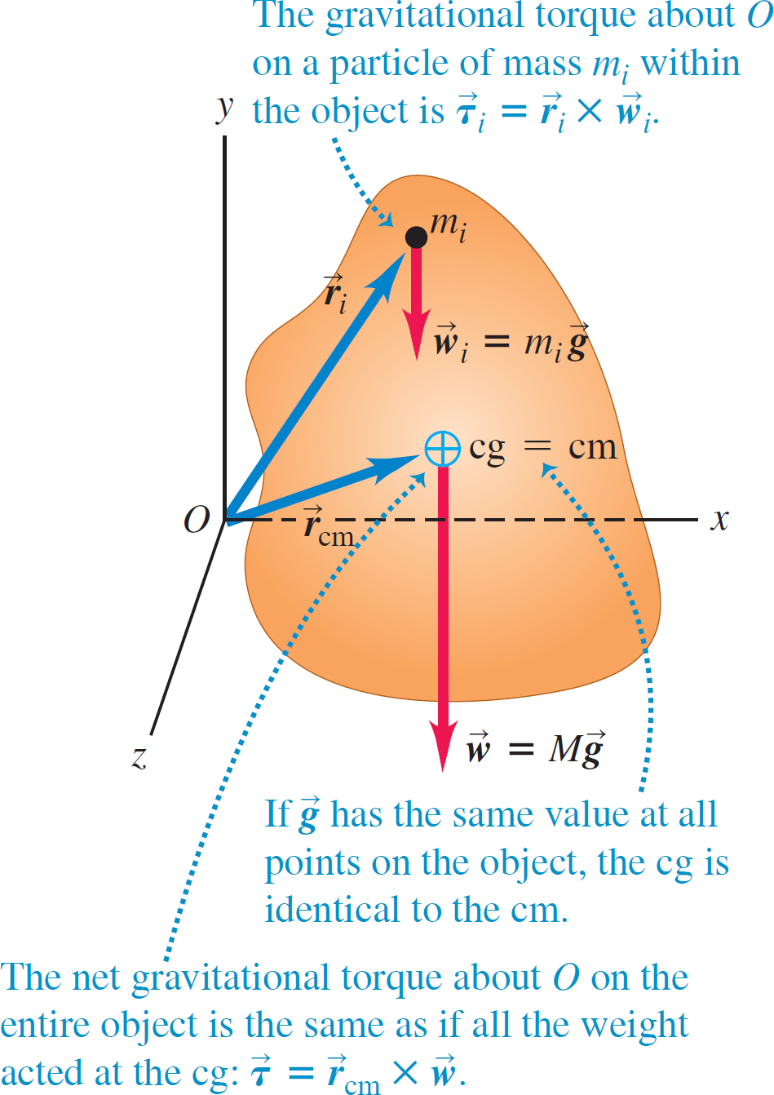
Center of Gravity (1 of 5)
We can treat an object’s weight as though it all acts at a single point: the center of gravity.
If we can ignore the variation of gravity with altitude, the center of gravity is the same as the center of mass.

Slide 9
Center of Gravity (2 of 5)
The acceleration due to gravity at the bottom of the 452-m-tall Petronas Towers in Malaysia is only 0.014% greater than at the top.
The center of gravity of the towers is only about 2 cm below the center of mass.

Slide 10
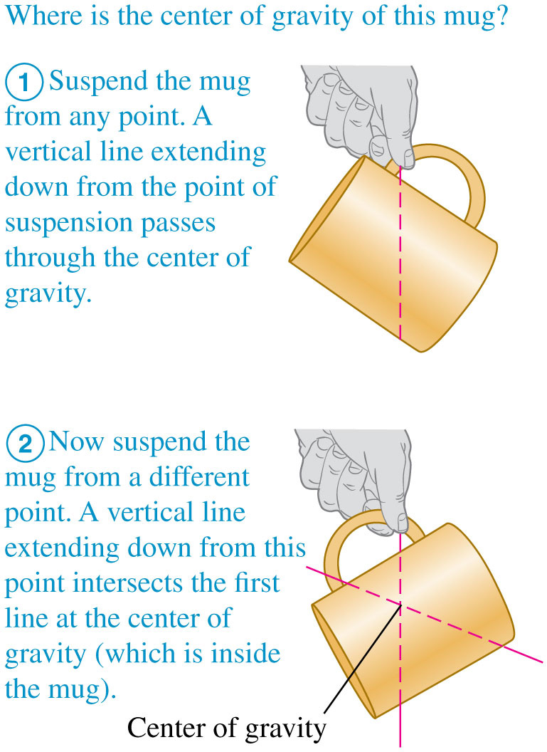
Center of Gravity (3 of 5)
When an object in rotational equilibrium and acted on by gravity is supported or suspended at a single point, the center of gravity is always at or directly above or below the point of suspension.

Slide 11
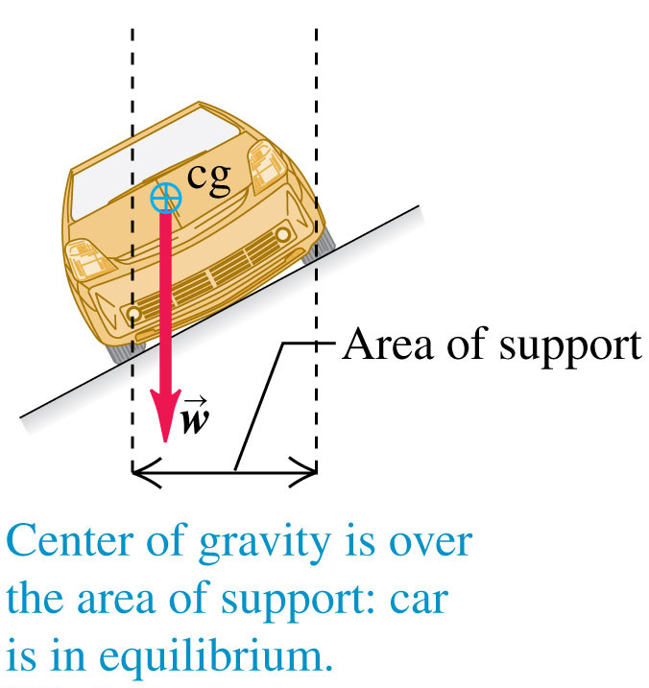
Center of Gravity (4 of 5)
To be in equilibrium, an object supported at several points must have its center of gravity somewhere within the area bounded by the supports.

Slide 12
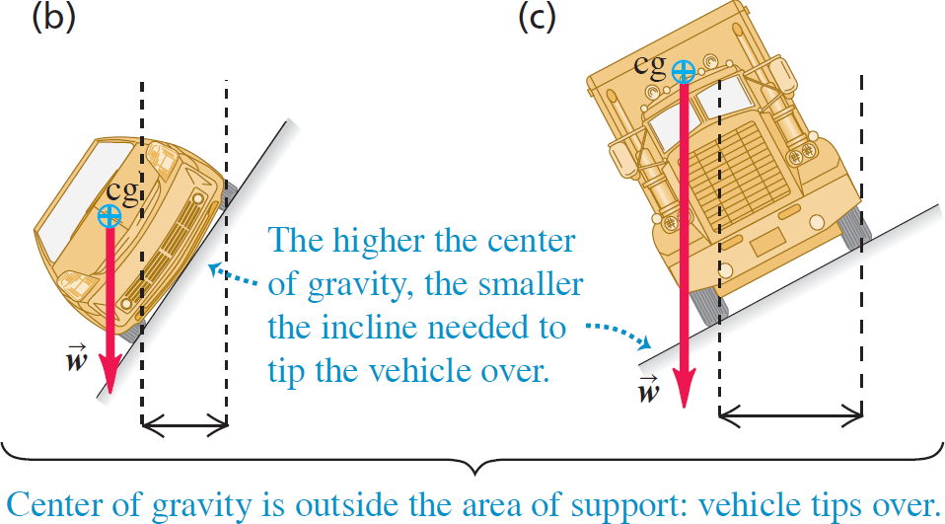
Center of Gravity (5 of 5)
An object is not in equilibrium if its center of gravity lies outside the area of support.

Slide 13
Problem-Solving Strategy for Static Equilibrium (1 of 2)
Identify the relevant concepts: The first and second conditions for equilibrium are ∑F_{x} = 0, ∑F_{y} = 0, and ∑τ_{z} = 0.
Set up the problem by using the following steps:
Sketch the physical situation and identify the object in equilibrium to be analyzed.
Draw a free-body diagram showing all forces acting on the object. Show the point on the object at which each force acts.
Choose coordinate axes and specify their direction. Specify a positive direction of rotation for torques.
Choose a reference point about which to compute torques.

Slide 14
Problem-Solving Strategy for Static Equilibrium (2 of 2)
Execute the solution as follows:
Write equations expressing the equilibrium conditions. Remember that ∑F_{x} = 0, ∑F_{y} = 0, and ∑τ_{z} = 0 are separate equations.
To obtain as many equations as you have unknowns, you may need to compute torques with respect to two or more reference points.
Evaluate your answer: Check your results by writing ∑τ_{z} = 0 with respect to a different reference point. You should get the same answers.
Video Tutor Solution: Example 11.1

Slide 15
Strain, Stress, and Elastic Moduli
Three types of stress:
Guitar strings under tensile stress, being stretched by forces acting at their ends.
A diver under bulk stress, being squeezed from all sides by forces due to water pressure.
A ribbon under shear stress, being deformed and eventually cut by forces exerted by the scissors.

Slide 16
Stress and Strain
When you pinch your nose, the force per area that you apply to your nose is called stress.
The fractional change in the size of your nose is called strain.
The deformation is elastic because your nose springs back to its initial size when you stop pinching.

Slide 17
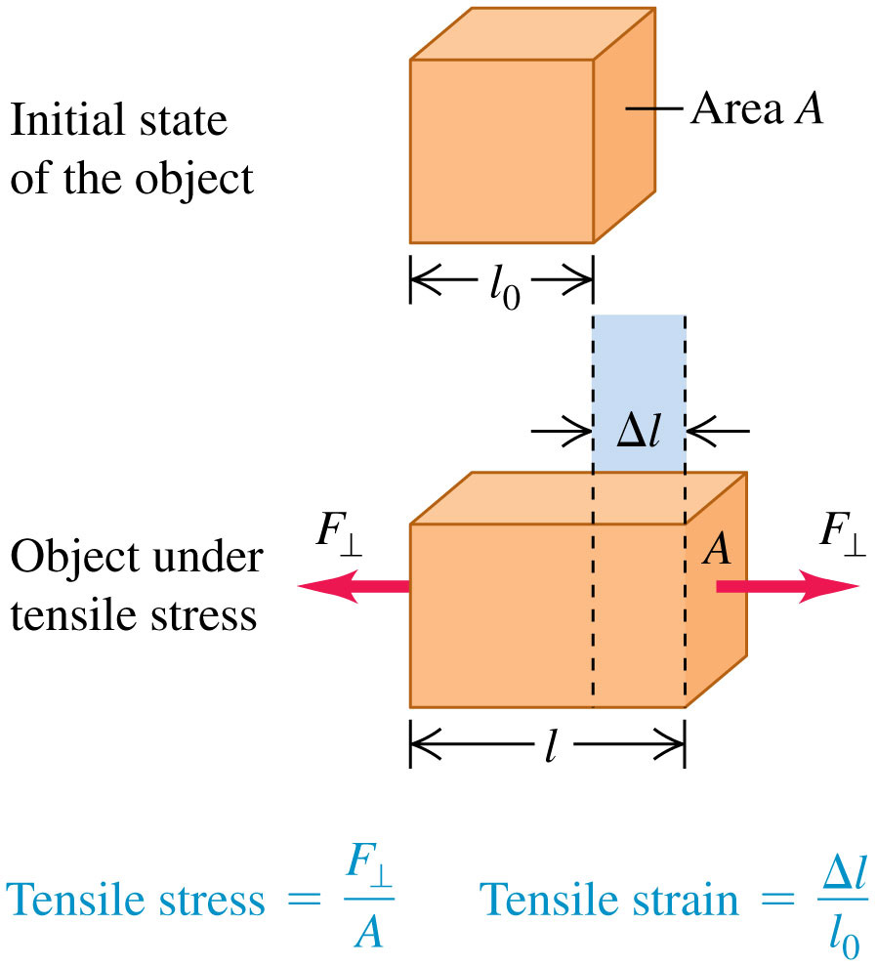
Tensile Stress and Strain
An object in tension.
The net force on the object is zero, but the object deforms.
The tensile stress produces a tensile strain.

Slide 18
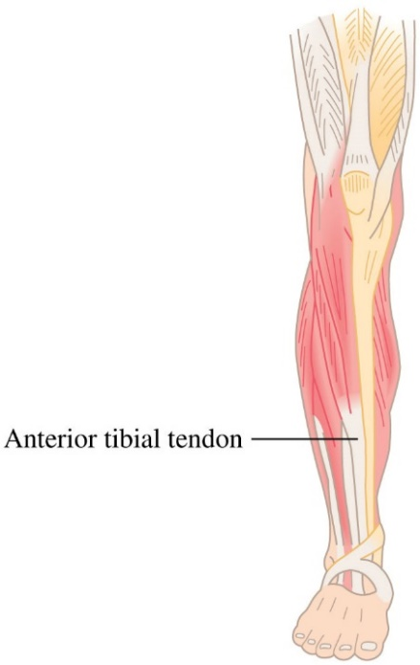
Young's Modulus
Experiment shows that for a sufficiently small tensile stress, stress and strain are proportional.
The corresponding elastic modulus is called Young’s modulus.
A human anterior tibial tendon has a Young’s modulus of

Slide 19
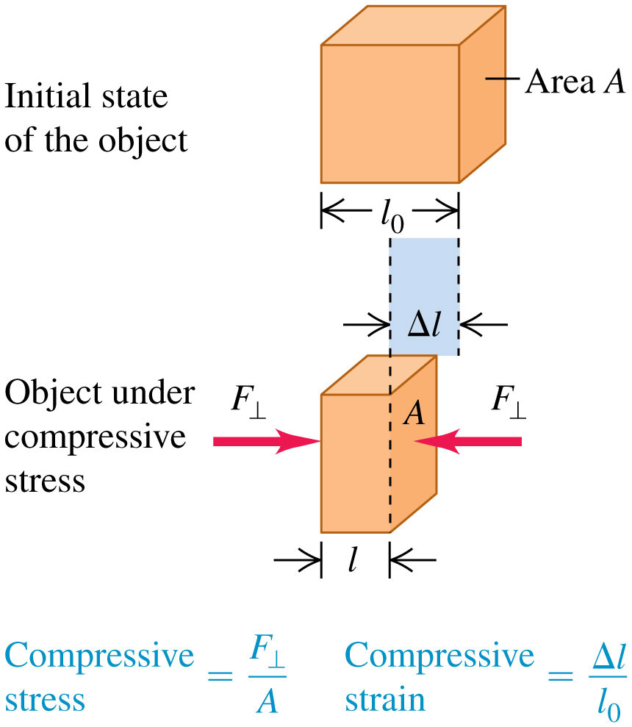
Compressive Stress and Strain
An object in compression.
The compressive stress and compressive strain are defined in the same way as tensile stress and strain, except that Δl now denotes the distance that the object contracts.

Slide 20
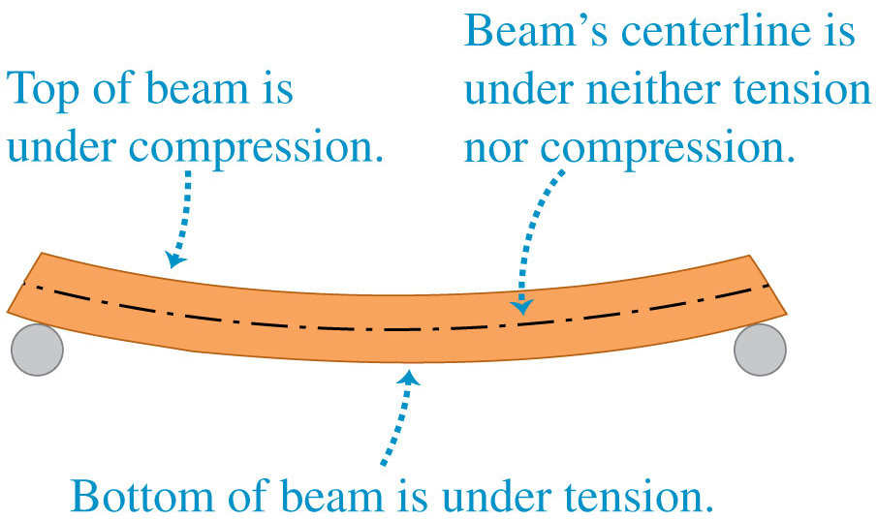
Compression and Tension
In many situations, objects can experience both tensile and compressive stresses at the same time.
For example, a horizontal beam supported at each end sags under its own weight.

Slide 21
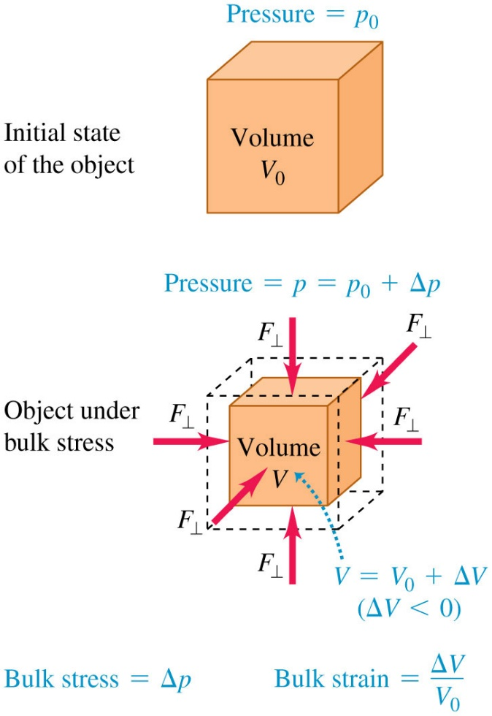
Bulk Stress and Strain
Pressure in a fluid is force per unit area
Bulk modulus is bulk stress divided by bulk strain and is given by
Video Tutor Solution: Example 11.6

Slide 22
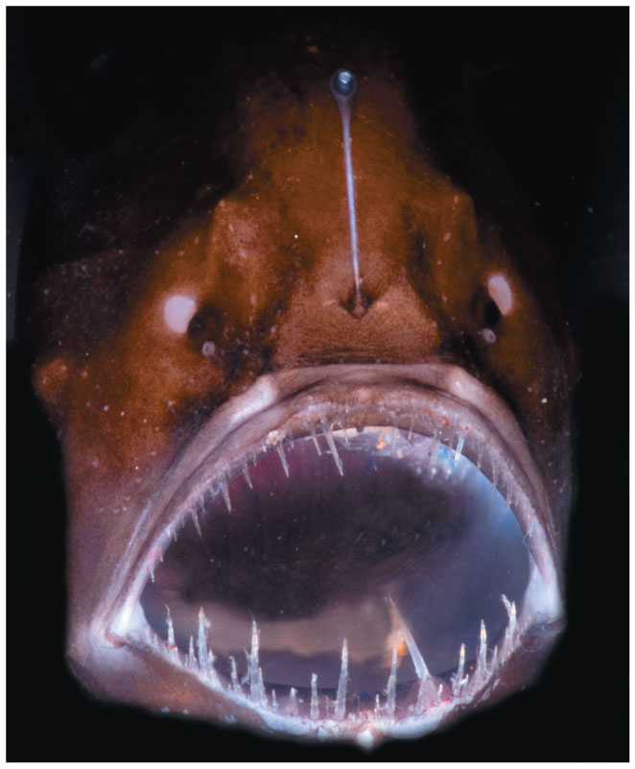
Bulk Stress on an Anglerfish
The anglerfish is found in oceans throughout the world at depths as great as 1000 m, where the pressure (that is, the bulk stress) is about 100 atmospheres.
Anglerfish are able to withstand such stress because they have no internal air spaces, unlike fish found in the upper ocean, where pressures are lower.
The largest anglerfish are about 12 cm (5 in) long.

Slide 23
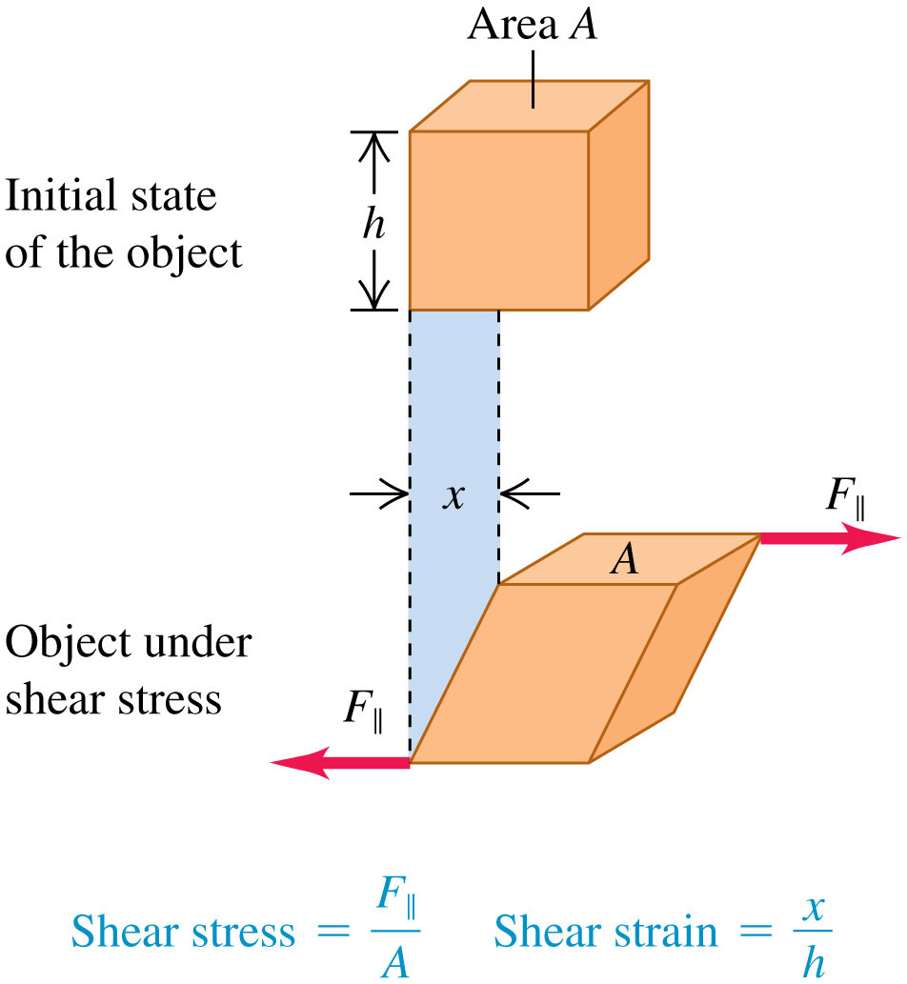
Sheer Stress and Strain
Sheer modulus is sheer stress divided by sheer strain, and is given by

Slide 24
Some Values of Approximate Elastic Moduli
Material | Young’s Modulus, Y (Pa) | Bulk Modulus, B (Pa) | Shear Modulus, S (Pa)
Aluminum | 7.0 times 10 to the tenth | 7.5 times 10 to the tenth | 2.5 times 10 to the tenth
Brass | 9.0 times 10 to the tenth | 6.0 times 10 to the tenth | 3.5 times 10 to the tenth
Copper | 11 times 10 to the tenth | 14 times 10 to the tenth | 4.4 times 10 to the tenth
Iron | 21 times 10 to the tenth | 16 times 10 to the tenth | 7.7 times 10 to the tenth
Lead | 1.6 times 10 to the tenth | 4.1 times 10 to the tenth | 0.6 times 10 to the tenth
Nickel | 21 times 10 to the tenth | 17 times 10 to the tenth | 7.8 times 10 to the tenth
Silicone rubber | 0.001 times 10 to the tenth | 0.2 times 10 to the tenth | 0.0002 times 10 to the tenth
Steel | 20 times 10 to the tenth | 16 times 10 to the tenth | 7.5 times 10 to the tenth
Tendon (typical) | 0.12 times 10 to the tenth | — | —

Slide 25
Compressibility
The reciprocal of the bulk modulus is called the compressibility and is denoted by k.
(compressibility)
Compressibility, k
Liquid | units per pascal | units per atmosphere
Carbon disulfide | 93 times 10 to the negative eleventh | 94 times 10 to the negative eleventh
Ethyl alcohol | 110 times 10 to the negative eleventh | 111 times 10 to the negative eleventh
Glycerine | 21 times 10 to the negative eleventh | 21 times 10 to the negative eleventh
Mercury | 3.7 times 10 to the negative eleventh | 3.8 times 10 to the negative eleventh
Water | 45.8 times 10 to the negative eleventh | 46.4 times 10 to the negative eleventh

Slide 26
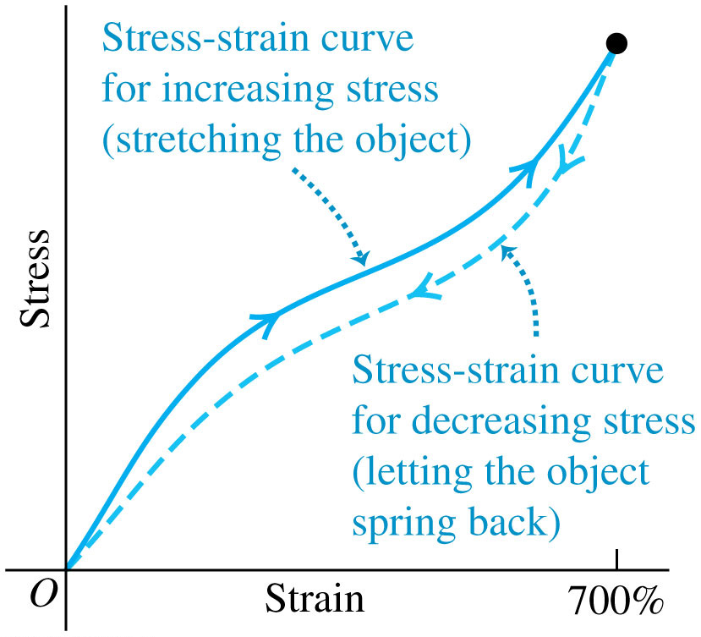
Elasticity and Plasticity (1 of 2)
Hooke’s law—the proportionality of stress and strain in elastic deformations—has a limited range of validity.
Shown is a typical stress-strain diagram for vulcanized rubber, illustrating a phenomenon called elastic hysteresis.

Slide 27
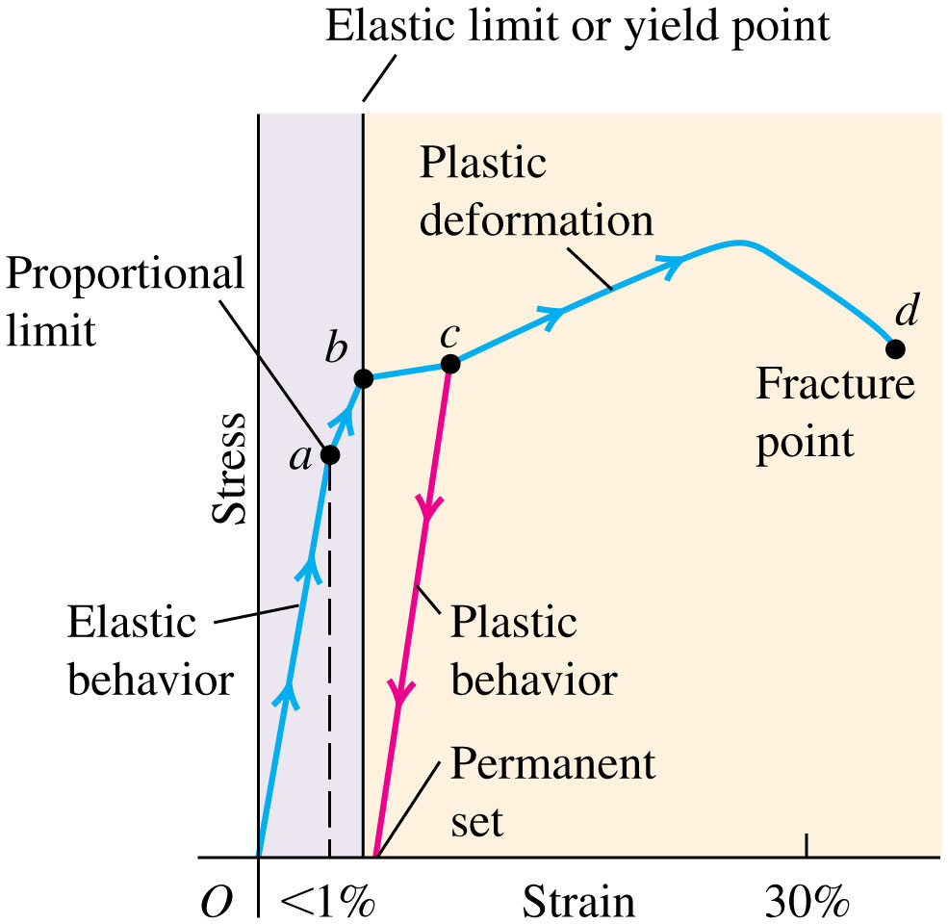
Elasticity and Plasticity (2 of 2)
Here is a typical stress-strain diagram for a ductile metal, such as copper or soft iron, under tension.

Slide 28
Approximate Breaking Stresses
The stress required to cause actual fracture of a material is called the breaking stress.
Table 11.3 gives typical values of breaking stress for several materials in tension:
Material | Breaking Stress pascals or Newtons per square meter
Aluminum | 2.2 times 10 to the eighth
Brass | 4.7 times 10 to the eighth
Glass | 10 times 10 to the eighth
Iron | 3.0 times 10 to the eighth
Steel | 5 to 20 times 10 to the eighth
Tendon (typical) | 1 times 10 to the eighth

