Slide 2
Chapter 22 Electromagnetic Waves

Slide 3
Contents of Chapter 22
Changing Electric Fields Produce Magnetic Fields; Maxwell’s Equations
Production of Electromagnetic Waves
Light as an Electromagnetic Wave and the Electromagnetic Spectrum
Measuring the Speed of Light
Energy in EM Waves
Momentum Transfer and Radiation Pressure
Radio and Television; Wireless Communication

Slide 4
22-1 Changing Electric Fields Produce Magnetic Fields; Maxwell’s Equations
Maxwell’s equations are the basic equations of electromagnetism. They involve calculus; here is a summary:
Gauss’s law relates electric field to charge
A law stating there are no magnetic “charges”
A changing electric field produces a magnetic field
A magnetic field is produced by an electric current, and also by a changing electric field

Slide 5
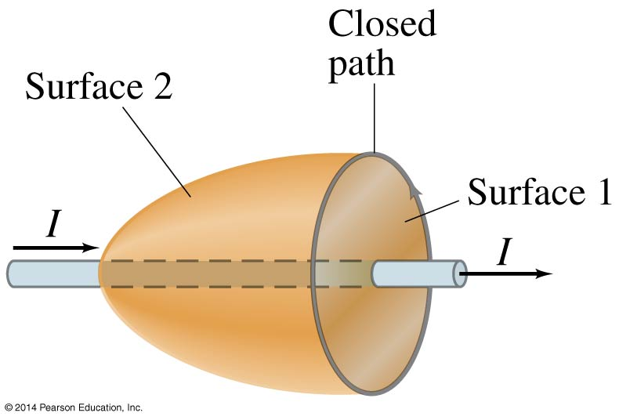
22-1 Changing Electric Fields Produce Magnetic Fields; Maxwell’s Equations
Only one part of this is new—that a changing electric field produces a magnetic field.
Ampère’s law relates the magnetic field around a current to the current through a surface.

Slide 6
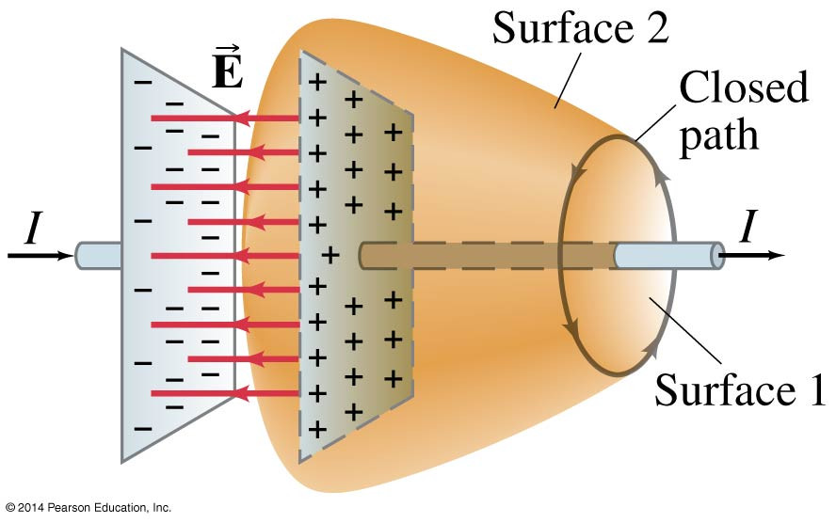
22-1 Changing Electric Fields Produce Magnetic Fields; Maxwell’s Equations
In order for Ampère’s law to hold, it can’t matter which surface we choose. But look at a discharging capacitor; there is a current through surface 1 but none through surface 2:

Slide 7
22-1 Changing Electric Fields Produce Magnetic Fields; Maxwell’s Equations
Therefore, Ampère’s law is modified to include the creation of a magnetic field by a changing electric field—the field between the plates of the capacitor in this example.

Slide 8
22-2 Production of Electromagnetic Waves
Since a changing electric field produces a magnetic field, and a changing magnetic field produces an electric field, once sinusoidal fields are created they can propagate on their own.
These propagating fields are called electromagnetic waves.

Slide 9
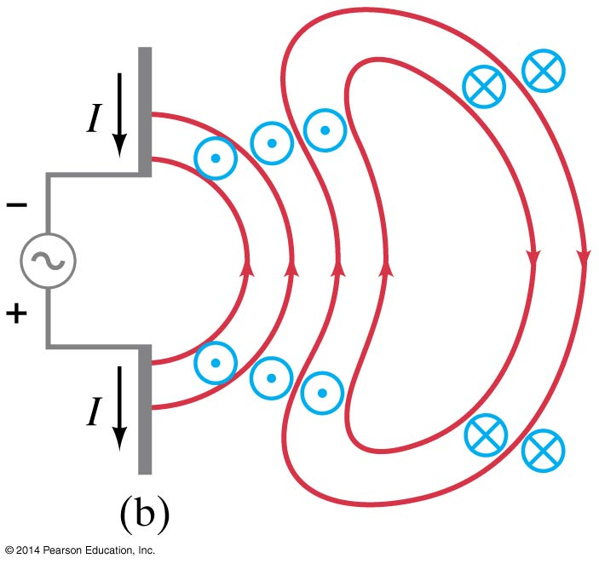
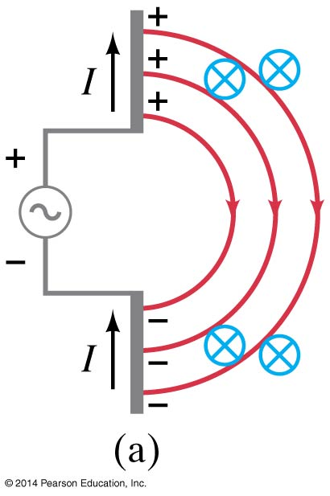
22-2 Production of Electromagnetic Waves
Oscillating charges will produce electromagnetic waves:

Slide 10
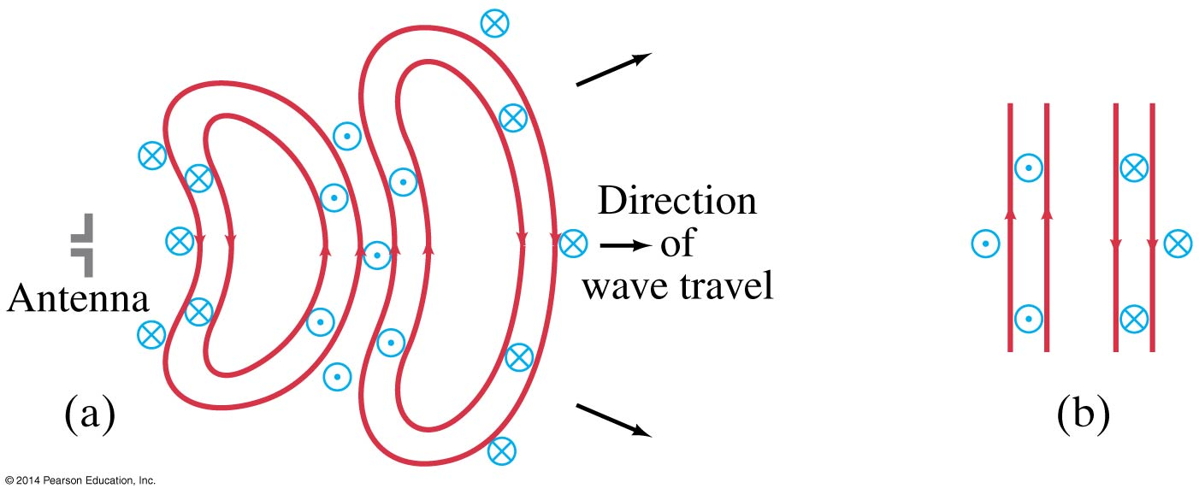
22-2 Production of Electromagnetic Waves
Far from the source, the waves are plane waves:

Slide 11
22-2 Production of Electromagnetic Waves
The electric and magnetic waves are perpendicular to each other, and to the direction of propagation.

Slide 12
22-2 Production of Electromagnetic Waves
When Maxwell calculated the speed of propagation of electromagnetic waves, he found:
Using the known values of ε₀ and μ₀ gives c = 3.00 x 10⁸ m/s.
This is the speed of light in a vacuum.
(22-3)

Slide 13
22-3 Light as an Electromagnetic Wave and the Electromagnetic Spectrum
Light was known to be a wave. The production and measurement of electromagnetic waves of other frequencies confirmed that light was an electromagnetic wave as well.
The frequency of an electromagnetic wave is related to its wavelength:
(22-4)

Slide 14
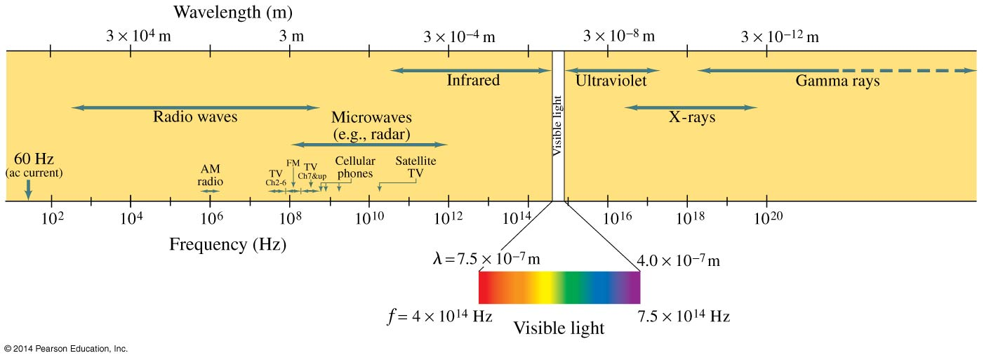
22-3 Light as an Electromagnetic Wave and the Electromagnetic Spectrum
Electromagnetic waves can have any wavelength; we have given different names to different parts of the electromagnetic spectrum.

Slide 15
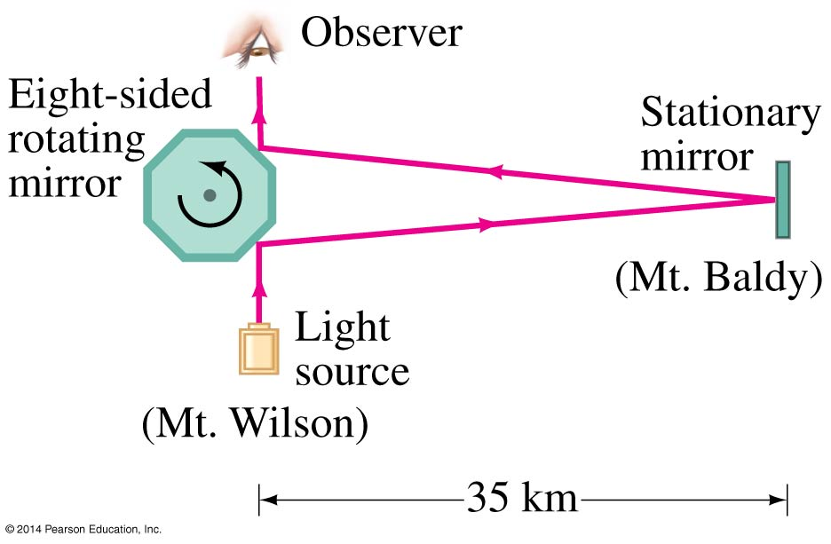
22-4 Measuring the Speed of Light
The speed of light was known to be very large, although careful studies of the orbits of Jupiter’s moons showed that it is finite.
One important measurement, by Michelson, used a rotating mirror:

Slide 16
22-4 Measuring the Speed of Light
Over the years, measurements have become more and more precise; now the speed of light is defined to be:
c = 2.99792458 × 10⁸ m/s
This is then used to define the meter.

Slide 17
22-5 Energy in EM Waves
Energy is stored in both electric and magnetic fields, giving the total energy density of an electromagnetic wave:
Each field contributes half the total energy density.
(22-5)
(22-6a)

Slide 18
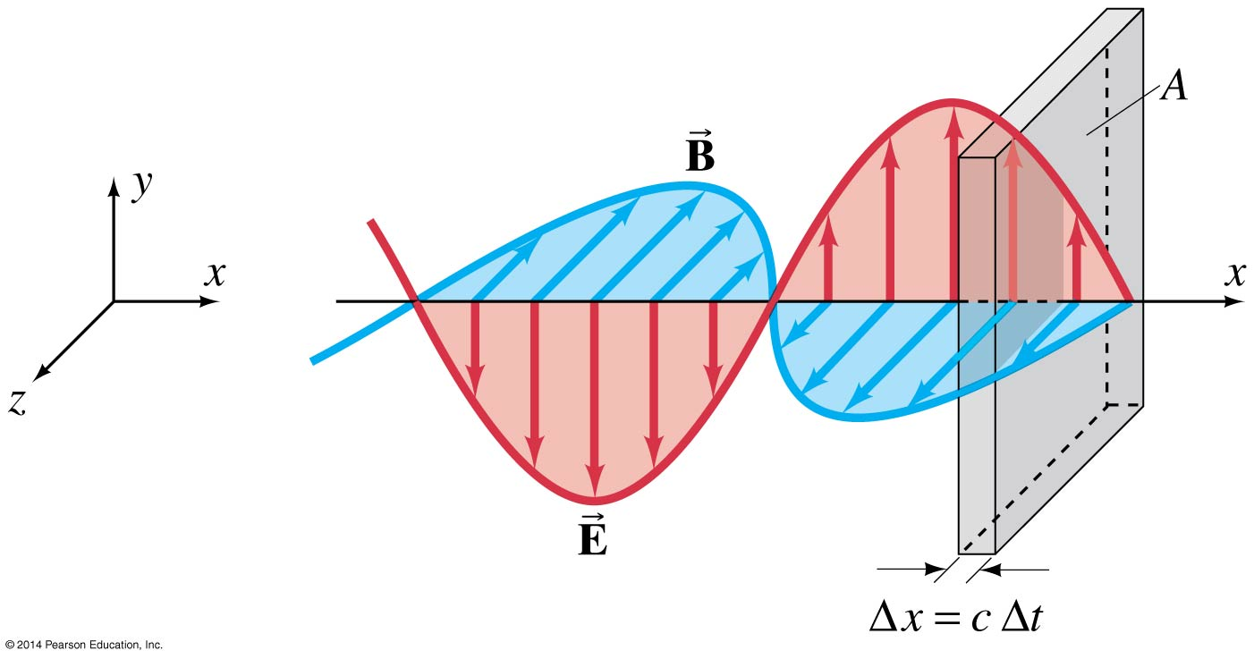
22-5 Energy in EM Waves
This energy is transported by the wave.

Slide 19
22-5 Energy in EM Waves
The energy transported through a unit area per unit time is called the intensity:
Its average value is given by:
(22-7)
(22-8)

Slide 20
22-6 Momentum Transfer and Radiation Pressure
In addition to carrying energy, electromagnetic waves also carry momentum. This means that a force will be exerted by the wave.
The radiation pressure is related to the average intensity. It is a minimum if the wave is fully absorbed:
and a maximum if it is fully reflected:
(22-10a)
(22-10b)

Slide 21
22-7 Radio and Television; Wireless Communication
This figure illustrates the process by which a radio station transmits information. The audio signal is combined with a carrier wave:

Slide 22
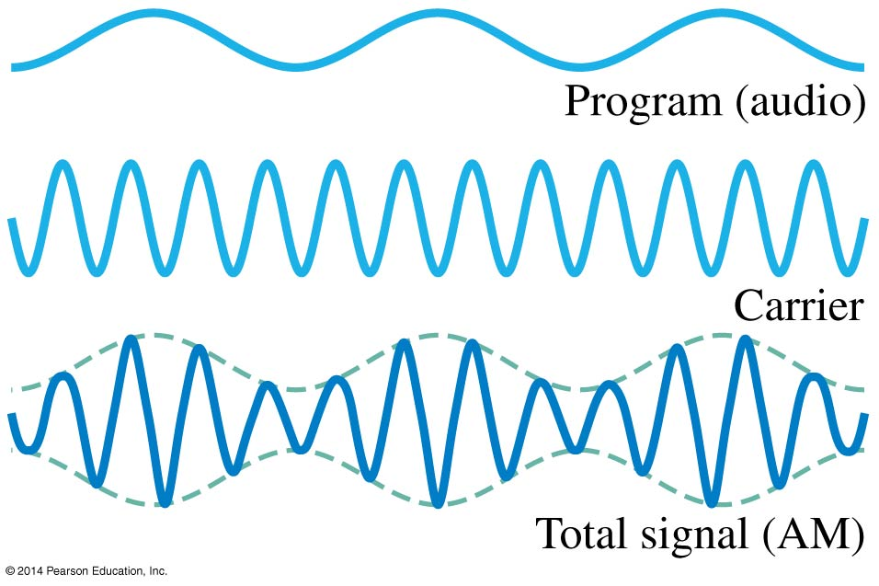
22-7 Radio and Television; Wireless Communication
The mixing of signal and carrier can be done two ways. First, by using the signal to modify the amplitude of the carrier (AM):

Slide 23
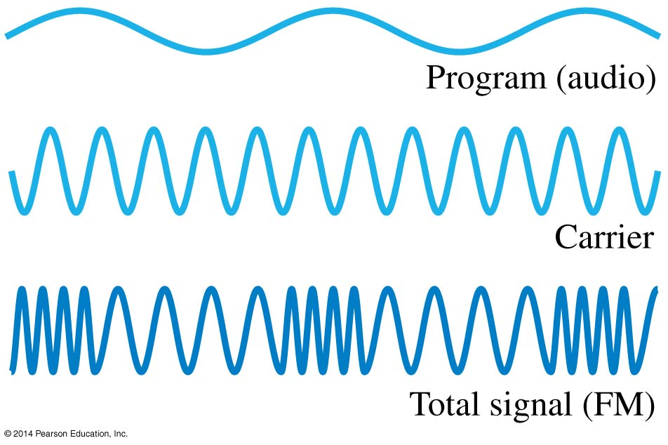
22-7 Radio and Television; Wireless Communication
Second, by using the signal to modify the frequency of the carrier (FM):

Slide 24
22-7 Radio and Television; Wireless Communication
At the receiving end, the wave is received, demodulated, amplified, and sent to a loudspeaker:

Slide 25
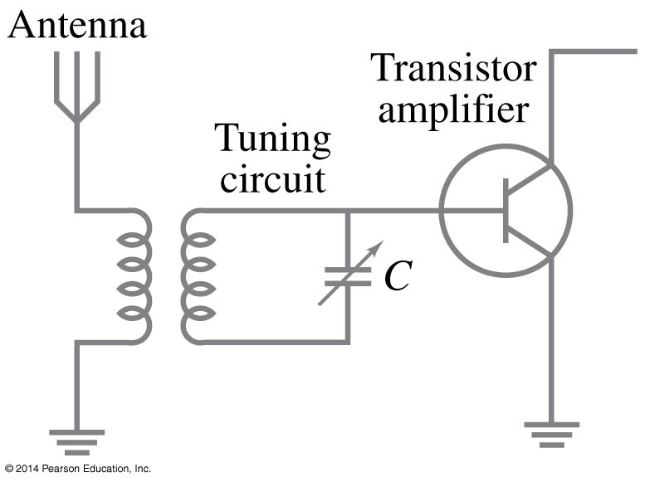
22-7 Radio and Television; Wireless Communication
The receiving antenna is bathed in waves of many frequencies; a tuner is used to select the desired one:

Slide 26
Summary of Chapter 22
Maxwell’s equations are the basic equations of electromagnetism
Electromagnetic waves are produced by accelerating charges; the propagation speed is given by:
The fields are perpendicular to each other and to the direction of propagation.

Slide 27
Summary of Chapter 22
The wavelength and frequency of EM waves are related:
The electromagnetic spectrum includes all wavelengths, from radio waves through visible light to gamma rays.

