Slide 2
Chapter 18 Electric Currents

Slide 3
Contents of Chapter 18
The Electric Battery
Electric Current
Ohm’s Law: Resistance and Resistors
Resistivity
Electric Power

Slide 4
Contents of Chapter 18
Power in Household Circuits
Alternating Current
Microscopic View of Electric Current
Superconductivity
Electrical Conduction in the Human Nervous System

Slide 5
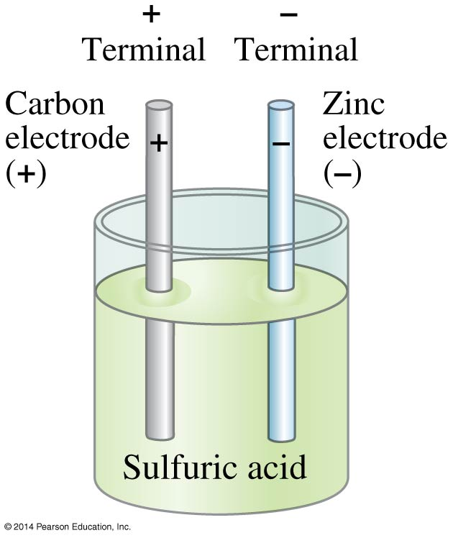
18-1 The Electric Battery
Volta discovered that electricity could be created if dissimilar metals were connected by a conductive solution called an electrolyte.
This is a simple electric cell.

Slide 6
18-1 The Electric Battery
A battery transforms chemical energy into electrical energy.
Chemical reactions within the cell create a potential difference between the terminals by slowly dissolving them. This potential difference can be maintained even if a current is kept flowing, until one or the other terminal is completely dissolved.

Slide 7
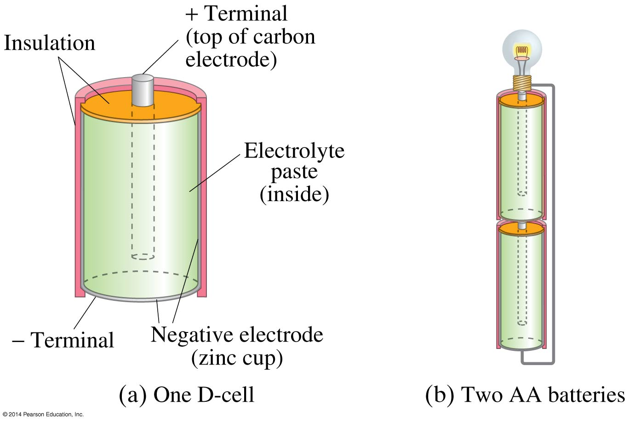
18-1 The Electric Battery
Several cells connected together make a battery, although now we refer to a single cell as a battery as well.

Slide 8
18-2 Electric Current
Electric current is the rate of flow of charge through a conductor:
Unit of electric current: the ampere, A.
1 A = 1 C/s
(18-1)

Slide 9
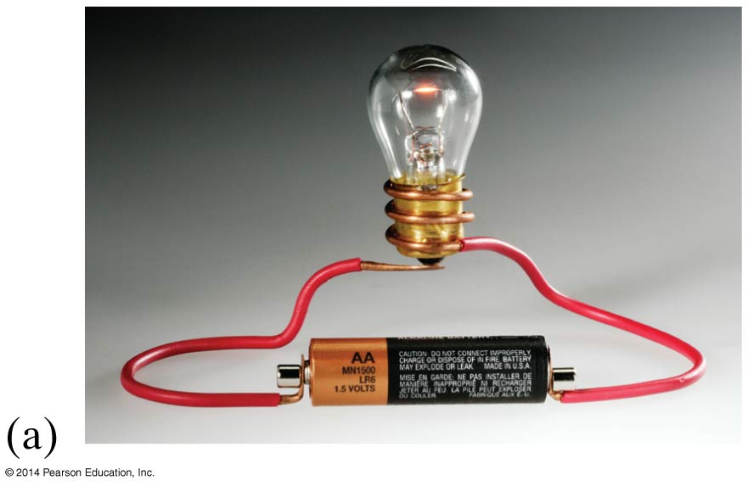
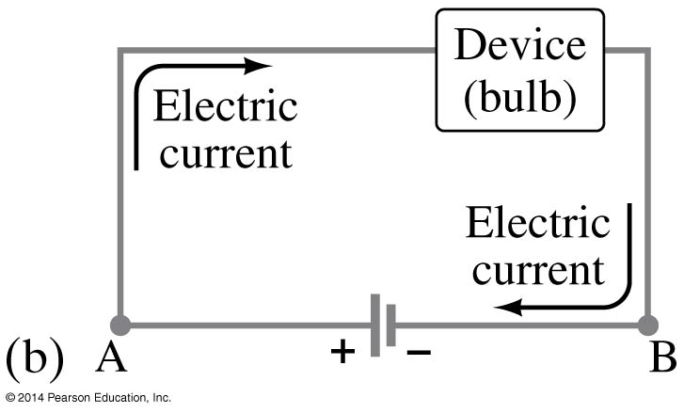
18-2 Electric Current
A complete circuit is one where current can flow all the way around. Note that the schematic drawing doesn’t look much like the physical circuit!

Slide 10
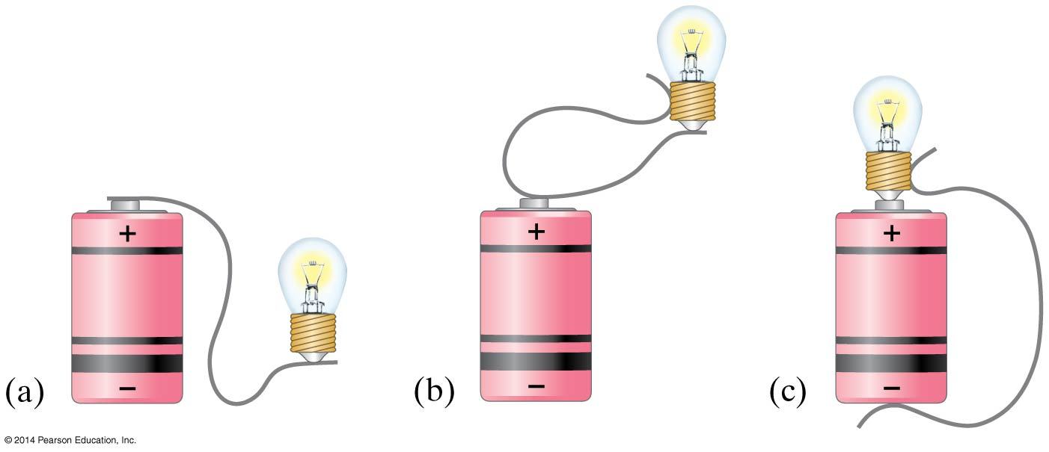
18-2 Electric Current
In order for current to flow, there must be a path from one battery terminal, through the circuit, and back to the other battery terminal. Only one of these circuits will work:

Slide 11
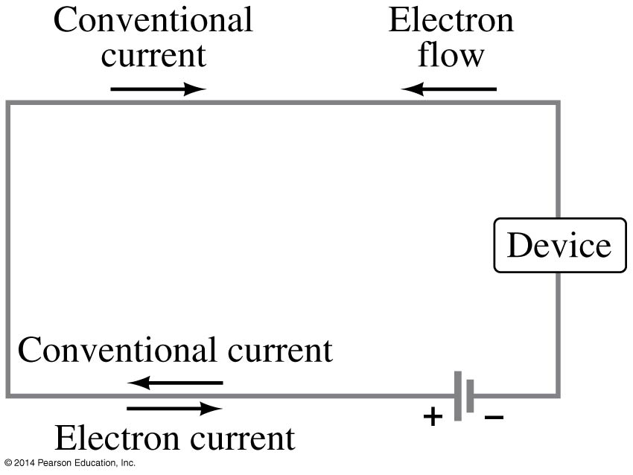
18-2 Electric Current
By convention, current is defined as flowing from + to –. Electrons actually flow in the opposite direction, but not all currents consist of electrons.

Slide 12
18-3 Ohm’s Law: Resistance and Resistors
Experimentally, it is found that the current in a wire is proportional to the potential difference between its ends:
I ∝ V

Slide 13
18-3 Ohm’s Law: Resistance and Resistors
The ratio of voltage to current is called the resistance:
(18-2)

Slide 14
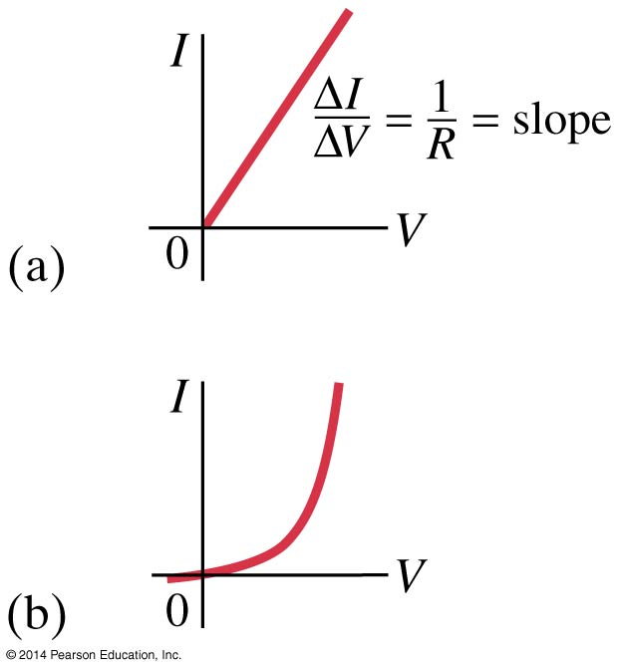
18-3 Ohm’s Law: Resistance and Resistors
In many conductors, the resistance is independent of the voltage; this relationship is called Ohm’s law. Materials that do not follow Ohm’s law are called nonohmic.
Unit of resistance: the ohm, Ω.
1 Ω = 1 V/A

Slide 15
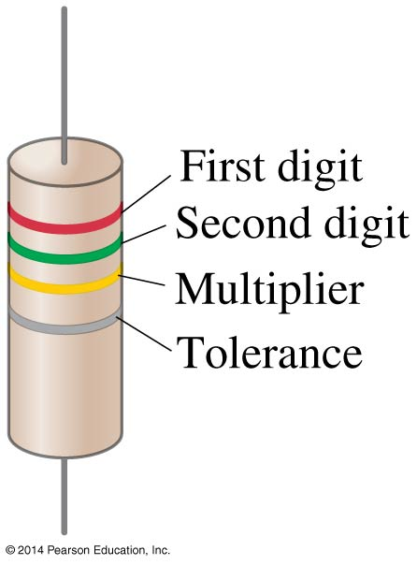
18-3 Ohm’s Law: Resistance and Resistors
Standard resistors are manufactured for use in electric circuits; they are color-coded to indicate their value and precision.

Slide 16
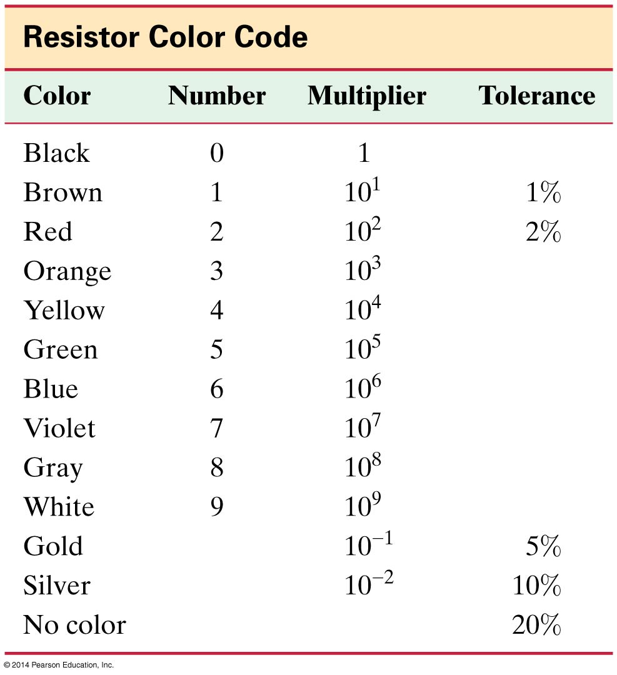
18-3 Ohm’s Law: Resistance and Resistors

Slide 17
18-3 Ohm’s Law: Resistance and Resistors
Some clarifications:
Batteries maintain a (nearly) constant potential difference; the current varies.
Resistance is a property of a material or device.
Current is not a vector but it does have a direction.
Current and charge do not get used up. Whatever charge goes in one end of a circuit comes out the other end.

Slide 18
18-4 Resistivity
The resistance of a wire is directly proportional to its length and inversely proportional to its cross-sectional area:
The constant ρ, the resistivity, is characteristic of the material.
(18-3)

Slide 19
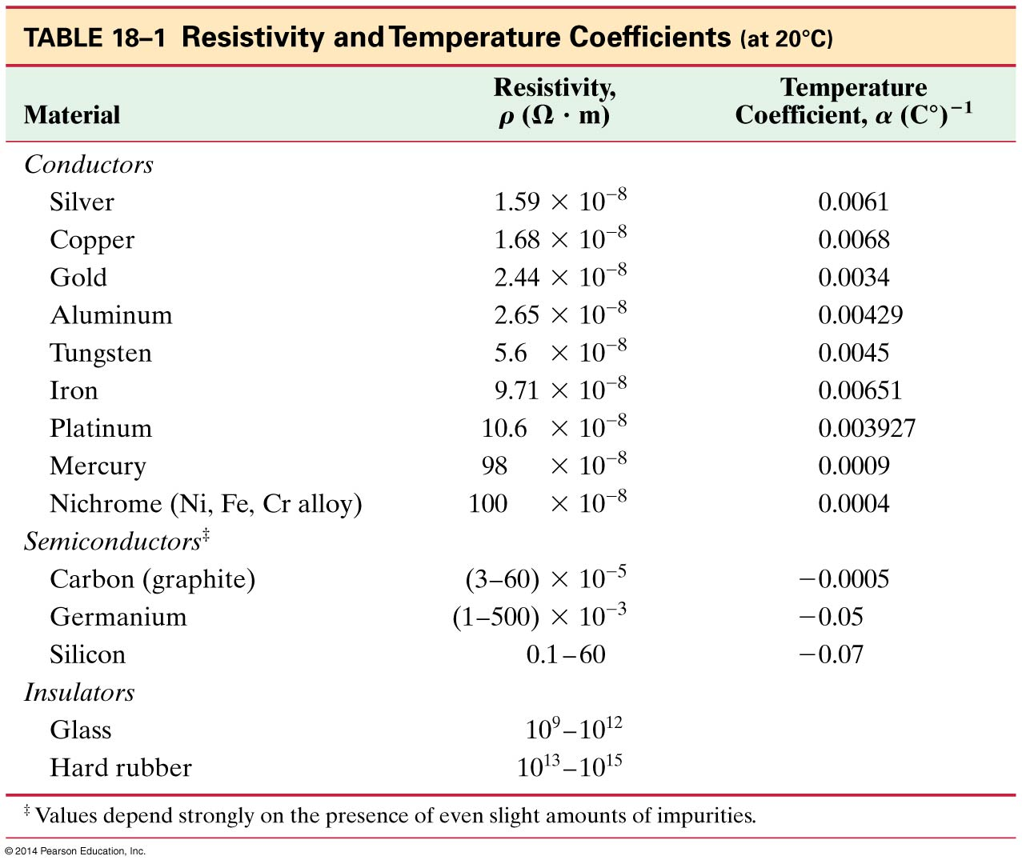
18-4 Resistivity

Slide 20
18-4 Resistivity
For any given material, the resistivity increases with temperature:
Semiconductors are complex materials, and may have resistivities that decrease with temperature.
(18-4)

Slide 21
18-5 Electric Power
Power, as in kinematics, is the energy transformed by a device per unit time:
(18-5)

Slide 22
18-5 Electric Power
The unit of power is the watt, W.
For ohmic devices, we can make the substitutions:
(18-6a)
(18-6b)

Slide 23
18-5 Electric Power
What you pay for on your electric bill is not power, but energy—the power consumption multiplied by the time.
We have been measuring energy in joules, but the electric company measures it in kilowatt-hours, kWh.
One kWh = (1000 W)(3600 s) = 3.60 x 10⁶ J

Slide 24
18-6 Power in Household Circuits
The wires used in homes to carry electricity have very low resistance. However, if the current is high enough, the power will increase and the wires can become hot enough to start a fire.
To avoid this, we use fuses or circuit breakers, which disconnect when the current goes above a predetermined value.

Slide 25
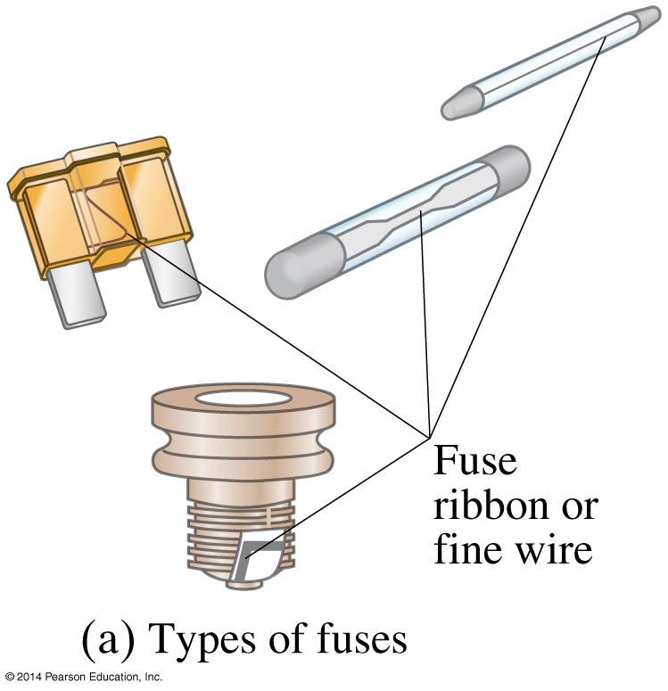
18-6 Power in Household Circuits
Fuses are one-use items—if they blow, the fuse is destroyed and must be replaced.

Slide 26
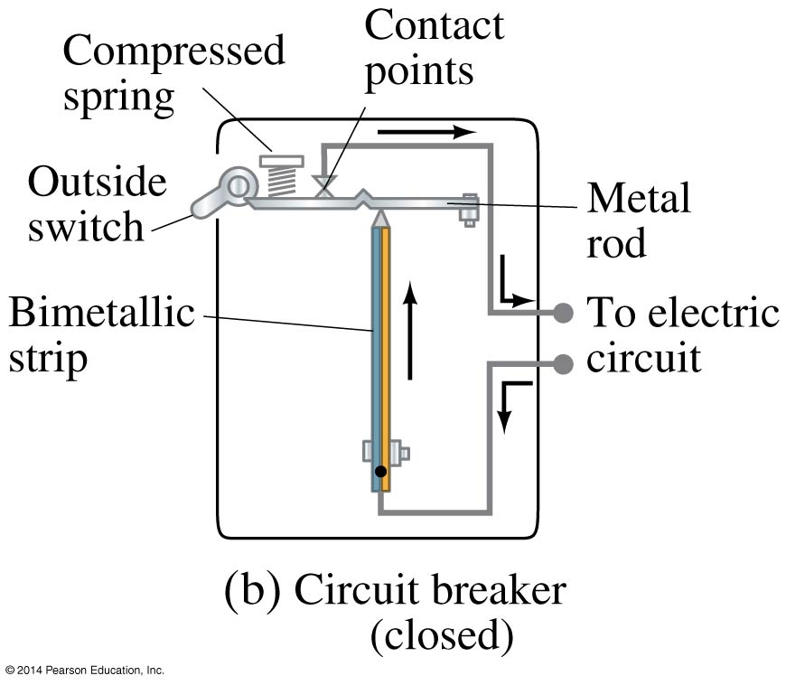
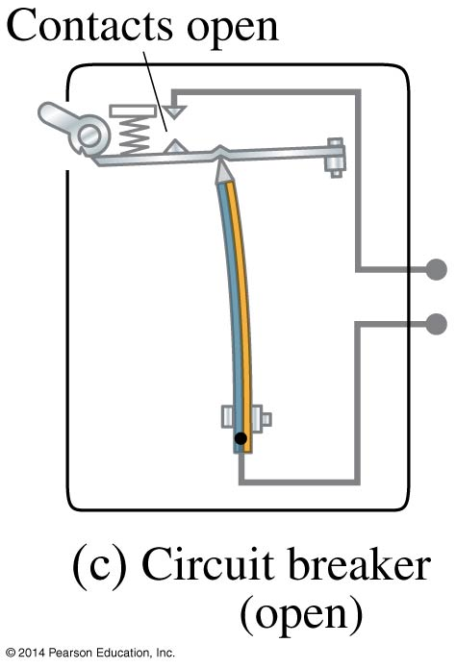
18-6 Power in Household Circuits
Circuit breakers, which are now much more common in homes than they once were, are switches that will open if the current is too high; they can then be reset.

Slide 27
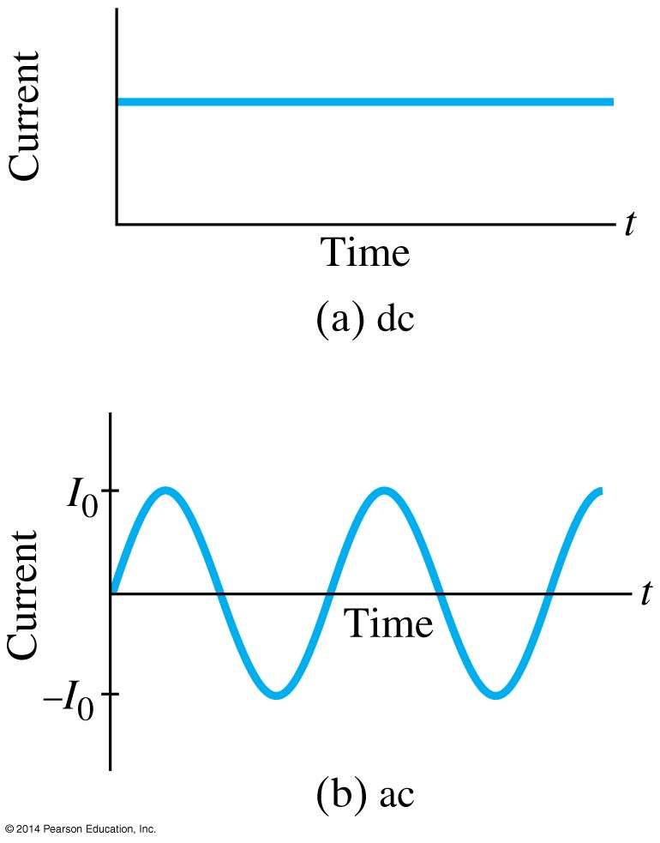
18-7 Alternating Current
Current from a battery flows steadily in one direction (direct current, DC). Current from a power plant varies sinusoidally (alternating current, AC).

Slide 28
18-7 Alternating Current
The voltage varies sinusoidally with time:
as does the current:
(18-7a)
(18-7b)

Slide 29
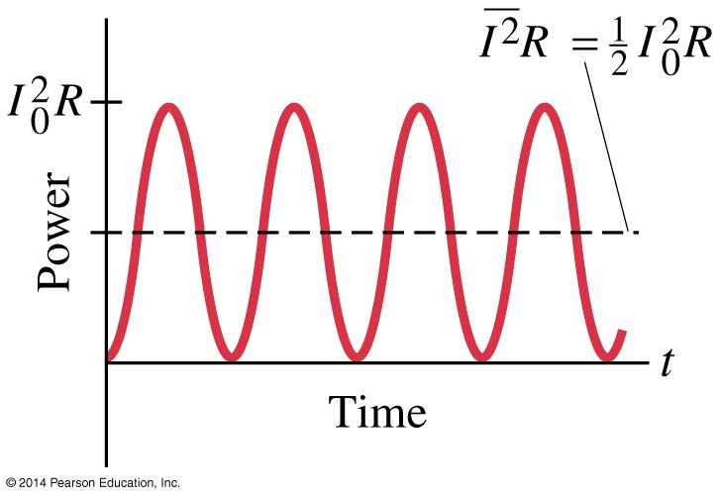
18-7 Alternating Current
Multiplying the current and the voltage gives the power:

Slide 30
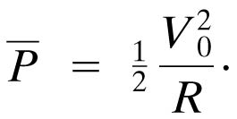
18-7 Alternating Current
Usually we are interested in the average power:

Slide 31
18-7 Alternating Current
The current and voltage both have average values of zero, so we square them, take the average, then take the square root, yielding the root mean square (rms) value.
(18-8a)
(18-8b)

Slide 32
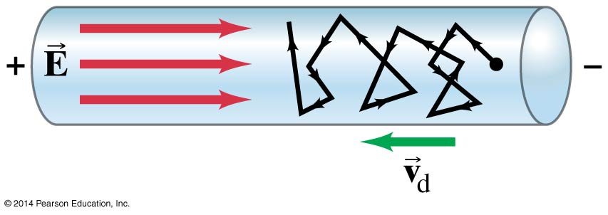
18-8 Microscopic View of Electric Current
Electrons in a conductor have large, random speeds just due to their temperature. When a potential difference is applied, the electrons also acquire an average drift velocity, which is generally considerably smaller than the thermal velocity.

Slide 33
18-8 Microscopic View of Electric Current
This drift speed is related to the current in the wire, and also to the number of electrons per unit volume.
(18-10)

Slide 34
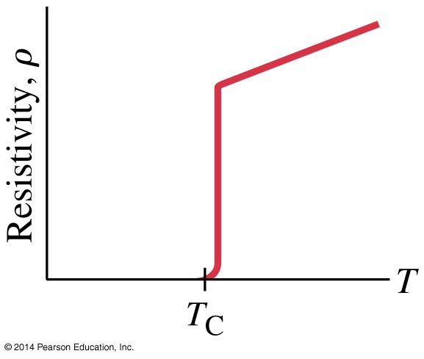
18-9 Superconductivity
In general, resistivity decreases as temperature decreases. Some materials, however, have resistivity that falls abruptly to zero at a very low temperature, called the critical temperature, T_{C}.

Slide 35
18-9 Superconductivity
Experiments have shown that currents, once started, can flow through these materials for years without decreasing even without a potential difference.
Critical temperatures are low; for many years no material was found to be superconducting above 23 K.
More recently, novel materials have been found to be superconducting below 90 K, critical temperatures as high as 160K have been reported.

Slide 36
18-10 Electrical Conduction in the Human Nervous System
The human nervous system depends on the flow of electric charge.
The basic elements of the nervous system are cells called neurons.
Neurons have a main cell body, small attachments called dendrites, and a long tail called the axon.

Slide 37
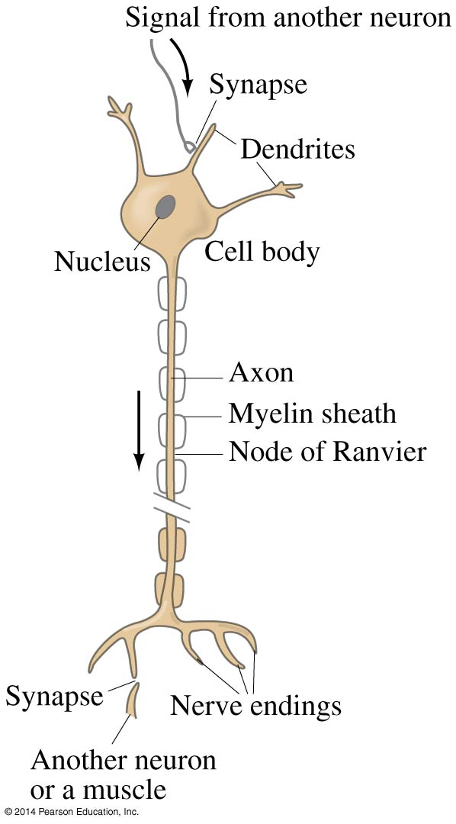
18-10 Electrical Conduction in the Human Nervous System
Signals are received by the dendrites, propagated along the axon, and transmitted through a connection called a synapse.

Slide 38
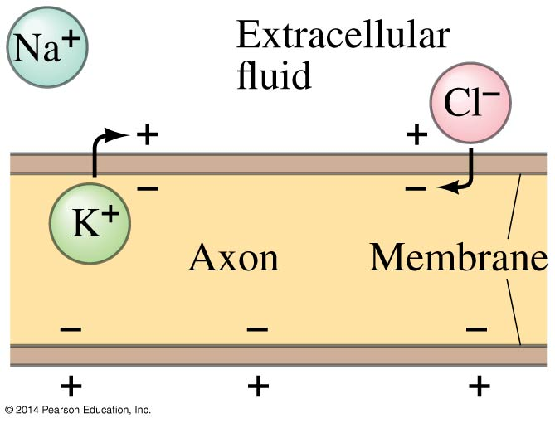
18-10 Electrical Conduction in the Human Nervous System
This process depends on there being a dipole layer of charge on the cell membrane, and different concentrations of ions inside and outside the cell.

Slide 39
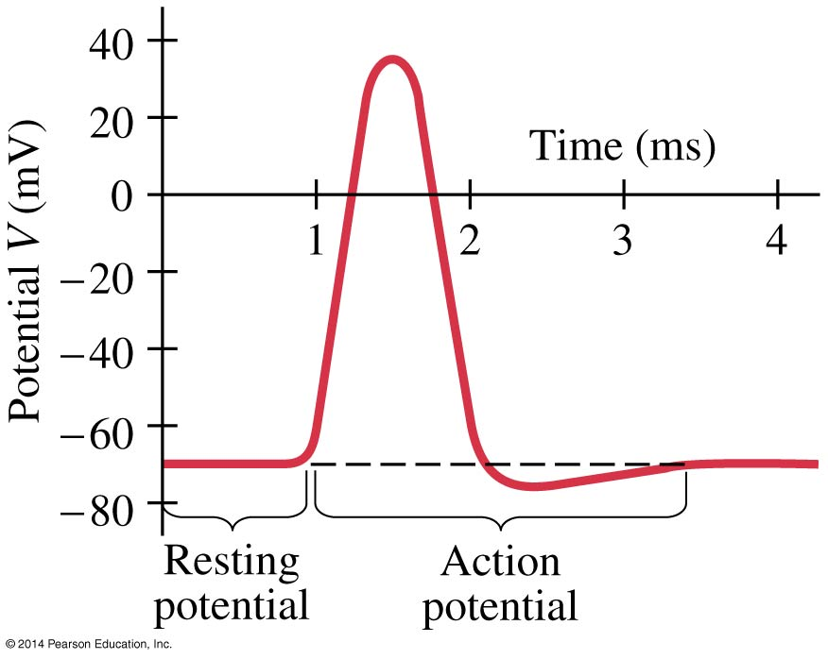
18-10 Electrical Conduction in the Human Nervous System
This applies to most cells in the body. Neurons can respond to a stimulus and conduct an electrical signal. This signal is in the form of an action potential.

Slide 40
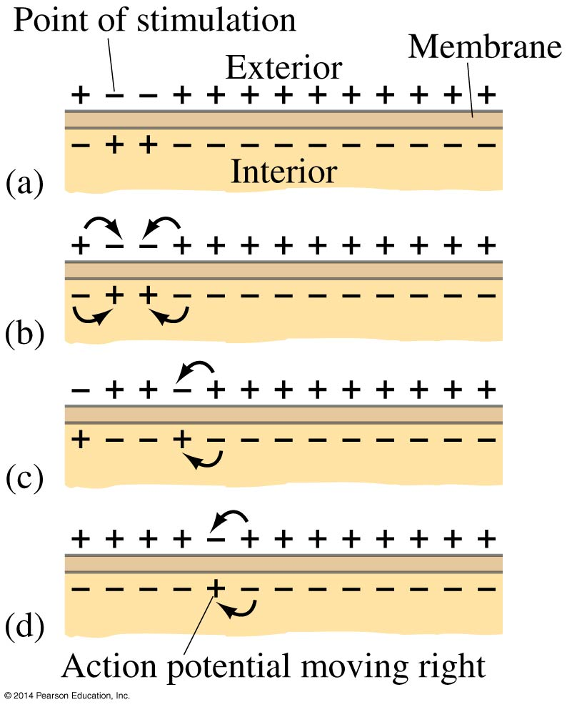
18-10 Electrical Conduction in the Human Nervous System
The action potential propagates along the axon membrane.

Slide 41
Summary of Chapter 18
A battery is a source of constant potential difference.
Electric current is the rate of flow of electric charge.
Conventional current is in the direction that positive charge would flow.
Resistance is the ratio of voltage to current:

Slide 42
Summary of Chapter 18
Ohmic materials have constant resistance, independent of voltage.
Resistance is determined by shape and material:
ρ is the resistivity.
Power in an electric circuit:

Slide 43
Summary of Chapter 18
Direct current is constant
Alternating current varies sinusoidally
The average (rms) current and voltage:
The average (rms) current and voltage:

