Slide 2
Chapter 17 Electric Potential

Slide 3
Contents of Chapter 17
Electric Potential Energy and Potential Difference
Relation between Electric Potential and Electric Field
Equipotential Lines and Surfaces
The Electron Volt, a Unit of Energy
Electric Potential Due to Point Charges
Potential Due to Electric Dipole; Dipole Moment

Slide 4
Contents of Chapter 17
Capacitance
Dielectrics
Storage of Electric Energy
Digital; Binary Numbers; Signal Voltage
TV and Computer Monitors: CRT, Flat Screens
Electrocardiogram (ECG or EKG)

Slide 5
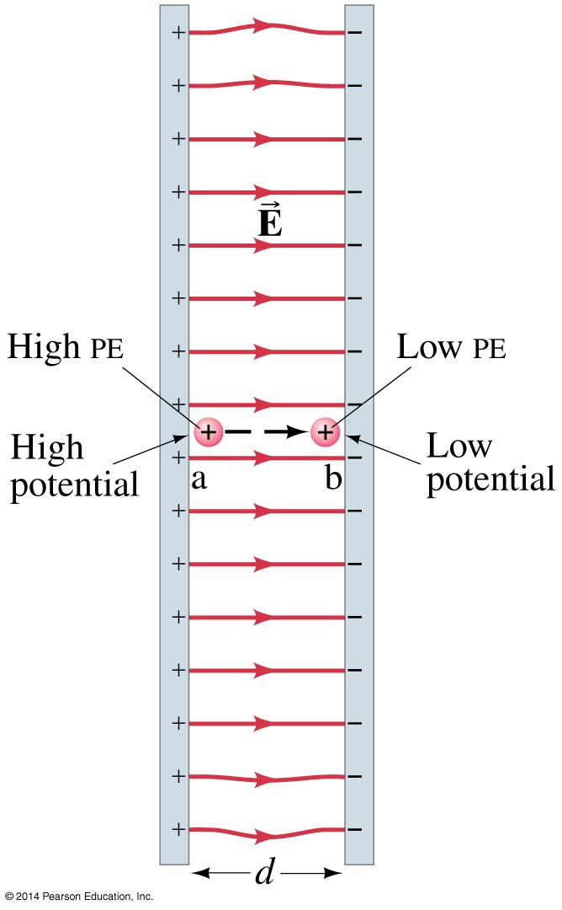
17.1 Electric Potential Energy and Potential Difference
The electrostatic force is conservative—potential energy can be defined
Change in electric potential energy is negative of work done by electric force:
(17-1)

Slide 6
17.1 Electric Potential Energy and Potential Difference
Electric potential is defined as potential energy per unit charge; analogous to definition of electric field as force per unit charge:
Unit of electric potential: the volt (V).
1 V = 1 J/C.
(17-2a)

Slide 7
17.1 Electric Potential Energy and Potential Difference
Only changes in potential can be measured, allowing free assignment of V = 0.
(17-2b)

Slide 8
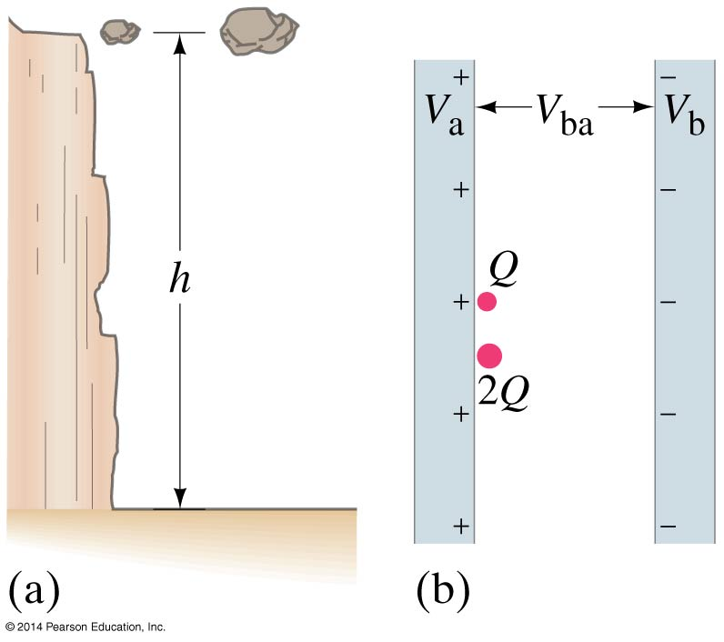
17.1 Electric Potential Energy and Potential Difference
Analogy between gravitational and electrical potential energy. Just as the more massive rock has more potential energy, so does the larger charge:

Slide 9
17.2 Relation between Electric Potential and Electric Field
Work is charge multiplied by potential:
Work is also force multiplied by distance:

Slide 10
17.2 Relation between Electric Potential and Electric Field
Solving for the field,
In general, the electric field in a given direction at any point in space is equal to the rate at which the electric potential decreases over distance in that direction.
(17-4b)

Slide 11
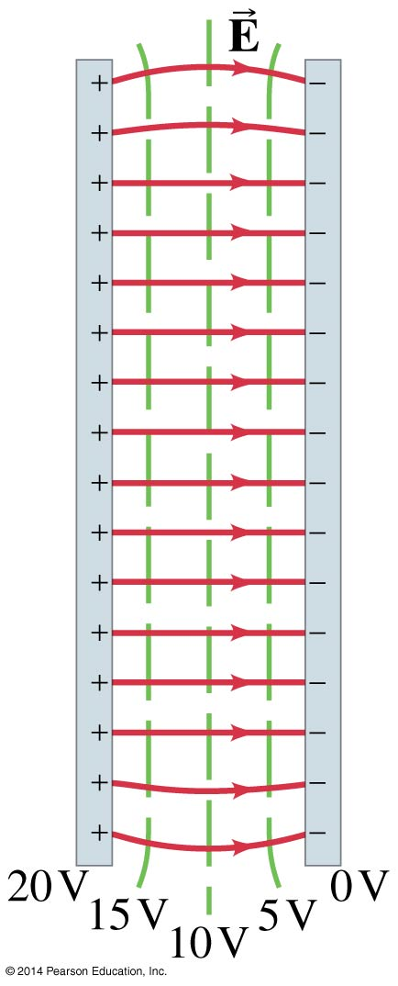
17.3 Equipotential Lines and Surfaces
An equipotential is a line or surface over which the potential is constant.
Electric field lines are perpendicular to equipotentials.
The surface of a conductor is an equipotential.

Slide 12
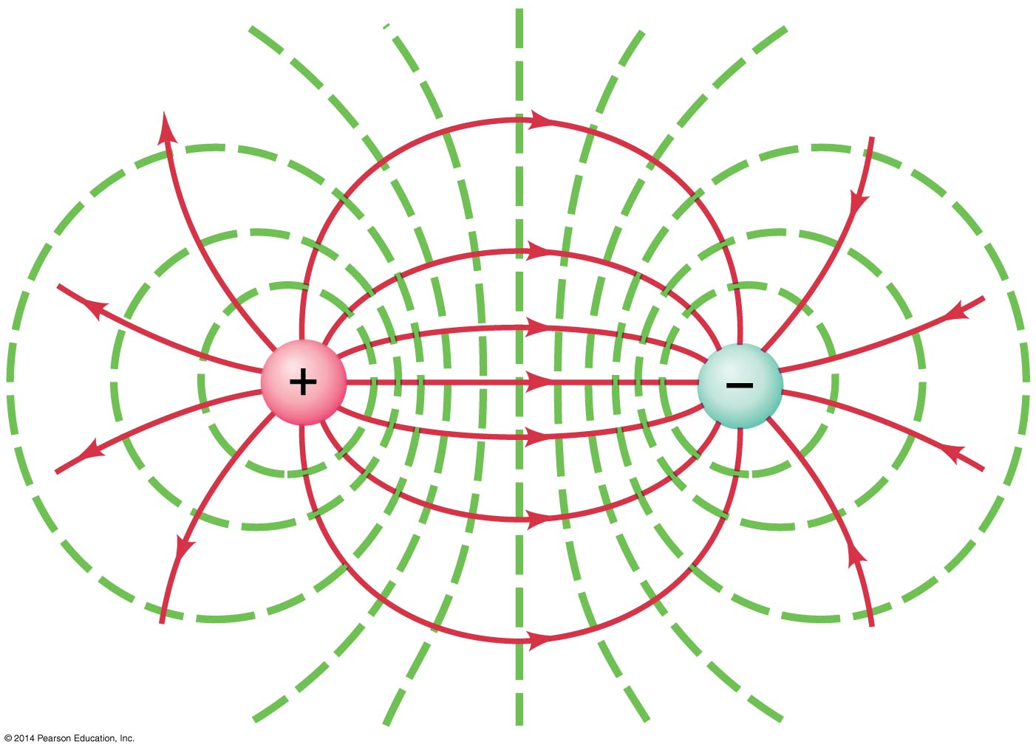
17.3 Equipotential Lines and Surfaces
Equipotential lines of an electric dipole:

Slide 13
17.4 The Electron Volt, a Unit of Energy
One electron volt (eV) is the energy gained by an electron moving through a potential difference of one volt.

Slide 14
17.5 Electric Potential Due to Point Charges
The electric potential due to a point charge can be derived using calculus.
(17-5)

Slide 15
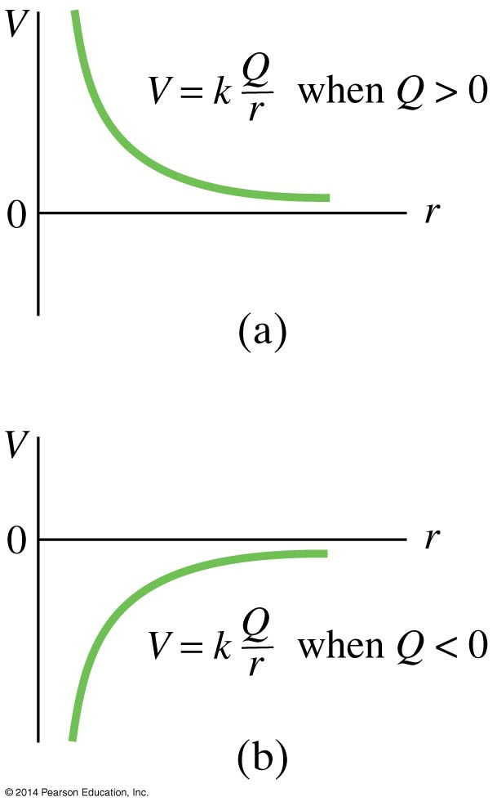
17.5 Electric Potential Due to Point Charges
These plots show the potential due to (a) positive and (b) negative charge.

Slide 16
17.5 Electric Potential Due to Point Charges
Using potentials instead of fields can make solving problems much easier—potential is a scalar quantity, whereas the field is a vector.

Slide 17
17.6 Potential Due to Electric Dipole; Dipole Moment
The potential due to an electric dipole is just the sum of the potentials due to each charge, and can be calculated exactly.

Slide 18
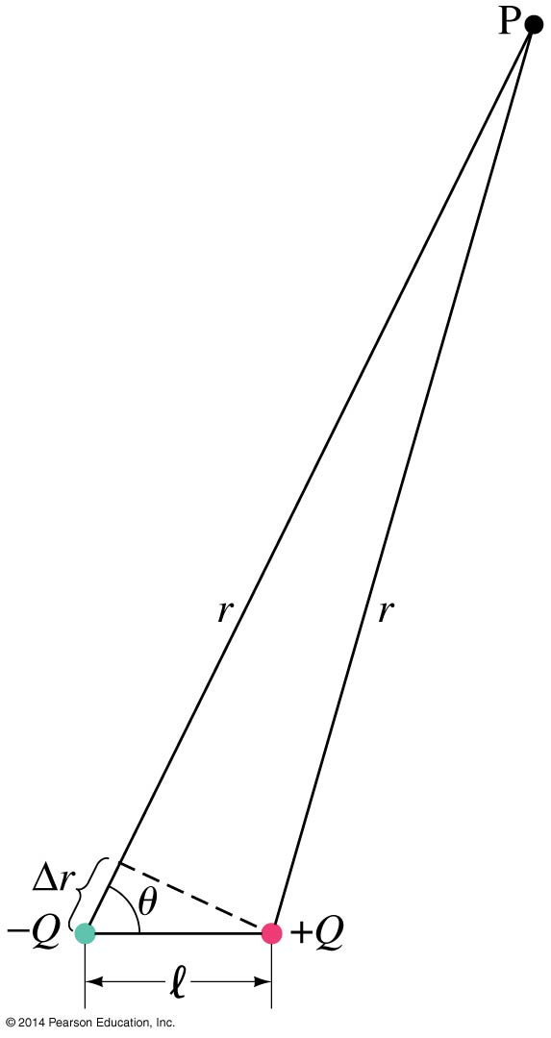
17.6 Potential Due to Electric Dipole; Dipole Moment
Approximation for potential far from dipole:
(17-6a)

Slide 19
17.6 Potential Due to Electric Dipole; Dipole Moment
Or, defining the dipole moment p = Ql,
(17-6b)

Slide 20
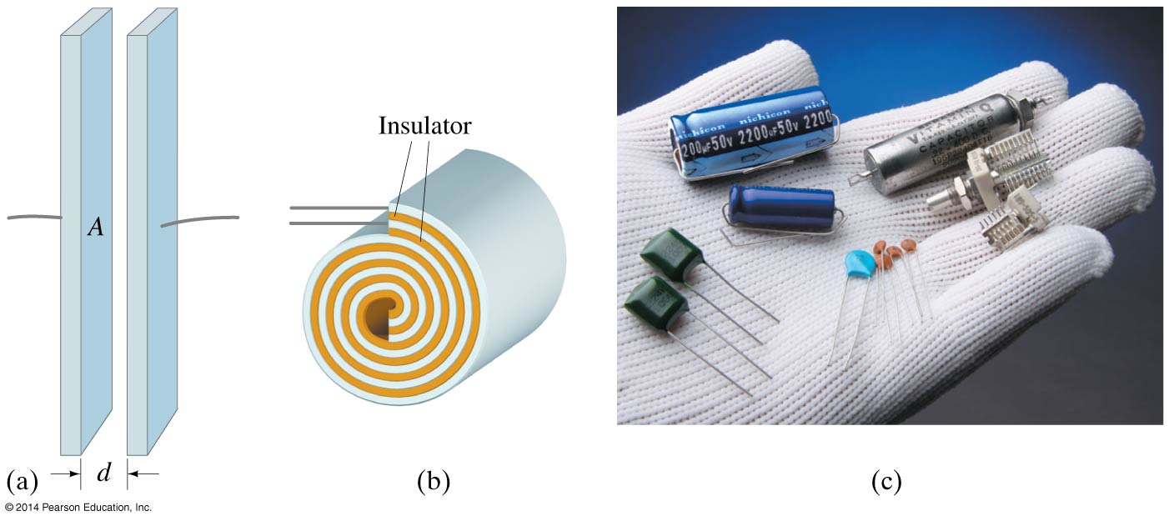
17.7 Capacitance
A capacitor consists of two conductors that are close but not touching. A capacitor has the ability to store electric charge.

Slide 21
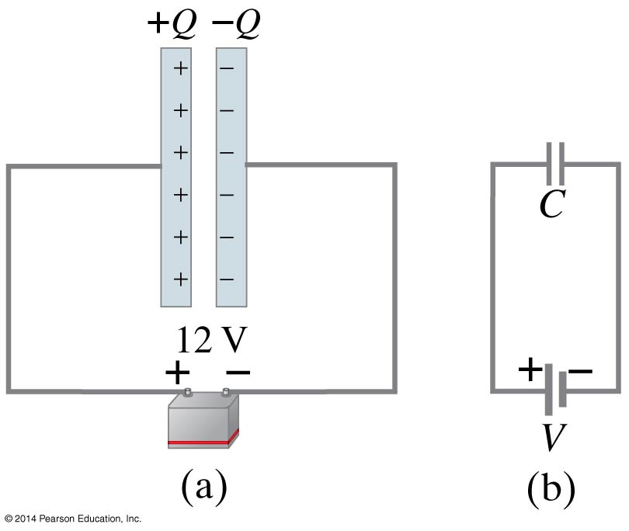
17.7 Capacitance
Parallel-plate capacitor connected to battery. (b) is a circuit diagram.

Slide 22
17.7 Capacitance
When a capacitor is connected to a battery, the charge on its plates is proportional to the voltage:
The quantity C is called the capacitance.
Unit of capacitance: the farad (F)
1 F = 1 C/V
(17-7)

Slide 23
17.7 Capacitance
The capacitance does not depend on the voltage; it is a function of the geometry and materials of the capacitor.
For a parallel-plate capacitor:
(17-8)

Slide 24
17.8 Dielectrics
A dielectric is an insulator, and is characterized by a dielectric constant K.
Capacitance of a parallel-plate capacitor filled with dielectric:
(17-9)

Slide 25
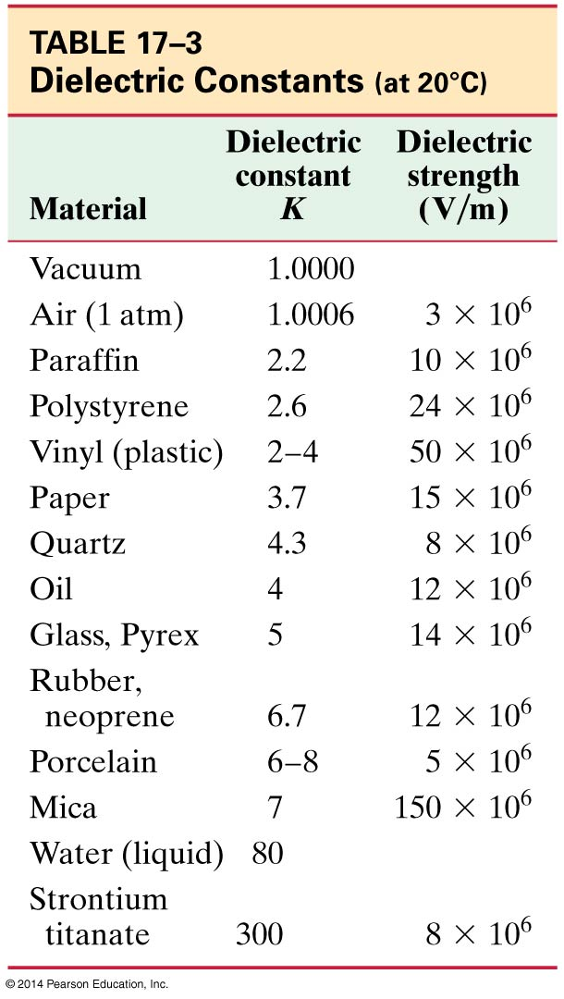
17.8 Dielectrics
Dielectric strength is the maximum field a dielectric can experience without breaking down.

Slide 26
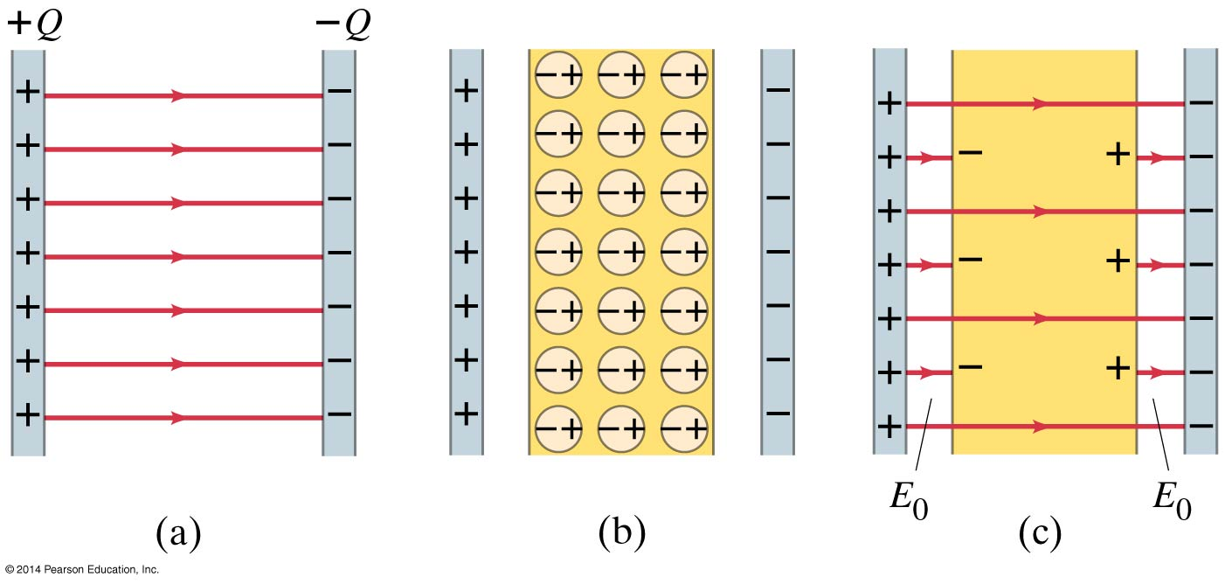
17.8 Dielectrics
The molecules in a dielectric tend to become oriented in a way that reduces the external field.

Slide 27
17.8 Dielectrics
This means that the electric field within the dielectric is less than it would be in air, allowing more charge to be stored for the same potential.

Slide 28
17.9 Storage of Electric Energy
A charged capacitor stores electric energy; the energy stored is equal to the work done to charge the capacitor.
(17-10)

Slide 29
17.9 Storage of Electric Energy
The energy density, defined as the energy per unit volume, is the same no matter the origin of the electric field:
The sudden discharge of electric energy can be harmful or fatal. Capacitors can retain their charge indefinitely even when disconnected from a voltage source—be careful!
(17-11)

Slide 30
17.9 Storage of Electric Energy
Heart defibrillators use electric discharge to “jump-start” the heart when its beats become irregular, and can save lives.

Slide 31
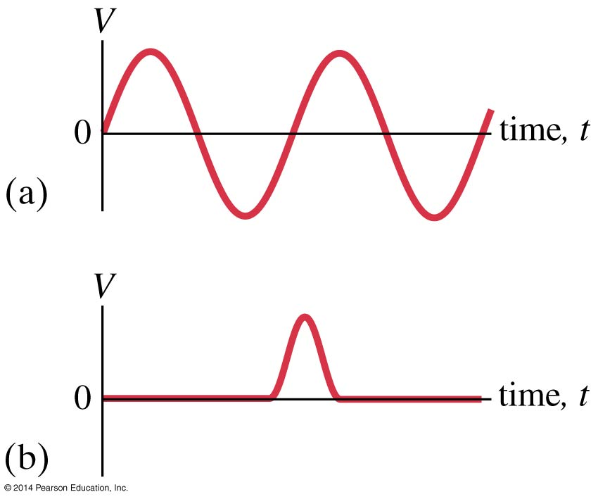
17.10 Digital; Binary Numbers; Signal Voltage
Analog signal voltages vary continuously.

Slide 32
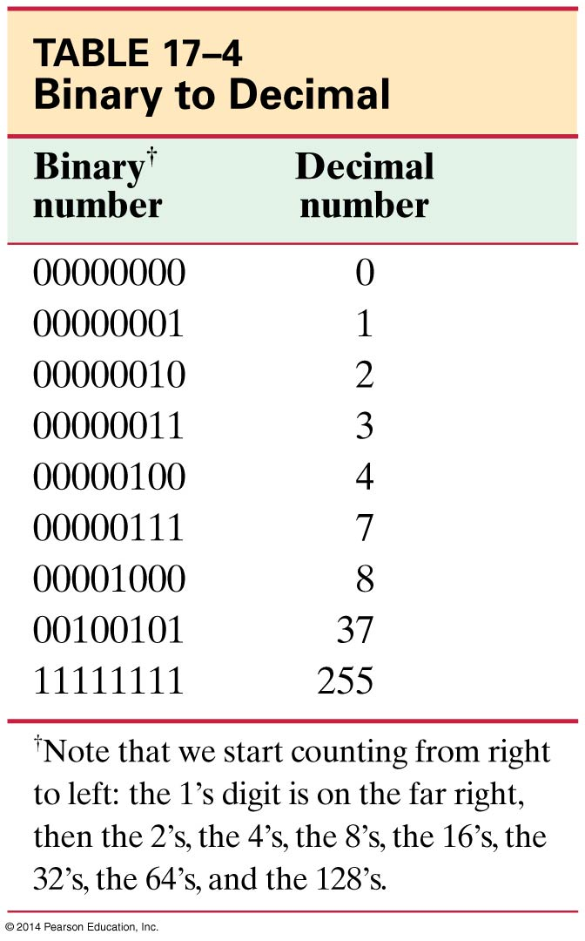
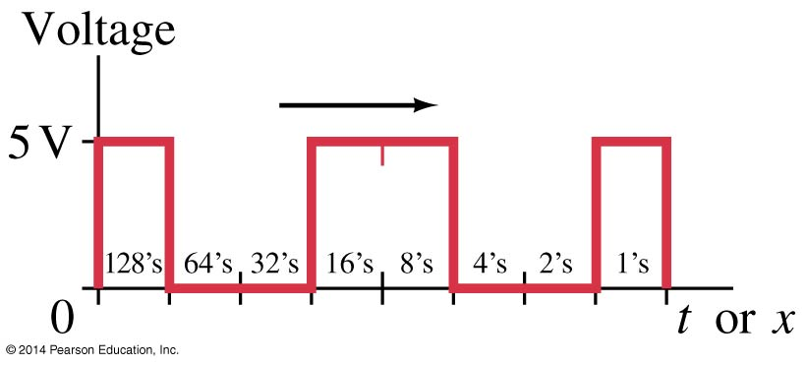
17.10 Digital; Binary Numbers; Signal Voltage
Digital signals use binary numbers to represent numerical values.

Slide 33
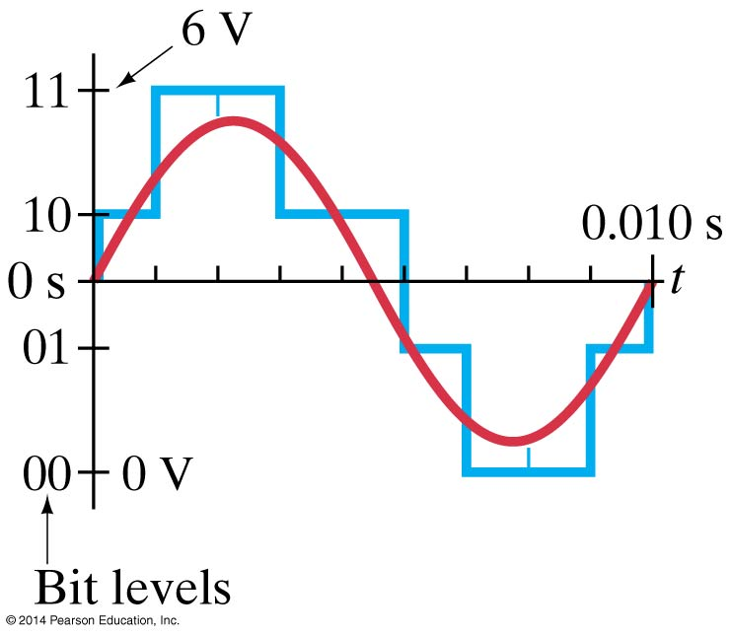
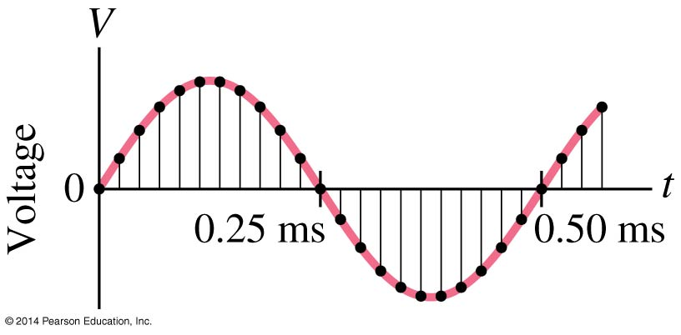
17.10 Digital; Binary Numbers; Signal Voltage
In order to convert an analog signal to digital, the signal must be sampled. A higher sampling rate reproduces the signal more precisely.

Slide 34
17.10 Digital; Binary Numbers; Signal Voltage
Before it is sent to a loudspeaker or headset, a digital audio signal must be converted back to analog.

Slide 35
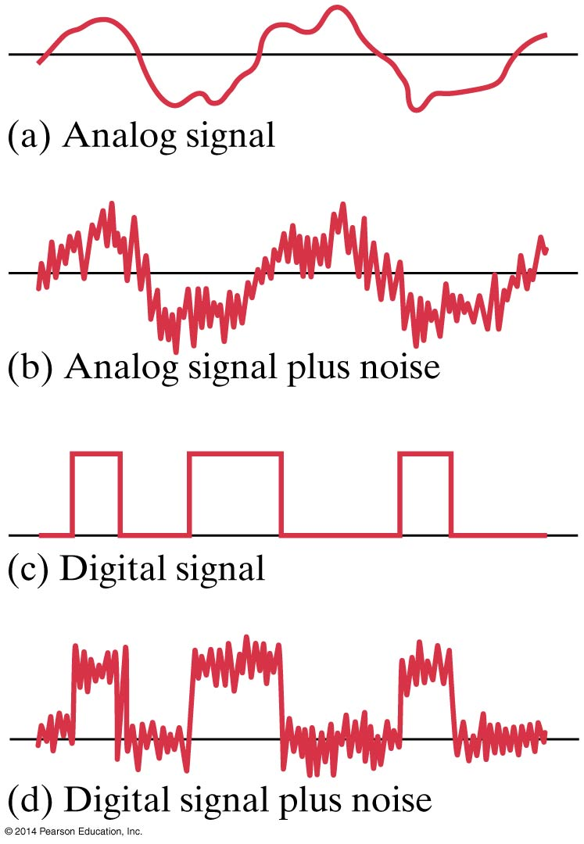
17.10 Digital; Binary Numbers; Signal Voltage
Noise can easily corrupt an analog signal; a digital signal is much less sensitive to noise.

Slide 36
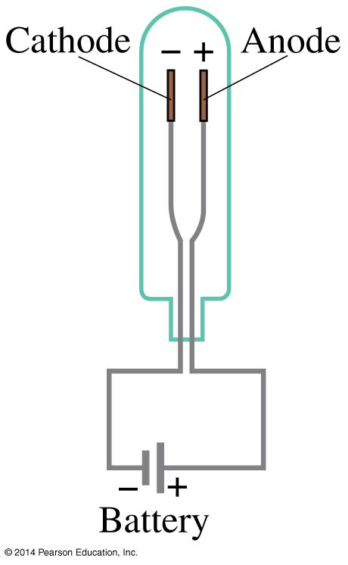
17.11 TV and Computer Monitors: CRTs, Flat Screens
A cathode ray tube contains a wire cathode that, when heated, emits electrons. A voltage source causes the electrons to travel to the anode.

Slide 37
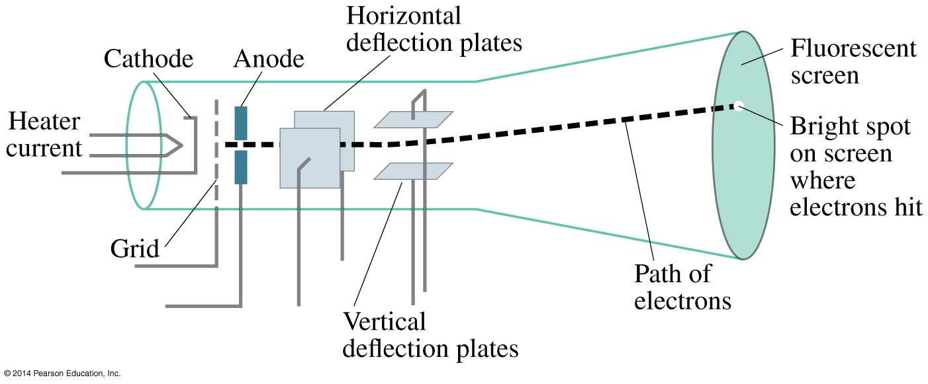
17.11 TV and Computer Monitors: CRTs, Flat Screens
The electrons can be steered using electric or magnetic fields.

Slide 38
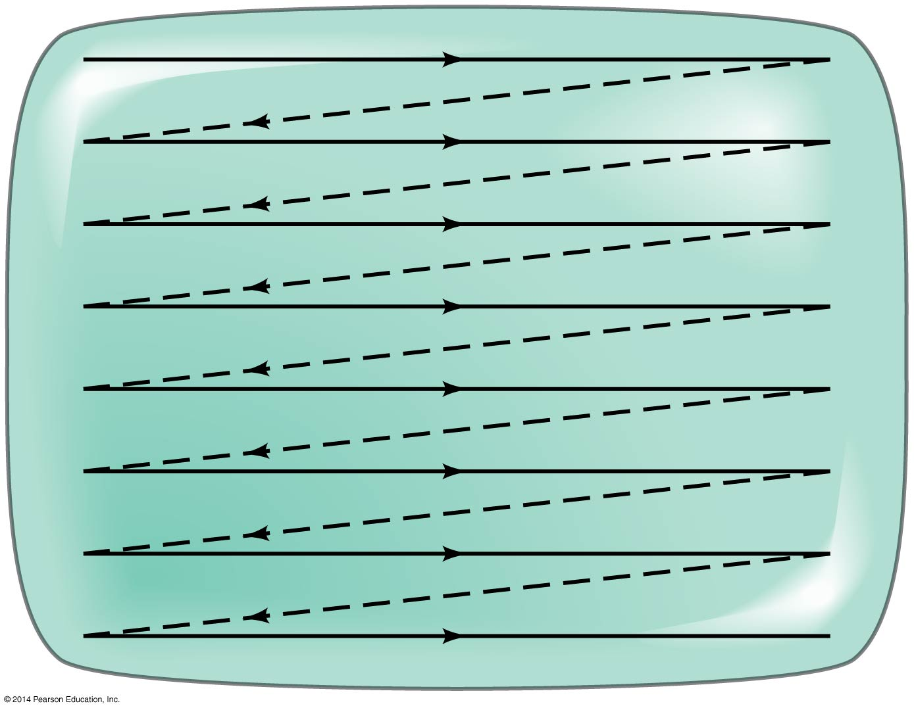
17.11 TV and Computer Monitors: CRTs, Flat Screens
CRT monitors have a large cathode ray tube as their display. Variations in the field steer the electrons on their way to the screen.

Slide 39
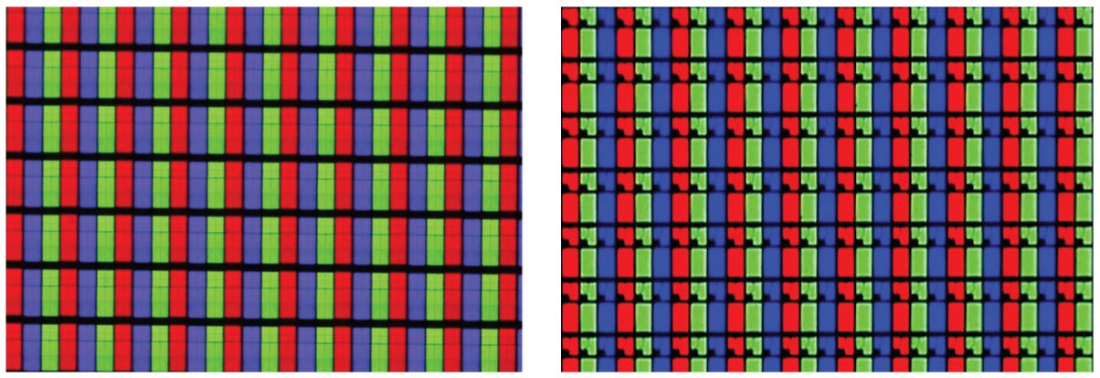
17.11 TV and Computer Monitors: CRTs, Flat Screens
Flat screens contain tiny pixels in red, green, and blue whose brightness can be changed.

Slide 40
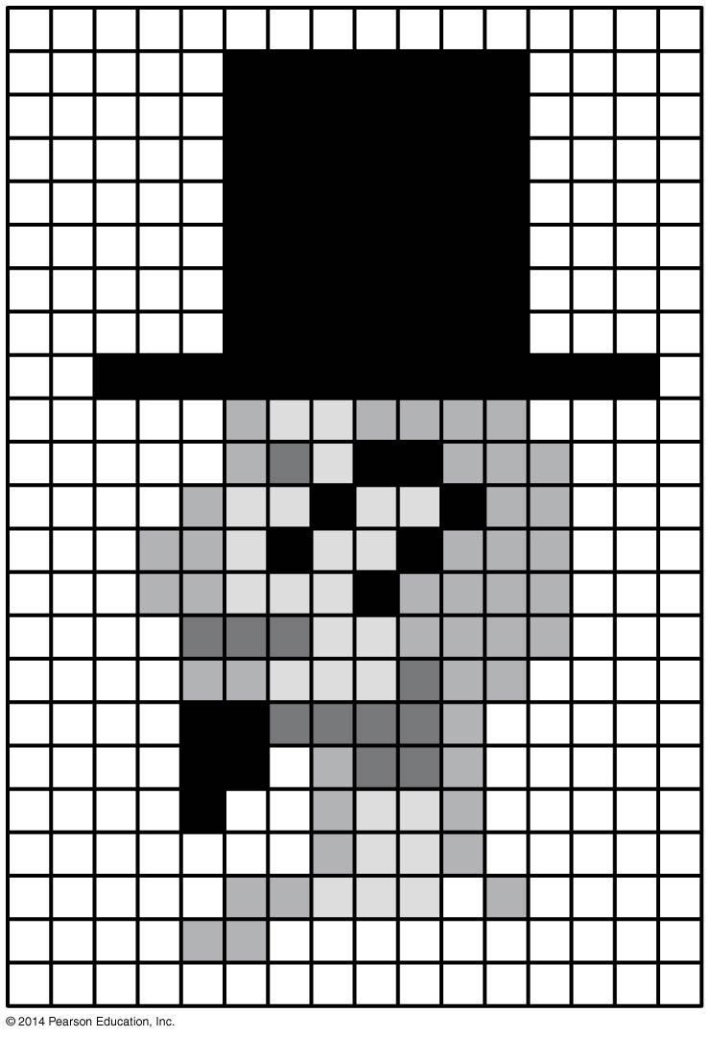
17.11 TV and Computer Monitors: CRTs, Flat Screens
The array of pixels then creates an image; this example has very low resolution. HD screens have 1080 × 1920 pixels.

Slide 41
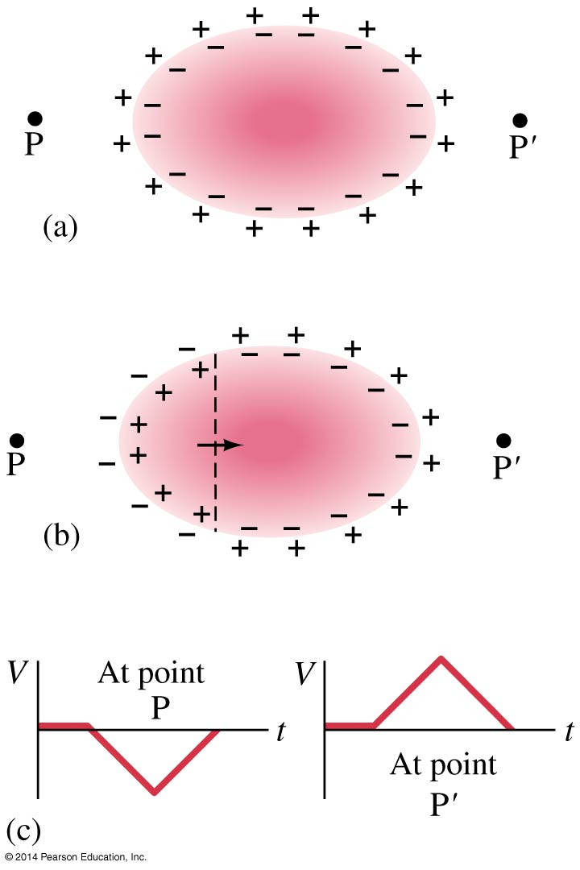
17.12 Electrocardiogram (ECG or EKG)
The electrocardiogram detects heart defects by measuring changes in potential on the surface of the heart.

Slide 42
Summary of Chapter 17
Electric potential is potential energy per unit charge:
Electric potential difference: work done to move charge from one point to another
Relationship between potential difference and field:
(17-2a)
(17-4a)

Slide 43
Summary of Chapter 17
Equipotential: line or surface along which potential is the same
Electric potential of a point charge:
Electric dipole potential drops off as 1/r²
(17-5)

Slide 44
Summary of Chapter 17
Capacitor: nontouching conductors carrying equal and opposite charge
Capacitance:
Capacitance of a parallel-plate capacitor:
(17-7)
(17-8)

Slide 45
Summary of Chapter 17
A dielectric is an insulator
Dielectric constant gives ratio of total field to external field
Energy density in electric field:
Digital electronics convert analog signal to digital approximation using binary numbers
(17-11)

