Slide 2
Chapter 16 Electric Charge and Electric Field

Slide 3
Contents of Chapter 16
Static Electricity; Electric Charge and Its Conservation
Electric Charge in the Atom
Insulators and Conductors
Induced Charge; the Electroscope
Coulomb’s Law
Solving Problems Involving Coulomb’s Law and Vectors
The Electric Field

Slide 4
Contents of Chapter 16
Electric Field Lines
Electric Fields and Conductors
Electric Forces in Molecular Biology: DNA Structure and Replication
Photocopy Machines and Computer Printers Use Electrostatics
Gauss’s Law

Slide 5
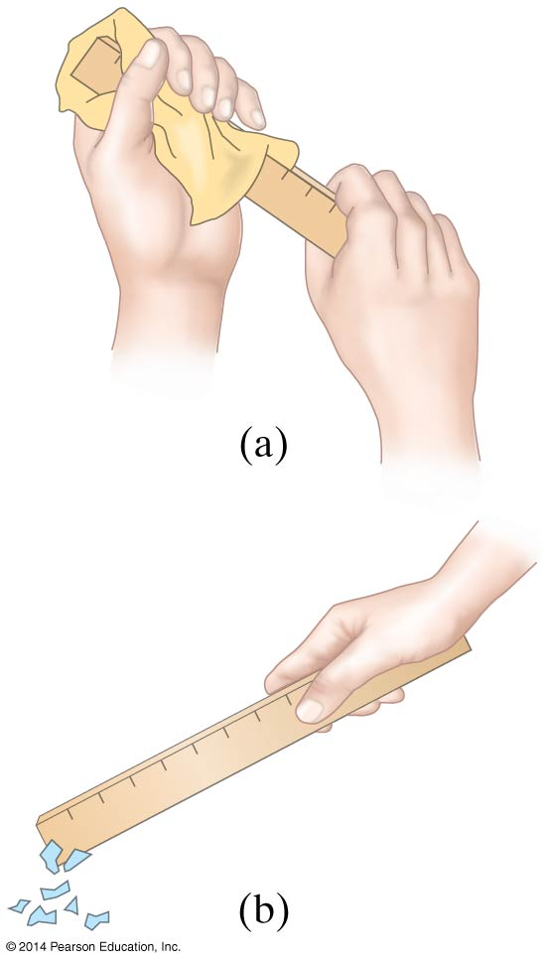
16-1 Static Electricity; Electric Charge and Its Conservation
Objects can be charged by rubbing

Slide 6
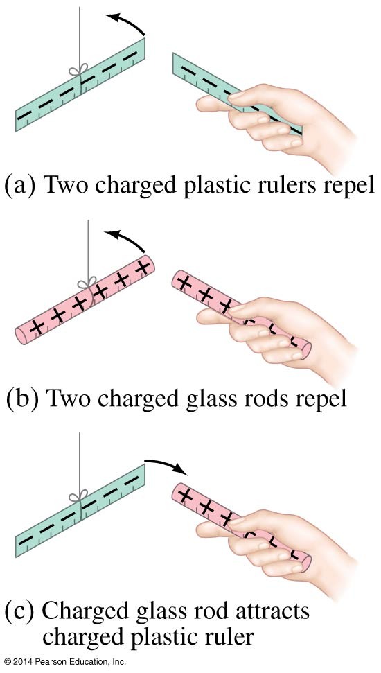
16-1 Static Electricity; Electric Charge and Its Conservation
Charge comes in two types, positive and negative; like charges repel and opposite charges attract

Slide 7
16-1 Static Electricity; Electric Charge and Its Conservation
Electric charge is conserved—the arithmetic sum of the total charge cannot change in any interaction.

Slide 8
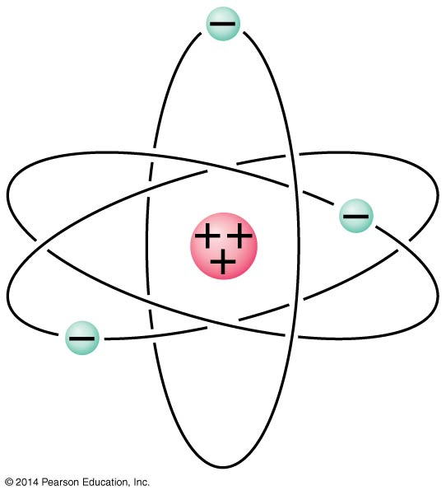
16-2 Electric Charge in the Atom
Atom:
Nucleus (small, massive, positive charge)
Electron cloud (large, very low density, negative charge)

Slide 9
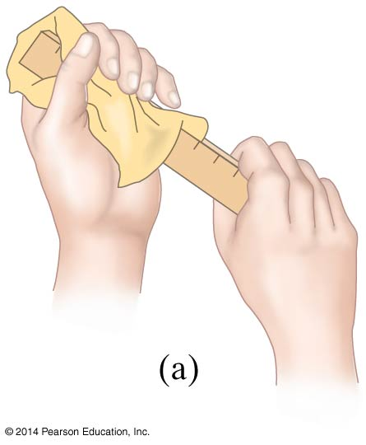
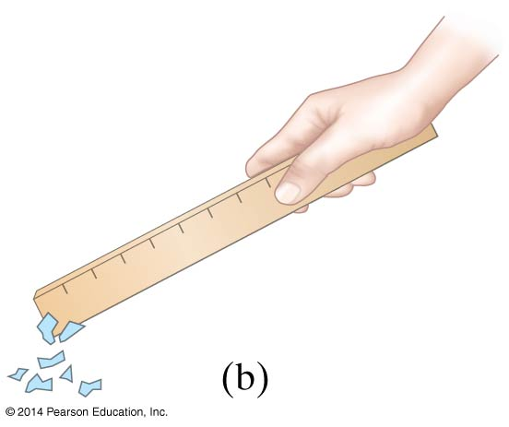
16-2 Electric Charge in the Atom
Atom is electrically neutral.
Rubbing charges objects by moving electrons from one to the other.

Slide 10
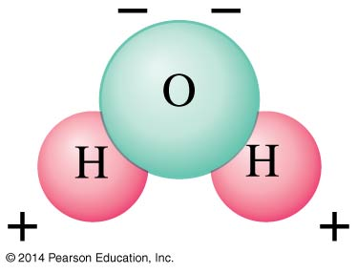
16-2 Electric Charge in the Atom
Polar molecule: neutral overall, but charge not evenly distributed

Slide 11
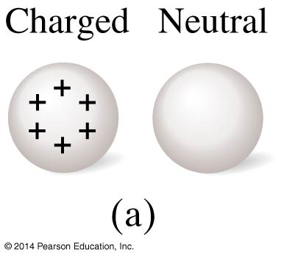
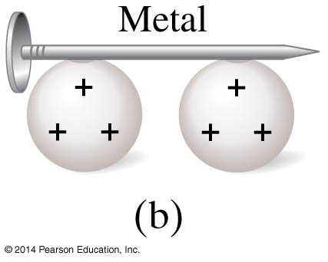
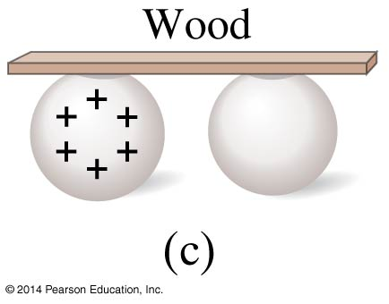
16-3 Insulators and Conductors
Conductor: Insulator:
Charge flows freely Almost no charge flows
Metals Most other materials
Some materials are semiconductors.

Slide 12
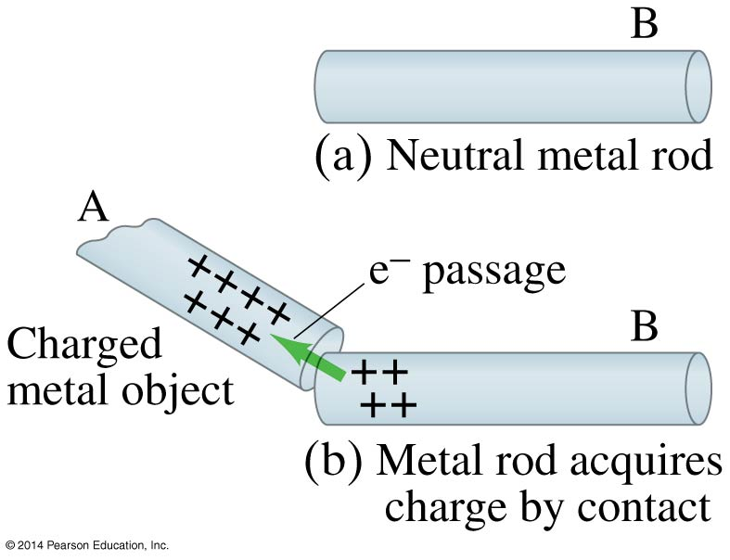
16-4 Induced Charge; the Electroscope
Metal objects can be charged by conduction:

Slide 13
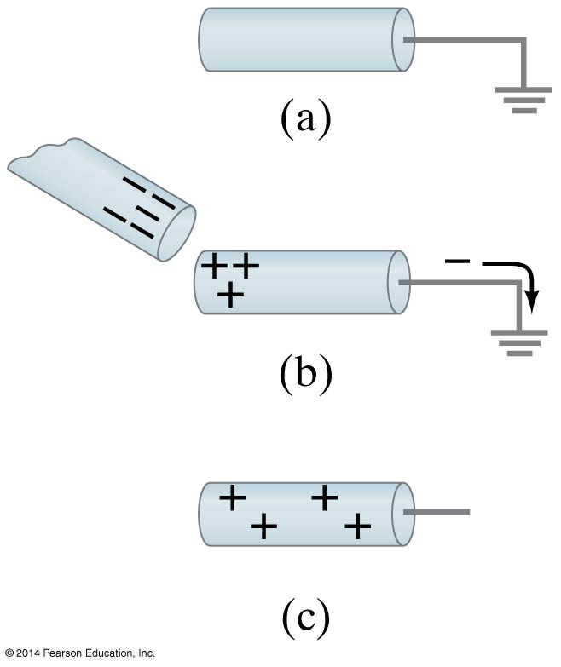
16-4 Induced Charge; the Electroscope
They can also be charged by induction:

Slide 14
16-4 Induced Charge; the Electroscope
Nonconductors won’t become charged by conduction or induction, but will experience charge separation:

Slide 15
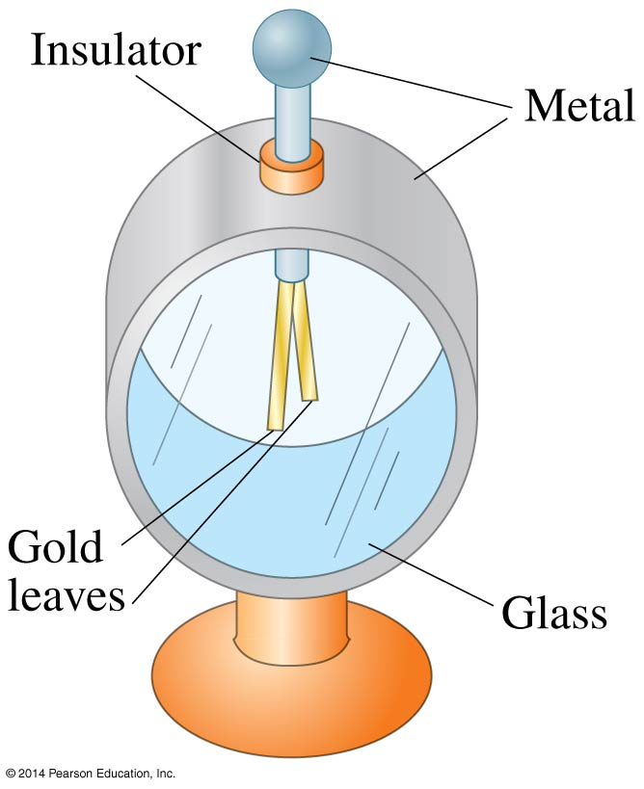
16-4 Induced Charge; the Electroscope
The electroscope can be used for detecting charge:

Slide 16
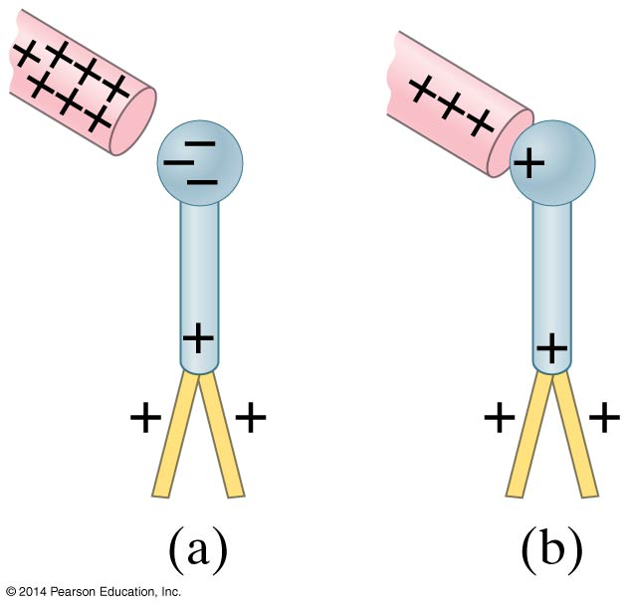
16-4 Induced Charge; the Electroscope
The electroscope can be charged either by conduction or by induction.

Slide 17
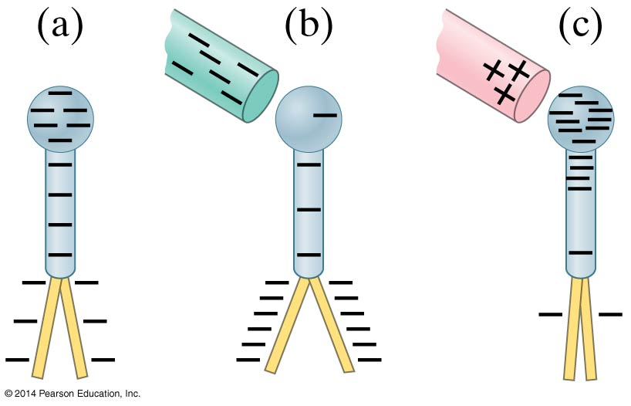
16-4 Induced Charge; the Electroscope
The charged electroscope can then be used to determine the sign of an unknown charge.

Slide 18
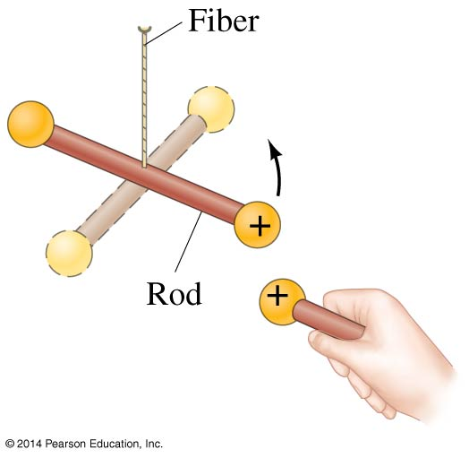
16-5 Coulomb’s Law
Experiment shows that the electric force between two charges is proportional to the product of the charges and inversely proportional to the distance between them.

Slide 19
16-5 Coulomb’s Law
Coulomb’s law:
This equation gives the magnitude of the force.
(16-1)

Slide 20
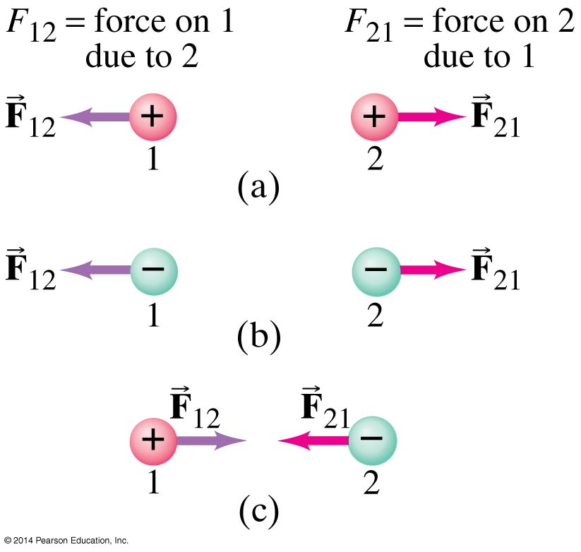
16-5 Coulomb’s Law
The force is along the line connecting the charges, and is attractive if the charges are opposite, and repulsive if they are the same.

Slide 21
16-5 Coulomb’s Law
Unit of charge: coulomb, C
The proportionality constant in Coulomb’s law is then:
k = 8.988 × 10⁹ N∙m²/C²
Charges produced by rubbing are typically around a microcoulomb:
1 µC = 10⁻⁶ C

Slide 22
16-5 Coulomb’s Law
Charge on the electron:
e = 1.602 × 10⁻¹⁹ C
Electric charge is quantized in units of the electron charge.

Slide 23
16-5 Coulomb’s Law
The proportionality constant k can also be written in terms of ε₀, the permittivity of free space:
(16-2)

Slide 24
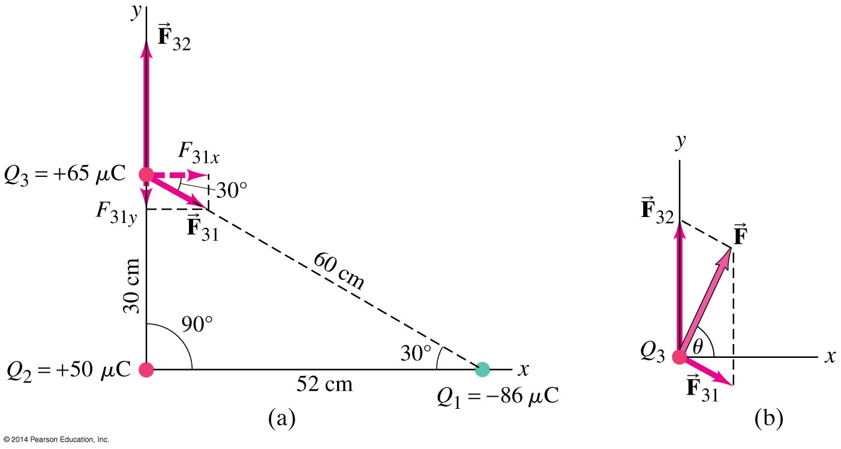
16-5 Coulomb’s Law
Coulomb’s law strictly applies only to point charges.
Superposition: for multiple point charges, the forces on each charge from every other charge can be calculated and then added as vectors.

Slide 25
16-6 Solving Problems Involving Coulomb’s Law and Vectors
The net force on a charge is the vector sum of all the forces acting on it.

Slide 26
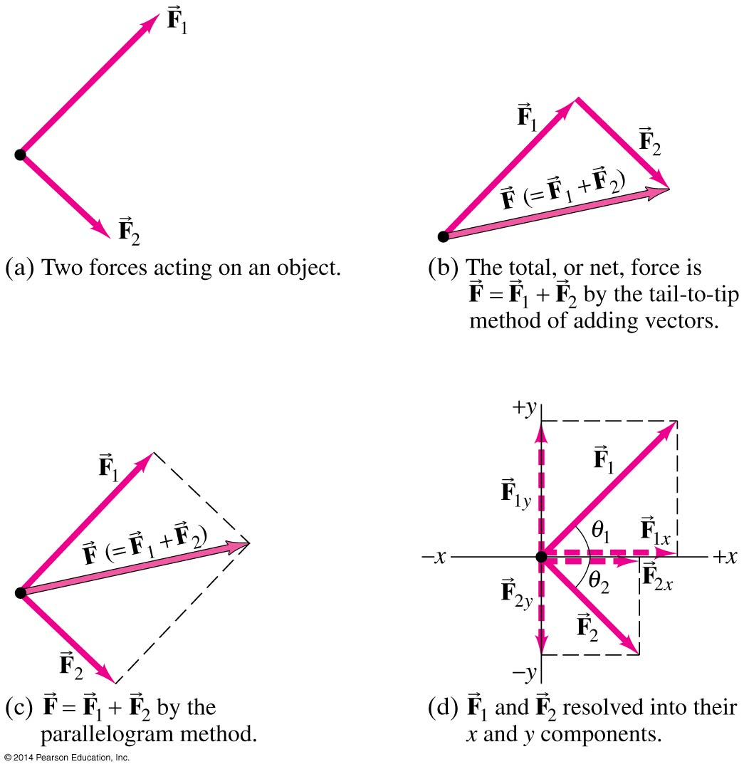
16-6 Solving Problems Involving Coulomb’s Law and Vectors
Vector addition review:

Slide 27
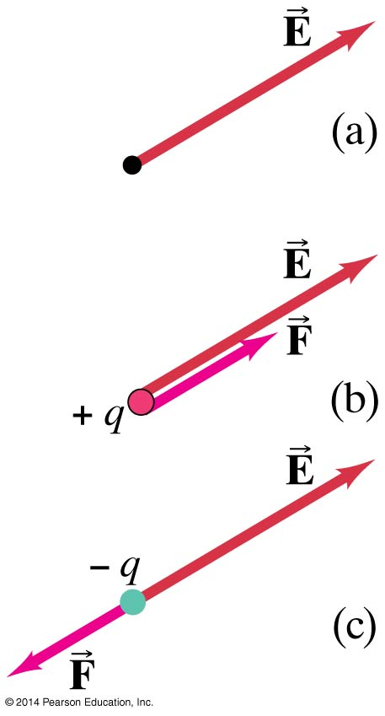
16-7 The Electric Field
The electric field is the force on a small charge, divided by the charge:
(16-3)

Slide 28
16-7 The Electric Field
For a point charge:
(16-4a)
(16-4b)

Slide 29
16-7 The Electric Field
Force on a point charge in an electric field:
Superposition principle for electric fields:
(16-5)

Slide 30
16-7 The Electric Field
Problem solving in electrostatics: electric forces and electric fields
Draw a diagram; show all charges, with signs, and electric fields and forces with directions
Calculate forces using Coulomb’s law
Add forces vectorially to get result

Slide 31
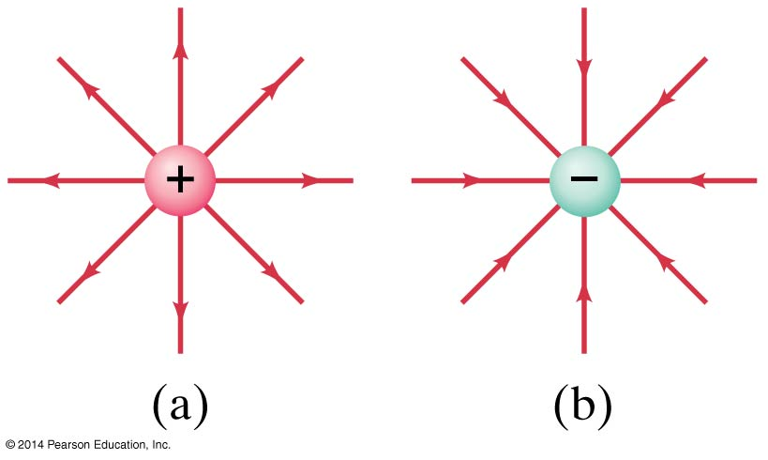
16-8 Electric Field Lines
The electric field can be represented by field lines. These lines start on a positive charge and end on a negative charge.

Slide 32
16-8 Electric Field Lines
The number of field lines starting (ending) on a positive (negative) charge is proportional to the magnitude of the charge.
The electric field is stronger where the field lines are closer together.

Slide 33
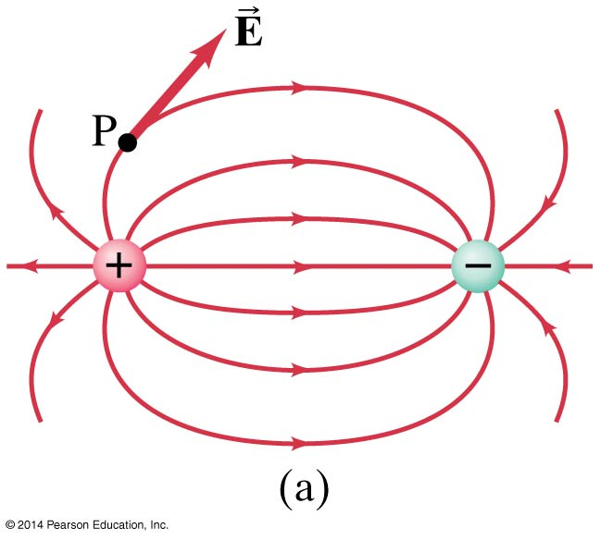
16-8 Electric Field Lines
Electric dipole: two equal charges, opposite in sign:

Slide 34
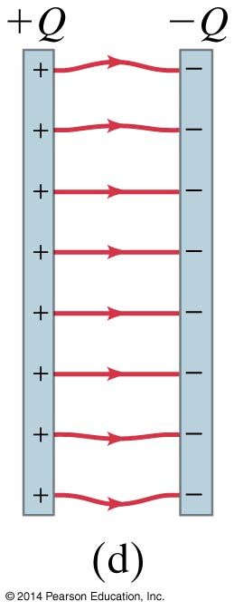
16-8 Electric Field Lines
The electric field between two closely spaced, oppositely charged parallel plates is constant.

Slide 35
16-8 Electric Field Lines
Summary of field lines:
Field lines indicate the direction of the field; the field is tangent to the line.
The magnitude of the field is proportional to the density of the lines.
Field lines start on positive charges and end on negative charges; the number is proportional to the magnitude of the charge.

Slide 36
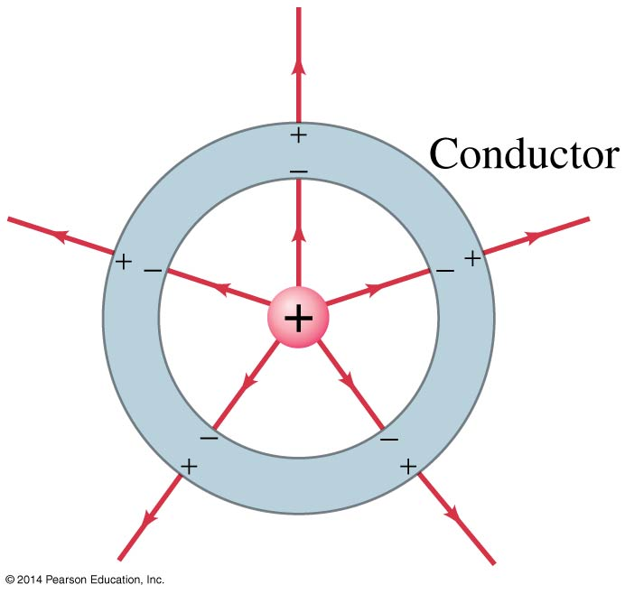
16-9 Electric Fields and Conductors
The static electric field inside a conductor is zero—if it were not, the charges would move.
The net charge on a conductor is on its surface.

Slide 37
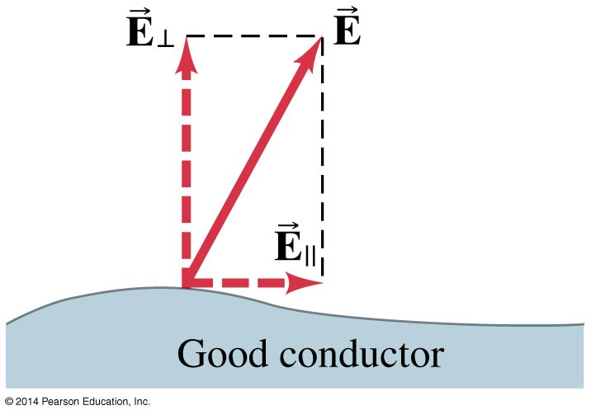
16-9 Electric Fields and Conductors
The electric field is perpendicular to the surface of a conductor—again, if it were not, charges would move.

Slide 38
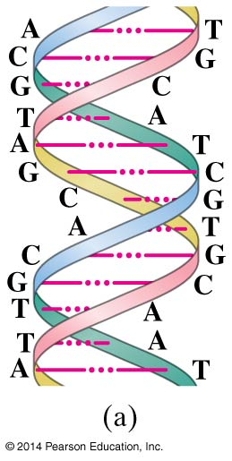
16-10 Electric Forces in Molecular Biology: DNA Structure and Replication
Molecular biology is the study of the structure and functioning of the living cell at the molecular level.
The DNA molecule is a double helix:

Slide 39
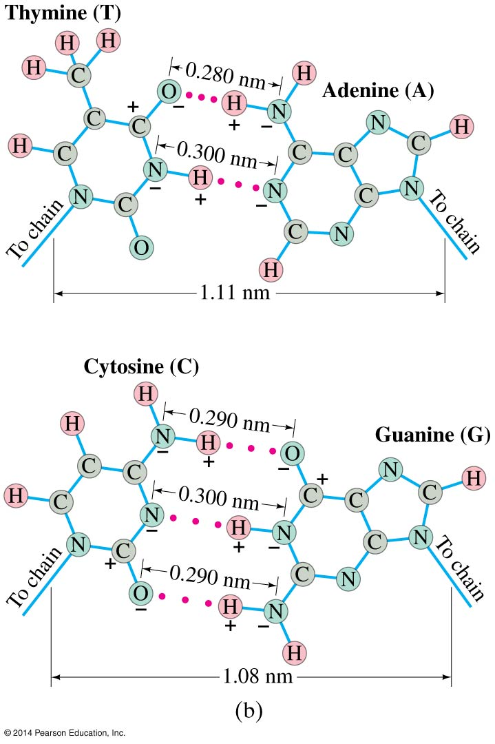
16-10 Electric Forces in Molecular Biology: DNA Structure and Replication
The A-T and G-C nucleotide bases attract each other through electrostatic forces.

Slide 40
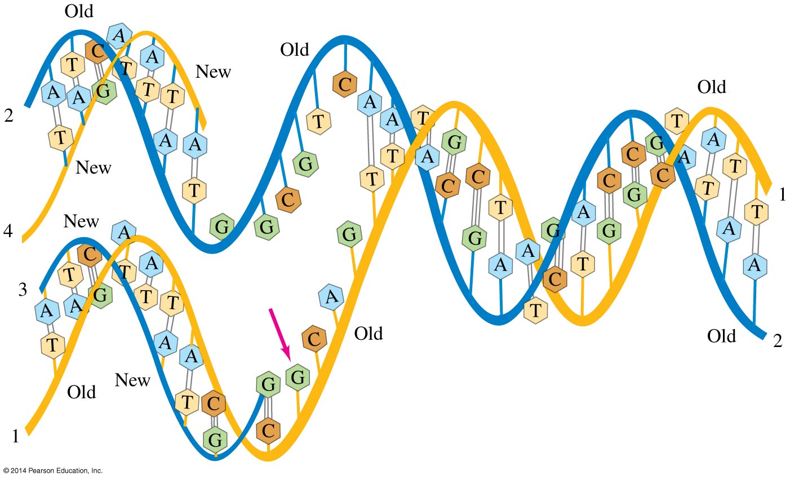
16-10 Electric Forces in Molecular Biology: DNA Structure and Replication
Replication: DNA is in a “soup” of A, C, G, and T in the cell. During random collisions, A and T will be attracted to each other, as will G and C; other combinations will not.

Slide 41
16-11 Photocopy Machines and Computer Printers Use Electrostatics
Photocopy machine:
drum is charged positively
image is focused on drum
only black areas stay charged and therefore attract toner particles
image is transferred to paper and sealed by heat

Slide 42
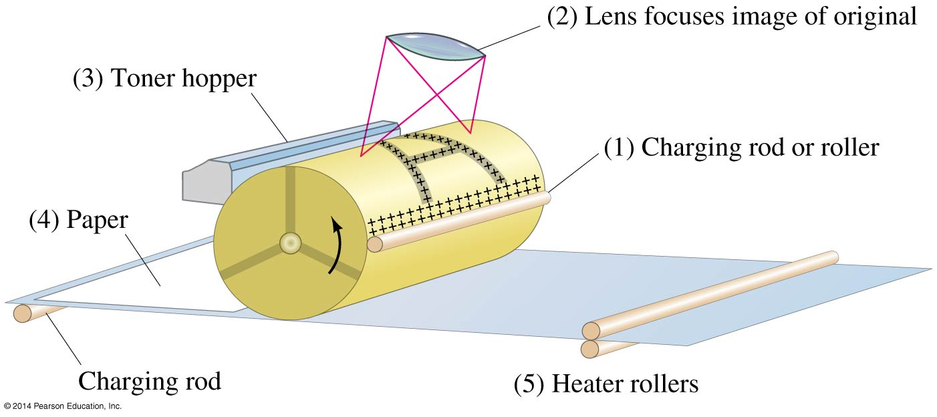
16-11 Photocopy Machines and Computer Printers Use Electrostatics

Slide 43
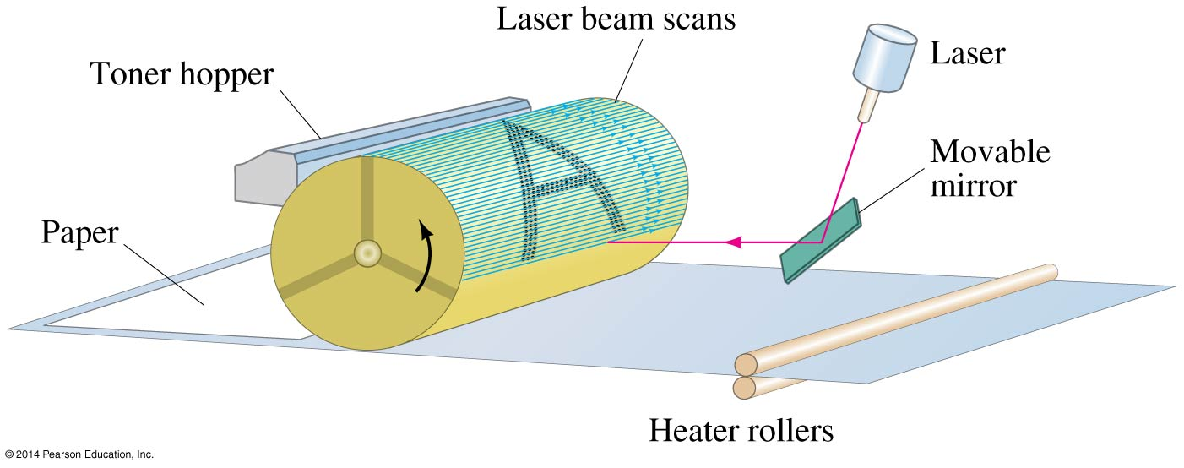
16-11 Photocopy Machines and Computer Printers Use Electrostatics
Laser printer is similar, except a computer controls the laser intensity to form the image on the drum

Slide 44
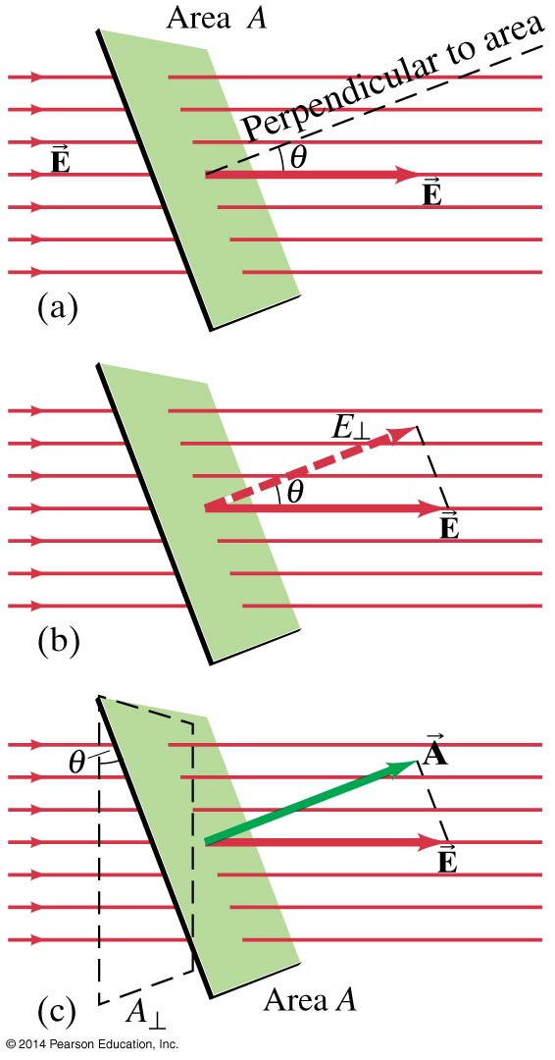
16-12 Gauss’s Law
Electric flux:
Electric flux through an area is proportional to the total number of field lines crossing the area.
(16-7)

Slide 45
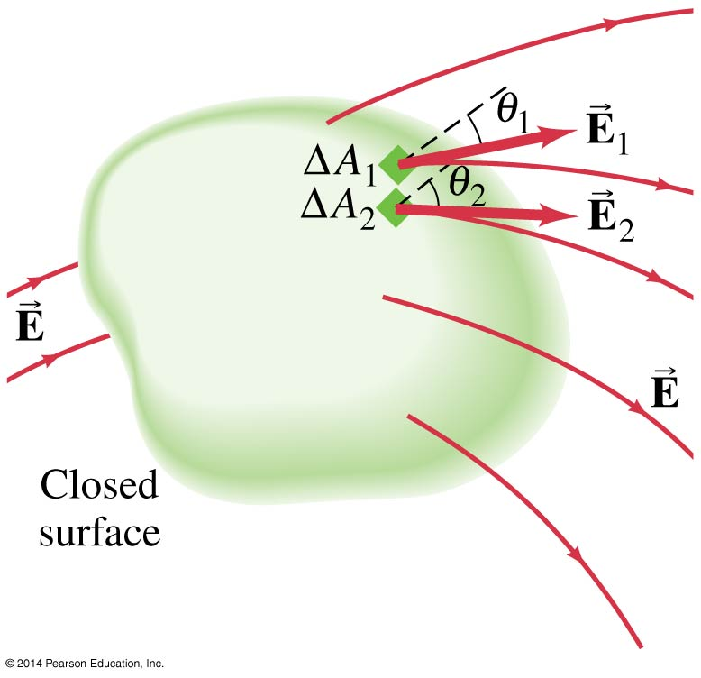
16-12 Gauss’s Law
Flux through a closed surface:

Slide 46
16-12 Gauss’s Law
The net number of field lines through the surface is proportional to the charge enclosed, and also to the flux, giving Gauss’s law:
This can be used to find the electric field in situations with a high degree of symmetry.
(16-9)

Slide 47
Summary of Chapter 16
Two kinds of electric charge—positive and negative
Charge is conserved
Charge on electron: e = 1.602 × 10⁻¹⁹ C
Conductors: electrons free to move
Insulators: nonconductors

Slide 48
Summary of Chapter 16
Charge is quantized in units of e
Objects can be charged by conduction or induction
Coulomb’s law:
Electric field is force per unit charge:
(16-1)
(16-3)

Slide 49
Summary of Chapter 16
Electric field of a point charge:
Electric field can be represented by electric field lines
Static electric field inside conductor is zero; surface field is perpendicular to surface
Electric flux:
Gauss’s law:
(16-4a)
(16-7)
(16-9)

