Slide 2
Chapter 15 The Laws of Thermodynamics

Slide 3
Contents of Chapter 15
The First Law of Thermodynamics
Thermodynamic Processes and the First Law
Human Metabolism and the First Law
The Second Law of Thermodynamics—Introduction
Heat Engines
Refrigerators, Air Conditioners, and Heat Pumps

Slide 4
Contents of Chapter 15
Entropy and the Second Law of Thermodynamics
Order to Disorder
Unavailability of Energy; Heat Death
Statistical Interpretation of Entropy and the Second Law
Thermal Pollution, Global Warming, and Energy Resources

Slide 5
15-1 The First Law of Thermodynamics
The change in internal energy of a closed system will be equal to the energy added to the system minus the work done by the system on its surroundings.
This is the law of conservation of energy, written in a form useful to systems involving heat transfer.
(15-1)

Slide 6
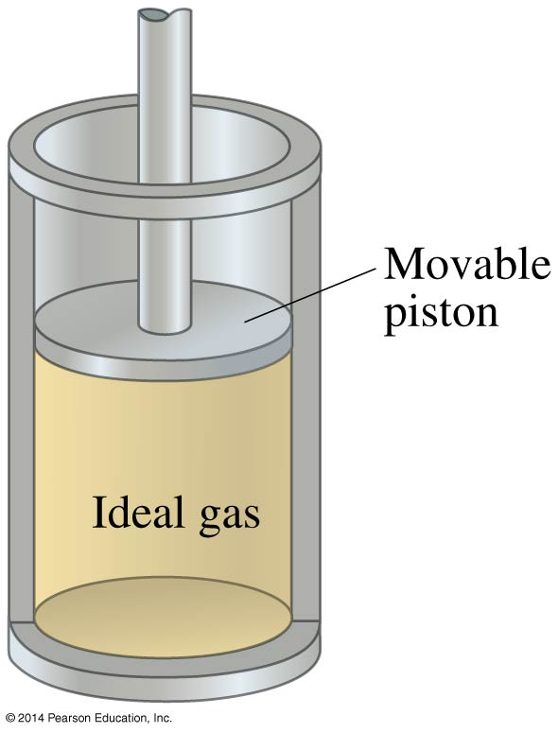
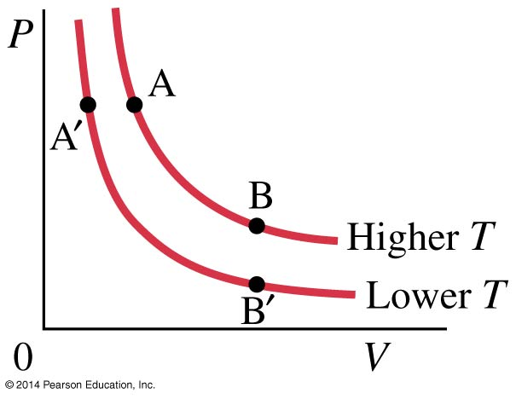
15-2 Thermodynamic Processes and the First Law
An isothermal process is one where the temperature does not change.

Slide 7
15-2 Thermodynamic Processes and the First Law
In order for an isothermal process to take place, we assume the system is in contact with a heat reservoir.
In general, we assume that the system remains in equilibrium throughout all processes.

Slide 8
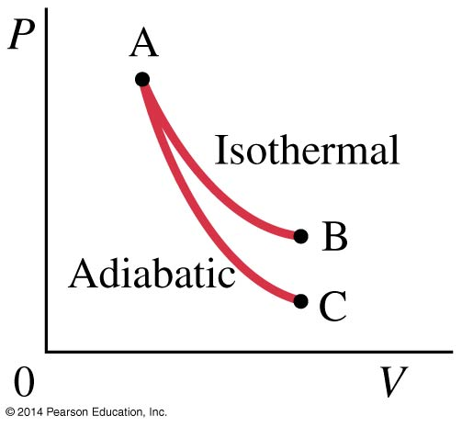
15-2 Thermodynamic Processes and the First Law
An adiabatic process is one where there is no heat flow into or out of the system.

Slide 9
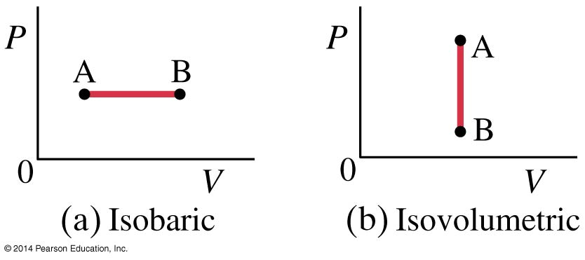
15-2 Thermodynamic Processes and the First Law
An isobaric process (a) occurs at constant pressure; an isovolumetric one (b) at constant volume.

Slide 10
15-2 Thermodynamic Processes and the First Law
If the pressure is constant, the work done is the pressure multiplied by the change in volume:
In an isometric process, the volume does not change, so the work done is zero.
(15-3)

Slide 11
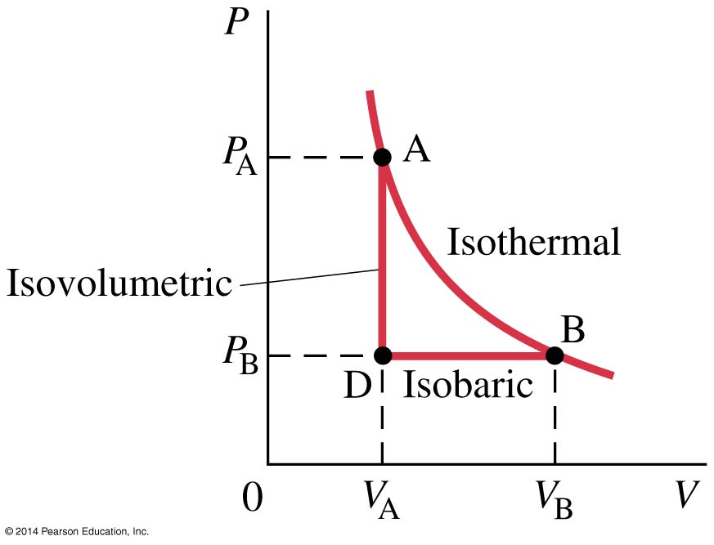
15-2 Thermodynamic Processes and the First Law
For processes where the pressure varies, the work done is the area under the P-V curve.

Slide 12
15-2 Thermodynamic Processes and the First Law

Slide 13
15-3 Human Metabolism and the First Law
If we apply the first law of thermodynamics to the human body:
we know that the body can do work. If the internal energy is not to drop, there must be energy coming in. It isn’t in the form of heat; the body loses heat rather than absorbing it. Rather, it is the chemical potential energy stored in foods.
(15-1)

Slide 14
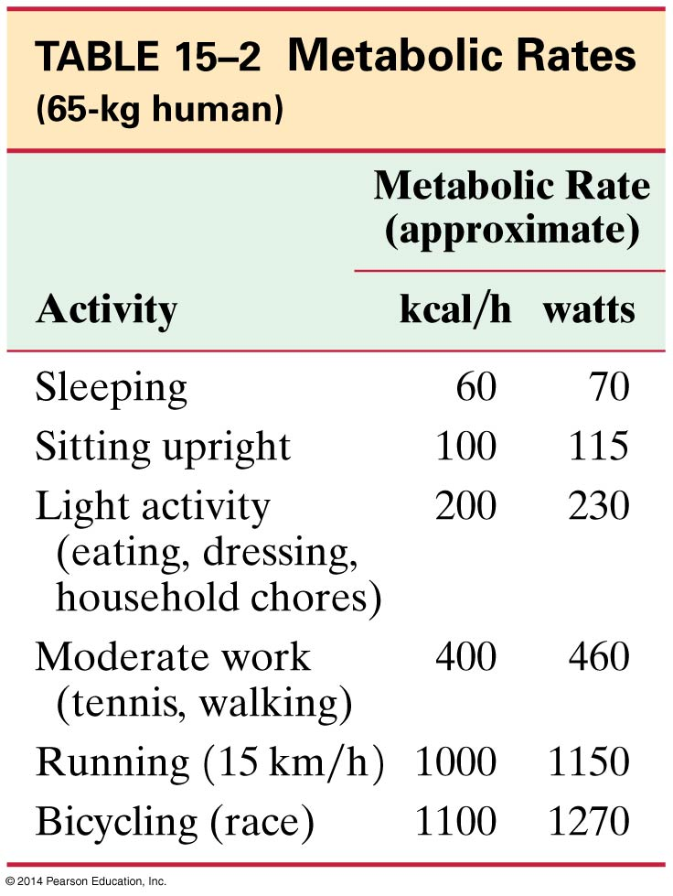
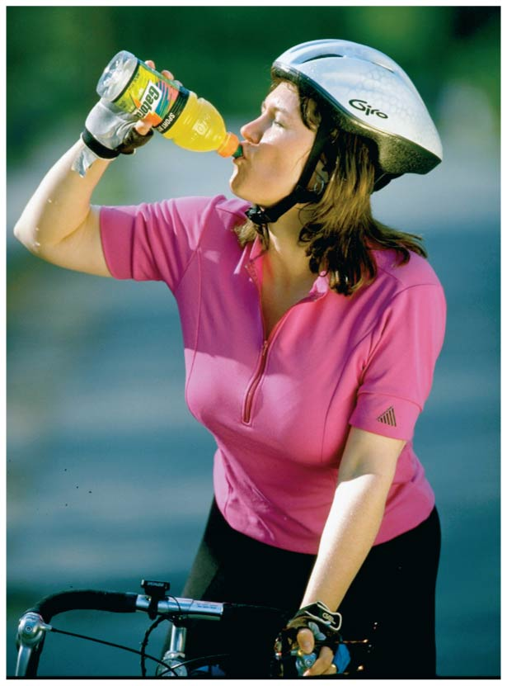
15-3 Human Metabolism and the First Law
The metabolic rate is the rate at which internal energy is transformed in the body.

Slide 15
15-4 The Second Law of Thermodynamics – Introduction
The absence of the process illustrated above indicates that conservation of energy is not the whole story. If it were, movies run backwards would look perfectly normal to us!

Slide 16
15-4 The Second Law of Thermodynamics – Introduction
The second law of thermodynamics is a statement about which processes occur and which do not. There are many ways to state the second law; here is one:
Heat can flow spontaneously from a hot object to a cold object; it will not flow spontaneously from a cold object to a hot object.

Slide 17
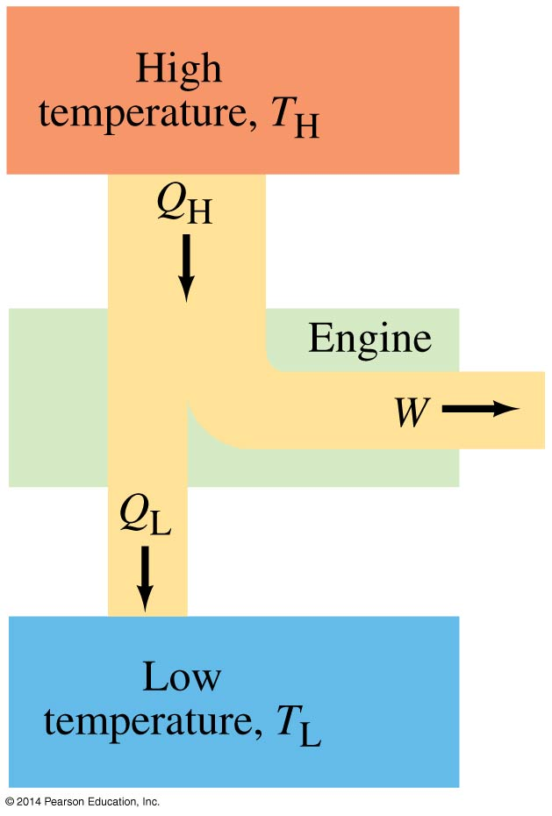
15-5 Heat Engines
It is easy to produce thermal energy using work, but how does one produce work using thermal energy?
This is a heat engine; mechanical energy can be obtained from thermal energy only when heat can flow from a higher temperature to a lower temperature.

Slide 18
15-5 Heat Engines
We will discuss only engines that run in a repeating cycle; the change in internal energy over a cycle is zero, as the system returns to its initial state.
The high temperature reservoir transfers an amount of heat Q_{H} to the engine, where part of it is transformed into work W and the rest, Q_{L}, is exhausted to the lower temperature reservoir. Note that all three of these quantities are positive.

Slide 19
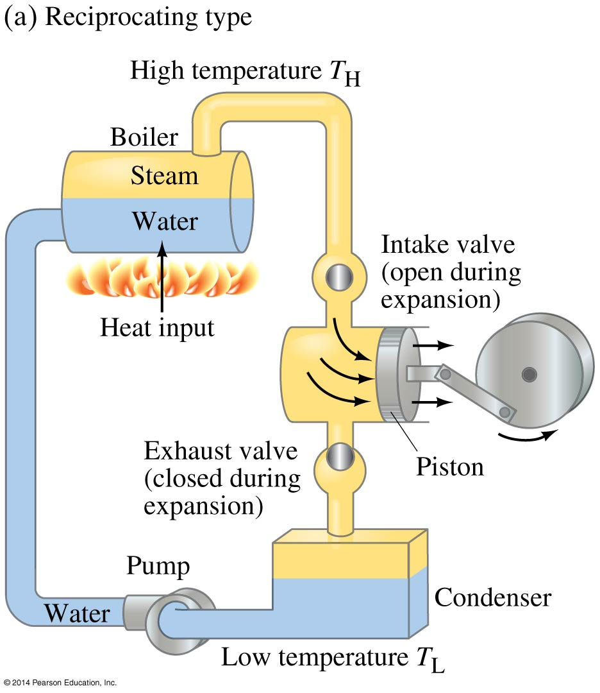
15-5 Heat Engines
A steam engine is one type of heat engine.

Slide 20
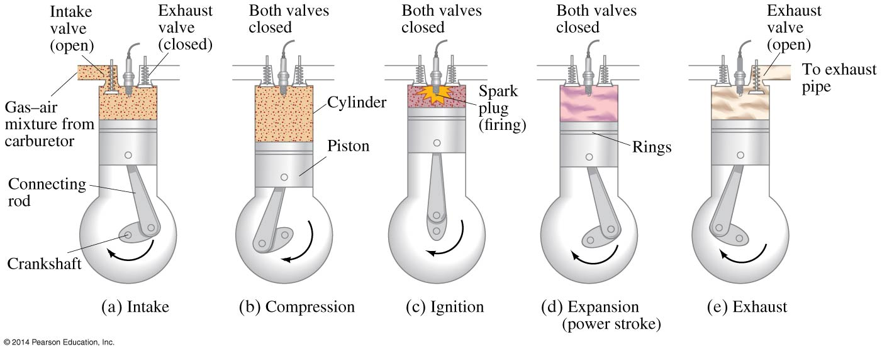
15-5 Heat Engines
The internal combustion engine is a type of heat engine as well.

Slide 21
15-5 Heat Engines
Why does a heat engine need a temperature difference?
Otherwise the work done on the system in one part of the cycle will be equal to the work done by the system in another part, and the net work will be zero.

Slide 22
15-5 Heat Engines
The efficiency of the heat engine is the ratio of the work done to the heat input:
Using conservation of energy to eliminate W, we find:
(15-4a)
(15-4b)

Slide 23
15-5 Heat Engines
The Carnot engine was created to examine the efficiency of a heat engine. It is idealized, as it has no friction. Each leg of its cycle is reversible.
The Carnot cycle consists of:
Isothermal expansion
Adiabatic expansion
Isothermal compression
Adiabatic compression
An example is on the next slide.

Slide 24
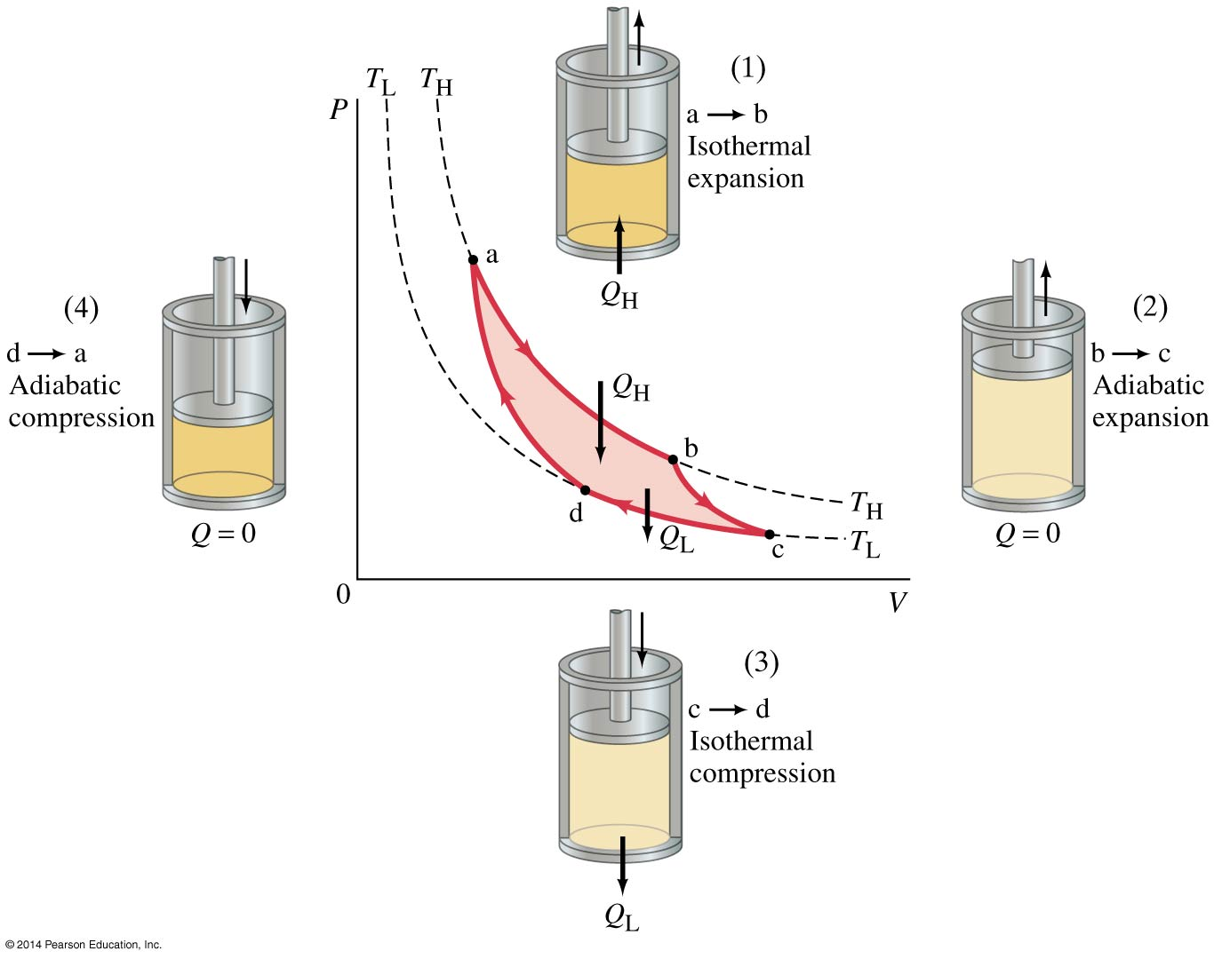
15-5 Heat Engines

Slide 25
15-5 Heat Engines
For an ideal reversible engine, the efficiency can be written in terms of the temperature:
From this we see that 100% efficiency can be achieved only if the cold reservoir is at absolute zero, which is impossible.
Real engines have some frictional losses; the best achieve 60-80% of the Carnot value of efficiency.
(15-5)

Slide 26
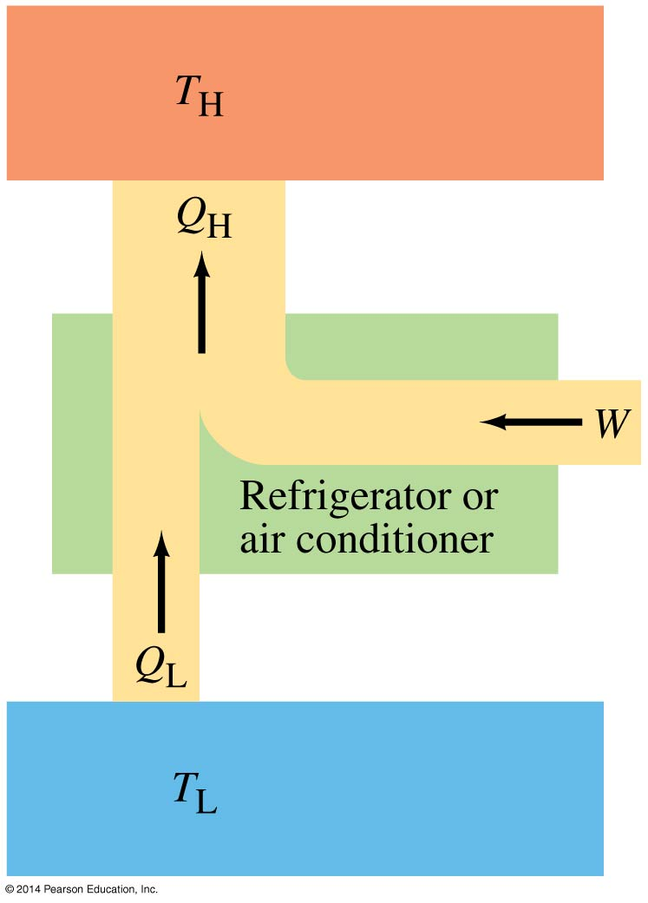
15-6 Refrigerators, Air Conditioners, and Heat Pumps
These appliances can be thought of as heat engines operating in reverse.
By doing work, heat is extracted from the cold reservoir and exhausted to the hot reservoir.

Slide 27
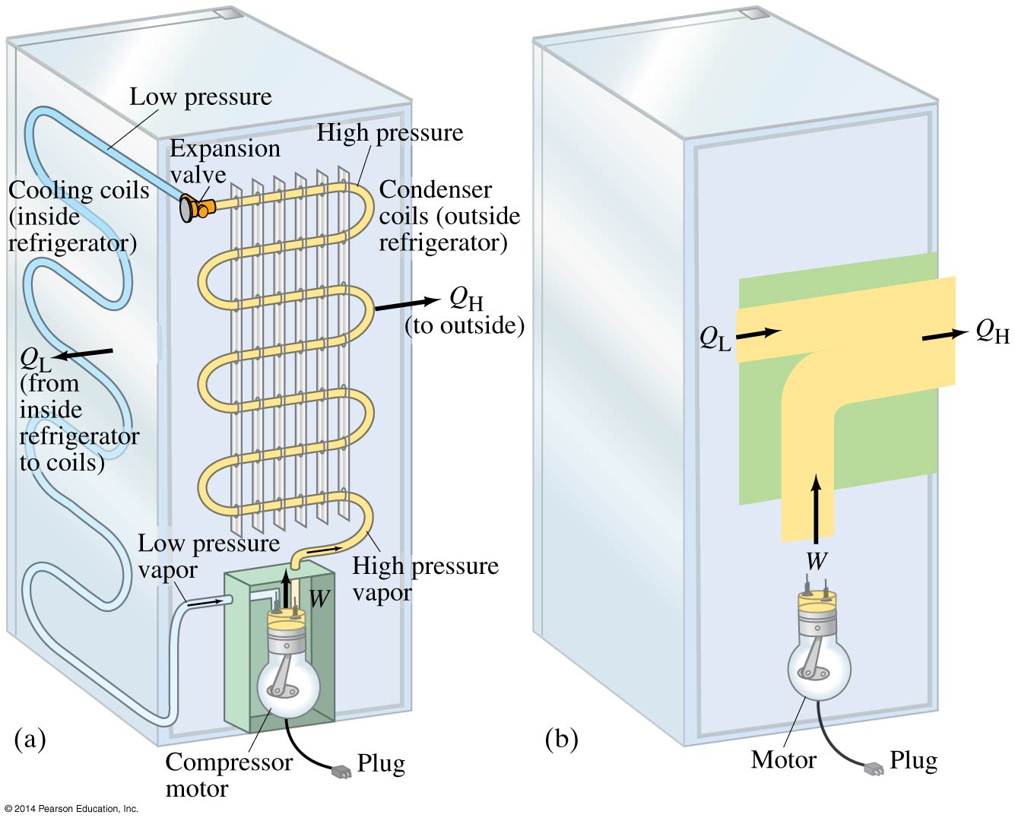
15-6 Refrigerators, Air Conditioners, and Heat Pumps

Slide 28
15-6 Refrigerators, Air Conditioners, and Heat Pumps
Refrigerator performance is measured by the coefficient of performance (COP):
Substituting:
(15-6a)
(15-6b)
(15-6c)

Slide 29
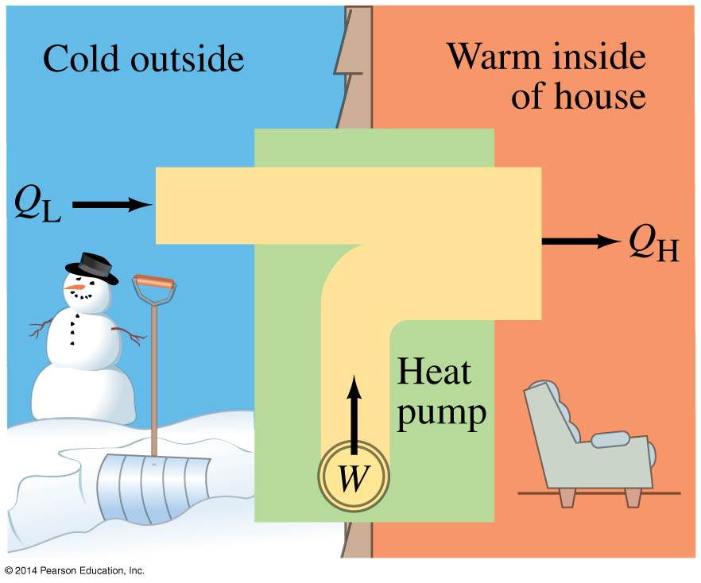
15-6 Refrigerators, Air Conditioners, and Heat Pumps
A heat pump can heat a house in the winter:
(15-7)

Slide 30
15-7 Entropy and the Second Law of Thermodynamics
Definition of the change in entropy S when an amount of heat Q is added:
Another statement of the second law of thermodynamics:
The total entropy of an isolated system never decreases.
(15-8)

Slide 31
15-8 Order to Disorder
Entropy is a measure of the disorder of a system. This gives us yet another statement of the second law:
Natural processes tend to move toward a state of greater disorder.
Example: If you put milk and sugar in your coffee and stir it, you wind up with coffee that is uniformly milky and sweet. No amount of stirring will get the milk and sugar to come back out of solution.

Slide 32
15-8 Order to Disorder
Another example: when a tornado hits a building, there is major damage. You never see a tornado approach a pile of rubble and leave a building behind when it passes.
Thermal equilibrium is a similar process—the uniform final state has more disorder than the separate temperatures in the initial state.

Slide 33
15-8 Order to Disorder
Growth of an individual, and evolution of a species, are both processes of increasing order. Do they violate the second law of thermodynamics?
No! These are not isolated systems. Energy comes into them in the form of food, sunlight, and air, and energy also leaves them.
The second law of thermodynamics is the one that defines the arrow of time—processes will occur that are not reversible, and movies that run backward will look silly.

Slide 34
15-9 Unavailability of Energy; Heat Death
Another consequence of the second law:
In any natural process, some energy becomes unavailable to do useful work.
If we look at the universe as a whole, it seems inevitable that, as more and more energy is converted to unavailable forms, the ability to do work anywhere will gradually vanish. This is called the heat death of the universe.

Slide 35
15-10 Statistical Interpretation of Entropy and the Second Law
A macrostate of a system is specified by giving its macroscopic properties—temperature, pressure, and so on.
A microstate of a system describes the position and velocity of every particle.
For every macrostate, there are one or more microstates.

Slide 36
15-10 Statistical Interpretation of Entropy and the Second Law
A simple example: tossing four coins. The macrostates describe how many heads and tails there are; the microstates list the different ways of achieving that macrostate.

Slide 37
15-10 Statistical Interpretation of Entropy and the Second Law
We assume that each microstate is equally probable; the probability of each macrostate then depends on how many microstates are in it.
The number of microstates quickly becomes very large if we have even 100 coins instead of four; the table on the next slide lists some macrostates, how many microstates they have, and the relative probability that each macrostate will occur. Note that the probability of getting fewer than 20 heads or tails is extremely small.

Slide 38
15-10 Statistical Interpretation of Entropy and the Second Law

Slide 39
15-10 Statistical Interpretation of Entropy and the Second Law
Now we can say that the second law does not forbid certain processes; all microstates are equally likely. However, some of them have an extraordinarily low probability of occurring—a lake freezing on a hot summer day, broken crockery re-assembling itself; all the air in a room moving into a single corner.
Remember how low some probabilities got just in going from four coins to 100—if we are dealing with many moles of material, they can become so rare as to be effectively impossible.

Slide 40
15-11 Thermal Pollution, Global Warming, and Energy Resources
The generation of electricity often involves a form of heat engine, whether it is powered by biomass (a) or solar power (b). Cooling towers (c) are a feature of many power plants.

Slide 41
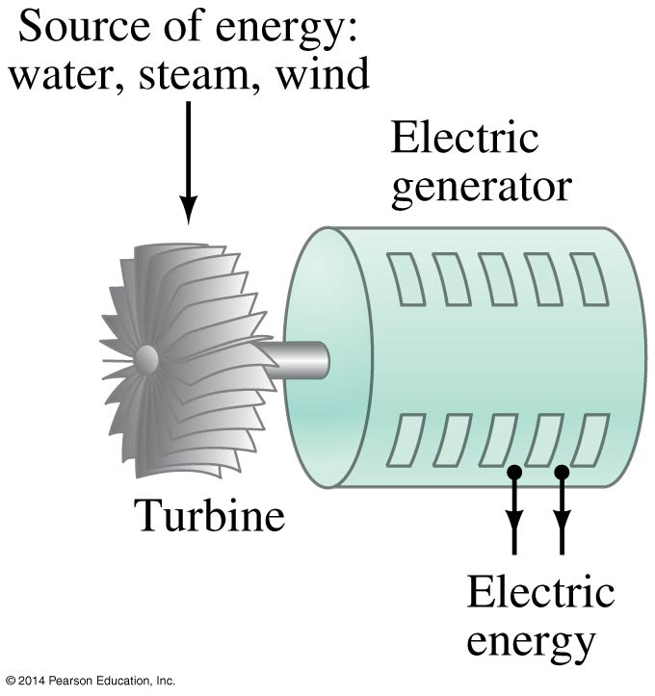
15-11 Thermal Pollution, Global Warming, and Energy Resources
The heat output of any heat engine, Q_{L}, is referred to as thermal pollution, as it must be absorbed by the environment.

Slide 42
15-11 Thermal Pollution, Global Warming, and Energy Resources
Air pollution is emitted by power plants, industries, and consumers. In addition, most forms of combustion result in a buildup of CO₂ in the atmosphere, contributing to global warming. This can be minimized through careful choices of fuels and processes.
The thermal pollution, however, is a consequence of the second law, and is unavoidable; it can be reduced only by reducing the amount of energy we use.

Slide 43
15-11 Thermal Pollution, Global Warming, and Energy Resources
Problem solving in thermodynamics:
Define what is part of the system and what is part of the surroundings.
Be careful of the signs for work and heat when using the first law of thermodynamics.
Be careful about units; be sure that you are using the same ones throughout the problem.
Express temperatures in kelvins.

Slide 44
15-11 Thermal Pollution, Global Warming, and Energy Resources
5. Efficiency is always less than 1.
6. Entropy increases when heat is added, and decreases when heat is removed.

Slide 45
Summary of Chapter 15
First law of thermodynamics:
Isothermal process: temperature is constant.
Adiabatic process: no heat is exchanged.
Work done by gas at constant pressure:
Heat engine changes heat into useful work; needs temperature difference.
Efficiency of a heat engine:
(15-1)
(15-3)
(15-4a)
(15-4b)

Slide 46
Summary of Chapter 15
Upper limit on efficiency:
Refrigerators and air conditioners do work to extract heat from a cooler region and send it to a warmer region:
A heat pump is similar:
(15-5)
(15-6a)
(15-7)

Slide 47
Summary of Chapter 15
Second law of thermodynamics:
heat flows spontaneously from a hot object to a cold one, but not the reverse
a given amount of heat cannot be changed entirely to work
natural processes tend to increase entropy.
Change in entropy:
Entropy is a measure of disorder.
As time goes on, less and less energy is available to do useful work.
(15-8)

