Slide 2
Chapter 14 Heat

Slide 3
Contents of Chapter 14
Heat As Energy Transfer
Internal Energy
Specific Heat
Calorimetry—Solving Problems
Latent Heat
Heat Transfer: Conduction
Heat Transfer: Convection
Heat Transfer: Radiation

Slide 4
14-1 Heat As Energy Transfer
We often speak of heat as though it were a material that flows from one object to another; it is not. Rather, it is a form of energy.
Unit of heat: calorie (cal)
1 cal is the amount of heat necessary to raise the temperature of 1 g of water by 1 Celsius degree.
Don’t be fooled—the calories on our food labels are really kilocalories (kcal or Calories), the heat necessary to raise 1 kg of water by 1 Celsius degree.

Slide 5
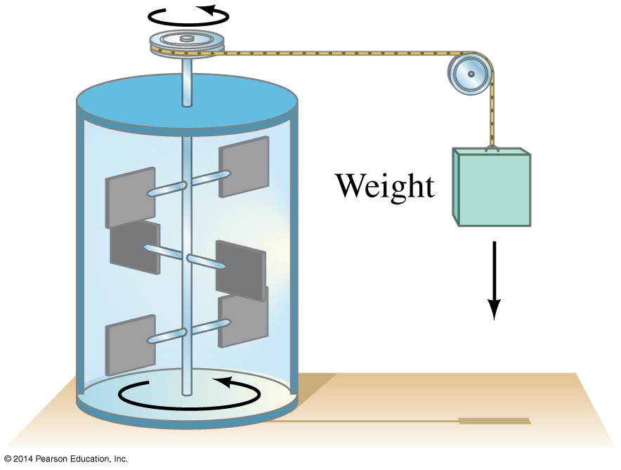
14-1 Heat As Energy Transfer
If heat is a form of energy, it ought to be possible to equate it to other forms. The experiment below found the mechanical equivalent of heat by using the falling weight to heat the water:
4.186 J = 1 cal
4.186 kJ = 1 kcal

Slide 6
14-1 Heat As Energy Transfer
Definition of heat:
Heat is energy transferred from one object to another because of a difference in temperature.
Remember that the temperature of a gas is a measure of the kinetic energy of its molecules.

Slide 7
14-2 Internal Energy
The sum total of all the energy of all the molecules in a substance is its internal (or thermal) energy.
Temperature: measures molecules’ average kinetic energy
Internal energy: total energy of all molecules
Heat: transfer of energy due to difference in temperature

Slide 8
14-2 Internal Energy
Internal energy of an ideal (atomic) gas is equal to the average kinetic energy per molecule multiplied by the number of molecules.
But since we know the average kinetic energy in terms of the temperature, we can write:
(14-1)

Slide 9
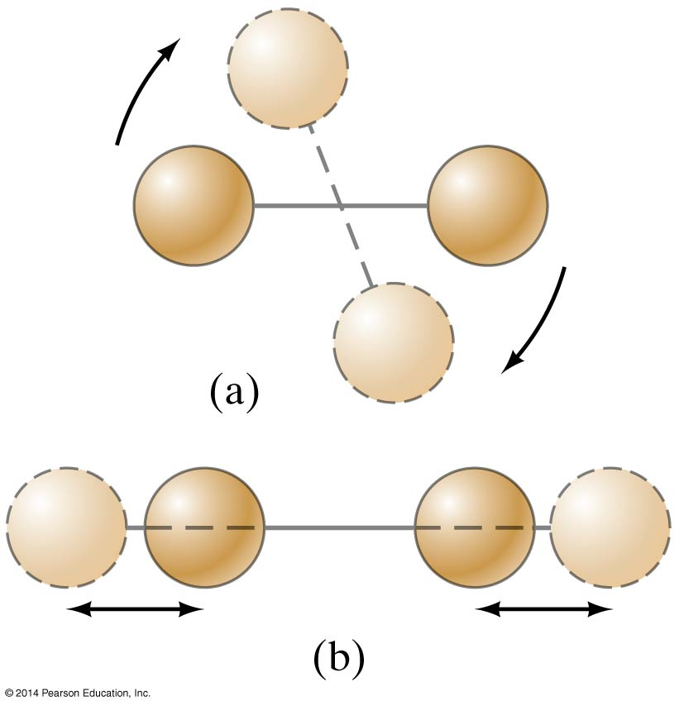
14-2 Internal Energy
If the gas is molecular rather than atomic, rotational and vibrational kinetic energy needs to be taken into account as well.

Slide 10
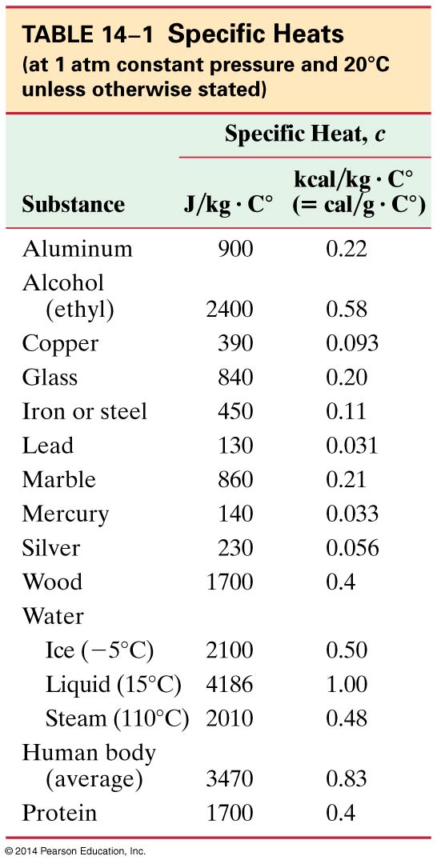
14-3 Specific Heat
The amount of heat required to change the temperature of a material is proportional to the mass and to the temperature change:
The specific heat, c, is characteristic of the material. Some values are listed at left.
(14-2)

Slide 11
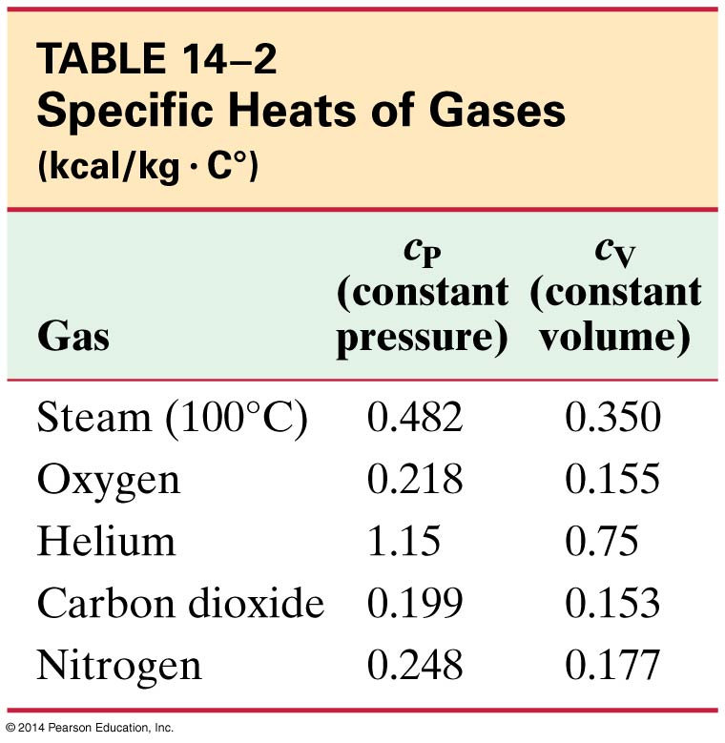
14-3 Specific Heat
Specific heats of gases are more complicated, and are generally measured at constant pressure (c_{P}) or constant volume (c_{V}).
Some sample values:

Slide 12
14-4 Calorimetry—Solving Problems
Closed system: no mass enters or leaves, but energy may be exchanged
Open system: mass may transfer as well
Isolated system: closed system where no energy in any form is transferred
For an isolated system,
Energy out of one part = energy into another part
Or: heat lost = heat gained

Slide 13
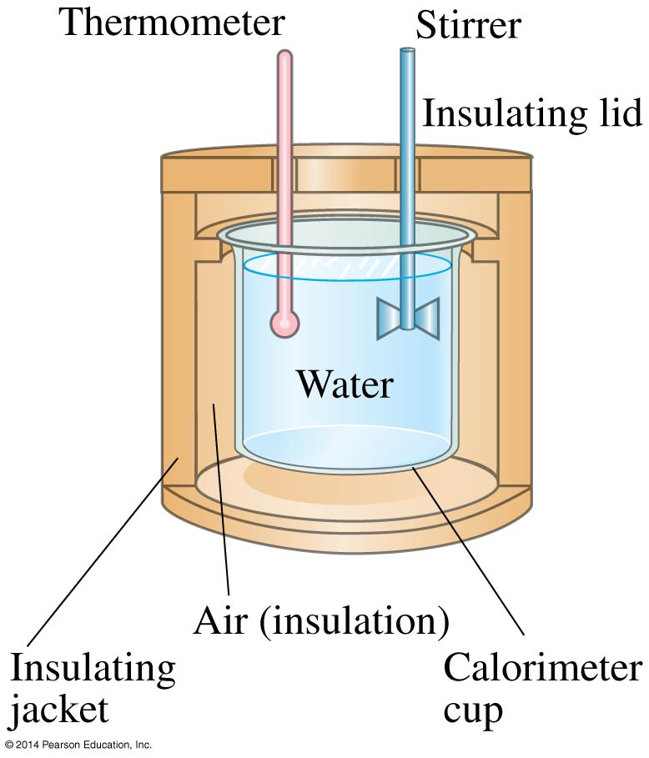
14-4 Calorimetry – Solving Problems
The instrument to the left is a calorimeter, which makes quantitative measurements of heat exchange. A sample is heated to a well-measured high temperature, plunged into the water, and the equilibrium temperature measured. This gives the specific heat of the sample.

Slide 14
14-4 Calorimetry—Solving Problems
Another type of calorimeter is called a bomb calorimeter; it measures the thermal energy released when a substance burns.
This is the way the caloric content of foods is measured.

Slide 15
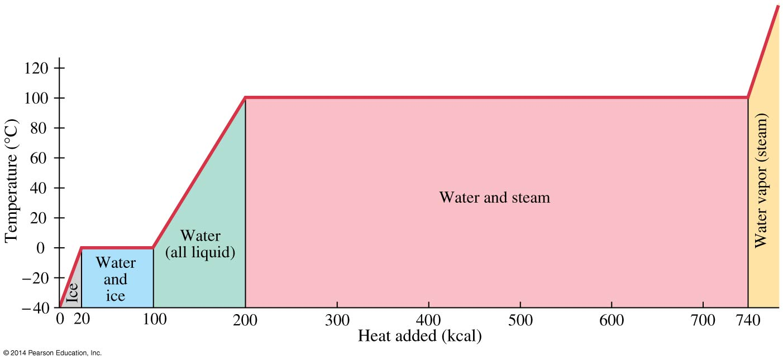
14-5 Latent Heat
Energy is required for a material to change phase, even though its temperature is not changing.

Slide 16
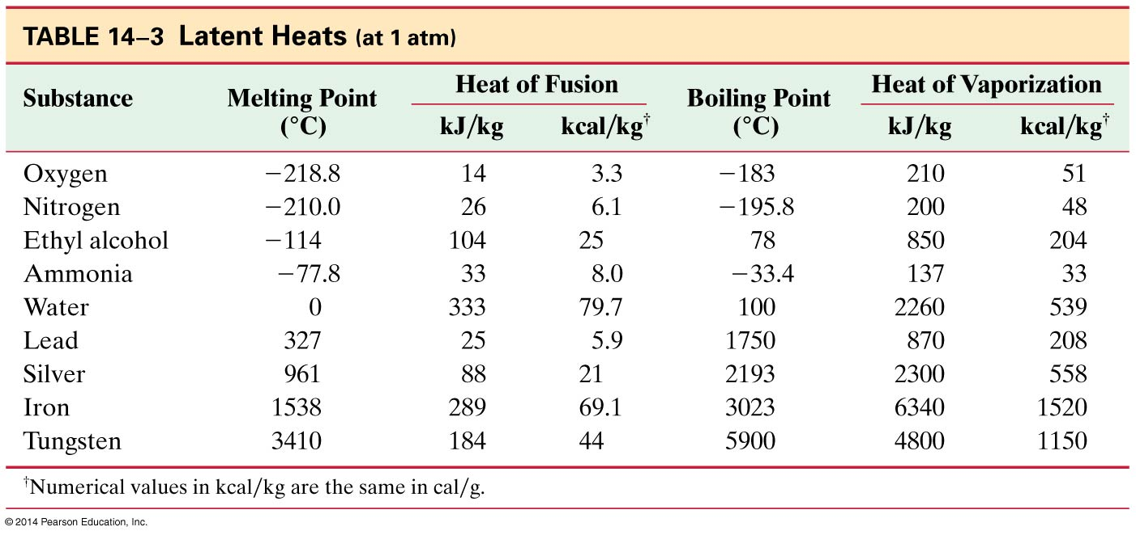
14-5 Latent Heat
Heat of fusion, L_{F}: heat required to change 1.0 kg of material from solid to liquid
Heat of vaporization, L_{V}: heat required to change 1.0 kg of material from liquid to vapor

Slide 17
14-5 Latent Heat
The total heat required for a phase change depends on the total mass and the latent heat:
Problem Solving: Calorimetry
Is the system isolated? Are all significant sources of energy transfer known or calculable?
Apply conservation of energy.
If no phase changes occur, the heat transferred will depend on the mass, specific heat, and temperature change.
(14-4)

Slide 18
14-5 Latent Heat
4. If there are, or may be, phase changes, terms that depend on the mass and the latent heat may also be present. Determine or estimate what phase the final system will be in.
5. Make sure that each term is in the right place and that all the temperature changes are positive.
6. There is only one final temperature when the system reaches equilibrium.
7. Solve.

Slide 19
14-5 Latent Heat
The latent heat of vaporization is relevant for evaporation as well as boiling. The heat of vaporization of water rises slightly as the temperature decreases.
On a molecular level, the heat added during a change of state does not go to increasing the kinetic energy of individual molecules, but rather to break the close bonds between them so the next phase can occur.

Slide 20
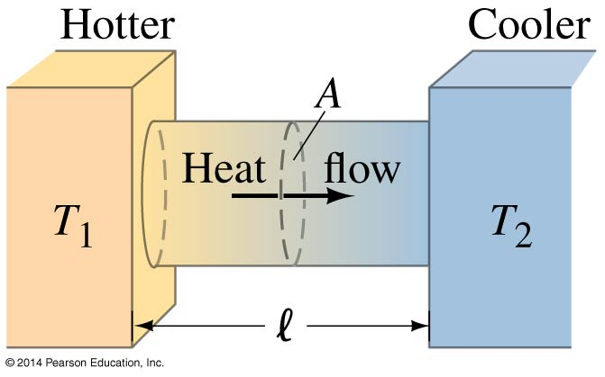
14-6 Heat Transfer: Conduction
Heat conduction can be visualized as occurring through molecular collisions.
The heat flow per unit time is given by:
(14-5)

Slide 21
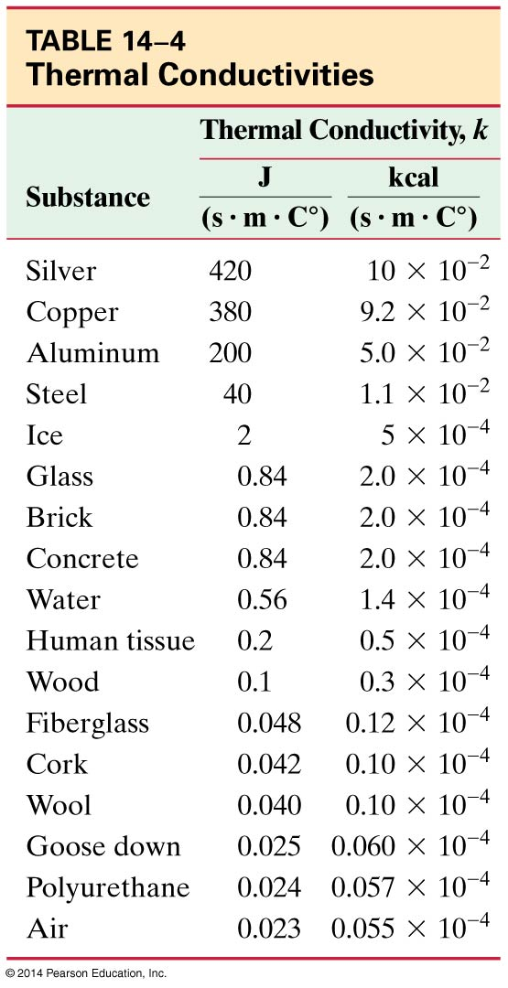
14-6 Heat Transfer: Conduction
The constant k is called the thermal conductivity.
Materials with large k are called conductors; those with small k are called insulators.

Slide 22
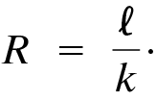
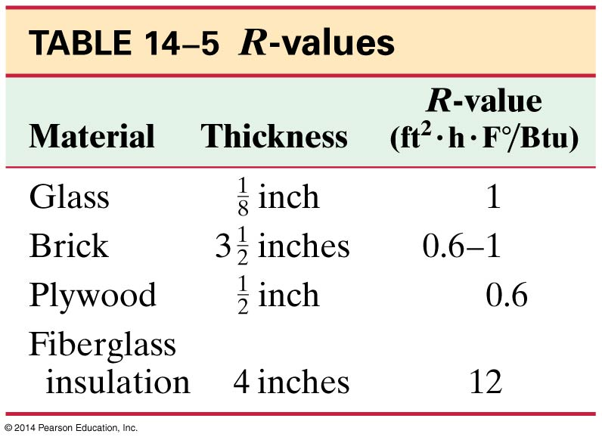
14-6 Heat Transfer: Conduction
Building materials are measured using R−values rather than thermal conductivity:
Here, l is the thickness of the material.

Slide 23
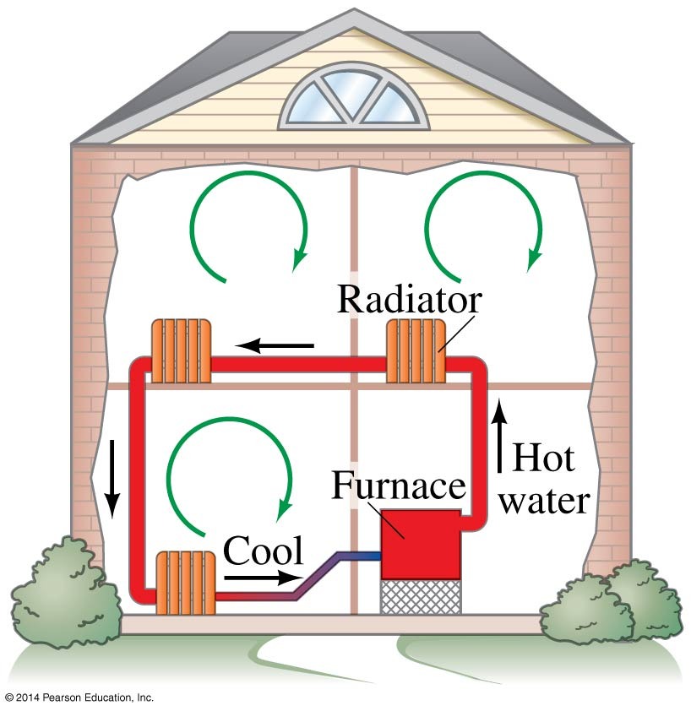
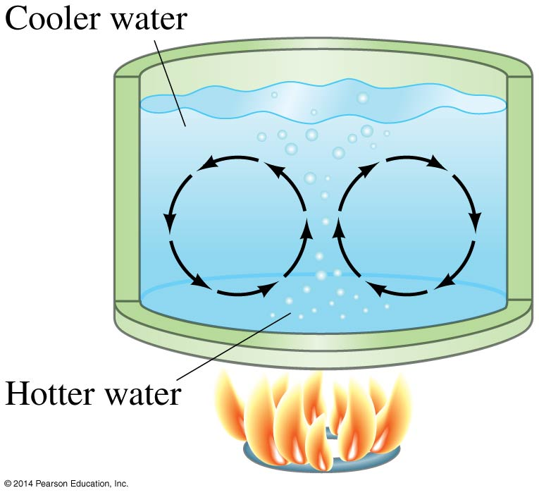
14-7 Heat Transfer: Convection
Convection occurs when heat flows by the mass movement of molecules from one place to another. It may be natural or forced; both these examples are natural convection.

Slide 24
14-7 Heat Transfer: Convection
Many home heating systems are forced hot-air systems; these have a fan that blows the air out of registers, rather than relying completely on natural convection.
Our body temperature is regulated by the blood; it runs close to the surface of the skin and transfers heat. Once it reaches the surface of the skin, the heat is released through convection, evaporation, and radiation.

Slide 25
14-8 Heat Transfer: Radiation
The most familiar example of radiation is our own Sun, which radiates at a temperature of almost 6000 K.

Slide 26
14-8 Heat Transfer: Radiation
The energy radiated has been found to be proportional to the fourth power of the temperature:
The constant σ is called the Stefan-Boltzmann constant:
σ = 5.67 × 10⁻⁸ W/m²∙K⁴
The emissivity e is a number between zero and one characterizing the surface; black objects have an emissivity near one, while shiny ones have an emissivity near zero.
(14-6)

Slide 27
14-8 Heat Transfer: Radiation
If you are sitting in a place that is too cold, your body radiates more heat than it can produce. You will start shivering and your metabolic rate will increase unless you put on warmer clothing.

Slide 28
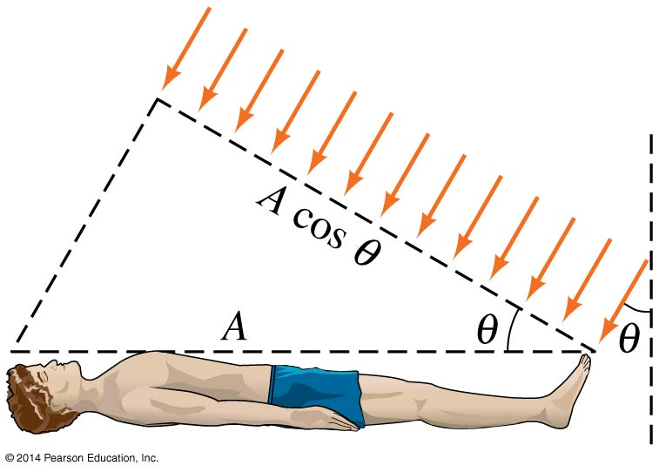
14-8 Heat Transfer: Radiation
If you are in the sunlight, the Sun’s radiation will warm you. In general, you will not be perfectly perpendicular to the Sun’s rays, and will absorb energy at the rate:
(14-8)

Slide 29
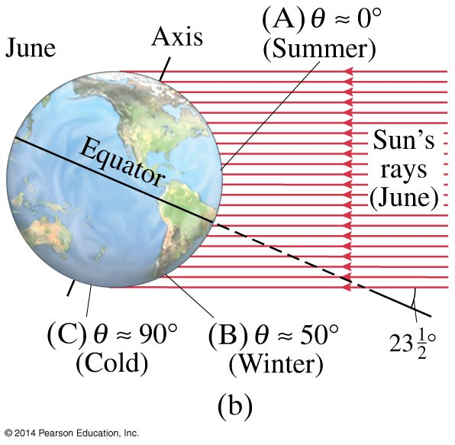
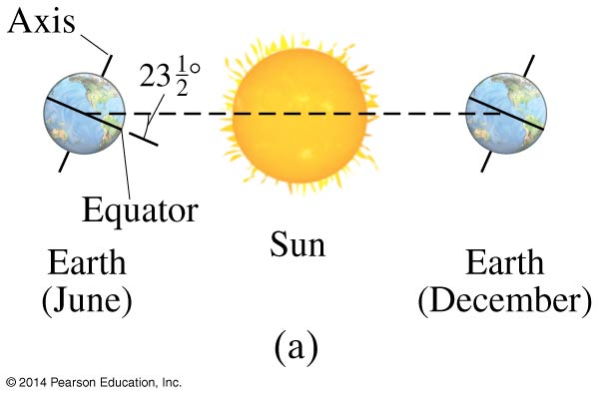
14-8 Heat Transfer: Radiation
This cos θ effect is also responsible for the seasons.

Slide 30
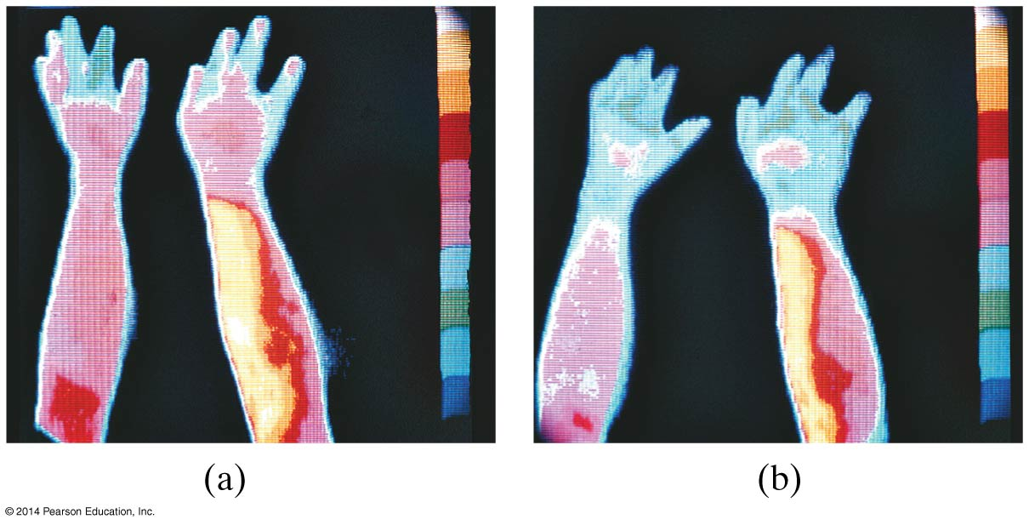
14-8 Heat Transfer: Radiation
Thermography—the detailed measurement of radiation from the body—can be used in medical imaging. Warmer areas may be a sign of tumors or infection; cooler areas on the skin may be a sign of poor circulation.

Slide 31
Summary of Chapter 14
Internal energy U refers to the total energy of all molecules in an object. For an ideal monatomic gas,
Heat is the transfer of energy from one object to another due to a temperature difference. Heat can be measured in joules or in calories.
Specific heat of a substance is the energy required to change the temperature of a fixed amount of matter by 1° C.
(14-1)

Slide 32
Summary of Chapter 14
In an isolated system, heat gained by one part of the system must be lost by another.
Calorimetry measures heat exchange quantitatively.
Phase changes require energy even though the temperature does not change.
Heat of fusion: amount of energy required to melt 1 kg of material.
Heat of vaporization: amount of energy required to change 1 kg of material from liquid to vapor.

Slide 33
Summary of Chapter 14
Heat transfer takes place by conduction, convection, and radiation.
In conduction, energy is transferred through the collisions of molecules in the substance.
In convection, bulk quantities of the substance flow to areas of different temperature.
Radiation is the transfer of energy by electromagnetic waves.

